Slide 1

What is the Core Humanitarian Standard?
The CHS sets out nine commitments to ensure that organisations support people and communities affected by crisis and vulnerability in ways that respect their rights and dignity and promote their primary role in finding solutions to the crises they face.
The CHS is a globally recognised, measurable standard.
It promotes equitable and collaborative relations between people and communities and those working to support them.
Organisations are encouraged to use the CHS in conjunction with the Sphere and HSP standards

Slide 2

The Core Humanitarian Standard (CHS)
Three custodian organisations: CHS Alliance, Groupe URD and Sphere
First issued in 2014, and revised in 2024
Broad consultations, with communities and people affected by crisis, NGOs and networks, governments, UN agencies, academics, and donors, for each edition.

Slide 3
Learning Objectives
By the end of this session, you will be able to:
Articulate the nine commitments of the Core Humanitarian Standard (CHS) and how they apply to your own work
Identify challenges to humanitarians in meeting the commitments of the CHS and propose ways to overcome them

Slide 4
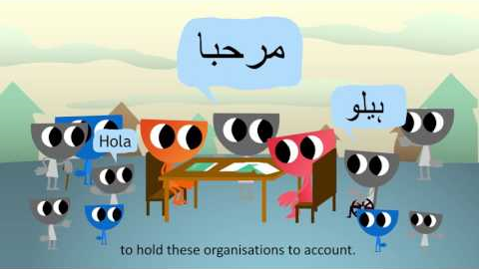
Introduction to the CHS: https://www.youtube.com/watch?v=dAkxy3o9vDY
Notes:
Show the embedded video then ask what, if anything, participants took away as the key points.
The video will start automatically at 1m01s. Stop the video at 4m26s.

Slide 5
The CHS as a standard
Puts Communities and people affected by crisis at the centre
Based on the humanitarian principles
Builds on the Sphere Humanitarian Charter
Nine Commitments
Each commitment is accompanied by
supporting requirements – what needs to be done to achieve the commitment.

Slide 6
Humanitarian Principles
Humanity, Impartiality, Independence, Neutrality
Humanity means that human suffering must be addressed wherever it is found, with particular attention to the most vulnerable.
Neutrality means that humanitarian aid must not favour any side in an armed conflict or other dispute.
Impartiality means that humanitarian aid must be provided solely on the basis of need, without discrimination.
Independence means the autonomy of humanitarian objectives from political, economic, military or other objectives.

Slide 7
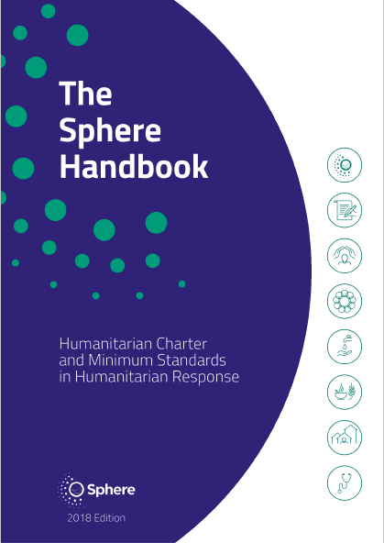
Sphere Humanitarian Charter
People’s right to:
Life with dignity
Receive support and assistance
Protection and security
Together with the Sphere Humanitarian Charter, the CHS is one of the Sphere handbook core chapters.

Slide 8
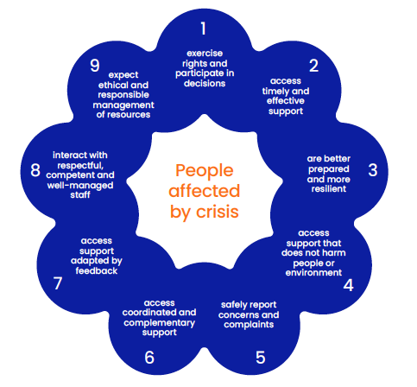
The 2024 CHS flower diagram

Slide 9

In the 2024 edition:
To simplify the CHS!
”commitments” only – no more ”quality criteria”
“requirements” only – no ”key actions” and “organisational responsibilities”
Each commitment includes at least one requirement that specifies the need for a “coherent organisational approach”
Commitments are, as much as possible, written in plain language (no need for a separate plain language CHS)

Slide 10
Changes in the commitments
2015
2024
1 –Appropriatednesss & Relevance
1 – Participation & inclusion
2 –Timeliness & Effectiveness
2 – Timeliness, effectiness & in accordance with specific needs
3 – Resilience & Do No Harm
3 – Preparedness, resilience & local leadership
4 – Information sharing, participation & Feed-back
4 – Do No Harm – people & the environment
Notes:
Some changes are not at commitment level but in the requirements, this slide does not intend to show all the details but pick a few elements that were given more focus

Slide 11
Changes in the commitments
2015
2024
5 – Complaints
5 – Concerns & complaints
6 – Coordination & complementarity
6 – Coordination & complementarity & partnership
7 – Continuous learning & Improvement
7 – Continuous improvement based on feedback
8 – Competent & well-managed staff & volunteers
8 – Respectful, competent & well-managed staff, & safety
9 – Effective, efficient & ethical management of resources
9 – Ethical & responsible management of resources
Notes:
Some changes are not at commitment level but in the requirements, this slide does not intend to show all the details but pick a few elements that were given more focus

Slide 12

Commitment 1|People and communities can exercise their rights and participate in actions and decisions that affect them.
Disability, Equity & Inclusion
Community engagement
Timely & accessible information
Meaningful participation
Ethical & respectful communication

Slide 13

Commitment 2|People and communities access timely and effective support in accordance with their specific needs and priorities.
Fair, impartial and transparent criteria
Monitor and adjust
Timeliness & accessibility
Use of standards
Referring unmet needs

Slide 14

Commitment 3|People and communities are better prepared and more resilient to potential crisis.
Community leadership
Resilience
Preparedness
Long term positive effect
Local ownership

Slide 15

Commitment 4|People and communities access support that does not cause harm to people or the environment.
Potential negative impact
Environmental impact
PSEAH
Data protection

Slide 16

Commitment 5 | People and communities can safely report concerns and complaints and get them addressed.
Identify and mitigate significant barriers to raising concerns and complaints
Understand and implement key principles for establishing and operating robust complaints systems
Explore Victim/survivor-centred approaches
Notes:
16

Slide 17

Commitment 6|People and communities access coordinated and complementary support.
Stakeholder analysis
National and local authorities
Partner support
Partnership quality and effectiveness

Slide 18

Commitment 7|People and communities access support that is continually adapted and improved based on feedback and learning.
Disaggregated data
From monitoring, feedback and complaints
For decision-making
With feedback to people and communities

Slide 19

Commitment 8|People and communities interact with staff and volunteers that are respectful, competent and well-managed.
Organisational culture
Safety and inclusivity
Skills, competencies and support
Code of conduct
Reporting mechanism

Slide 20

Commitment 9|People and communities can expect that resources are managed ethically and responsibly.
Resource allocation and monitoring
Environment
Fraud & corruption
Risk assessment & mitigation

Slide 21
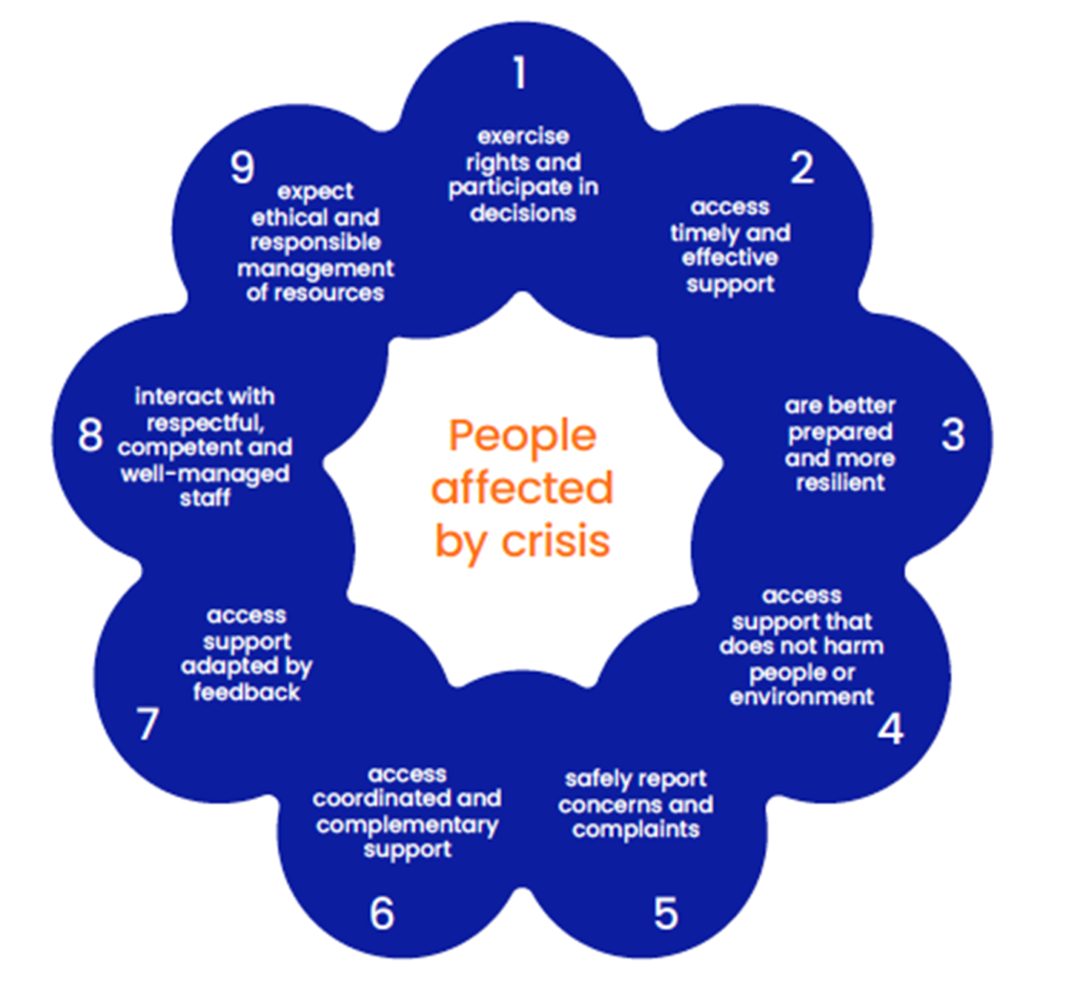
It’s all in the Core Humanitarian Standard!

Slide 22
Group Exercise
Form four small groups.
Access the CHS commitments here: https://handbook.hspstandards.org/en/chs/2024/#ch001
Pick two CHS commitments in which we should further improve as a humanitarian organization. Which requirements are the most difficult to realize? Why?
Use 10 minutes for group discussion and 10 minutes for reflection in the larger group.

Slide 23
Key messages
The CHS provides guidance for both individuals and humanitarian organisations to improve quality and accountability across all their work with people and communities affected by crisis.
Communities affected by crisis should be consulted, collaborated with, take part in the decisions that affect them, and provided with feedback mechanisms to enable humanitarian actors to better assist them in the fulfilment of their needs.
Humanitarians should hold themselves accountable to the communities and people affected by crisis, staff, donors, governments and other stakeholders.
At the centre of all the commitments are the communities and people affected by crisis.

Slide 24

Notes:
Thank everyone, end on time, and take a break.

