Slide 1


Lessons Learnt from Kahramanmaraş Earthquakes in Türkiye
HNPW, Geneva, 8 May 2024

Slide 2

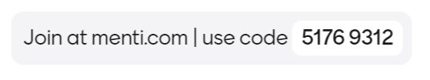

Slide 3

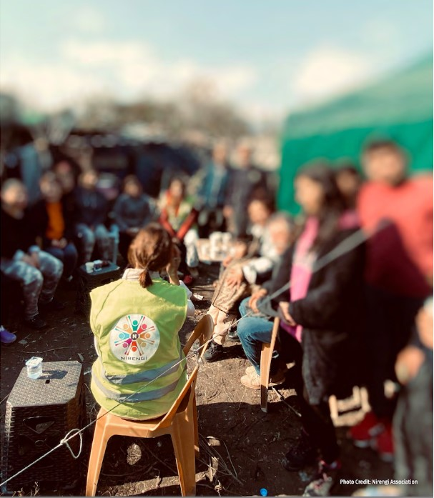



Slide 4
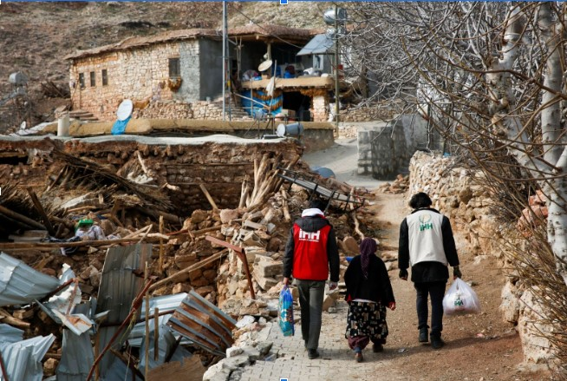

Slide 5
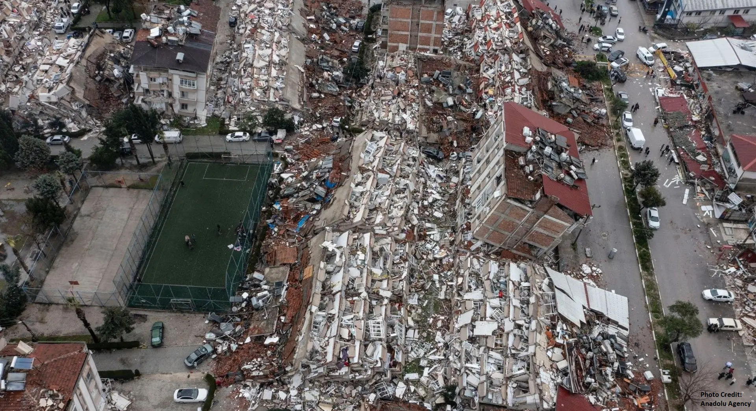

Slide 6

Lessons Learnt from Kahramanmaraş Earthquakes in Türkiye
Q &A
HNPW, Geneva, 8 May 2024

Slide 7
