Slide 1
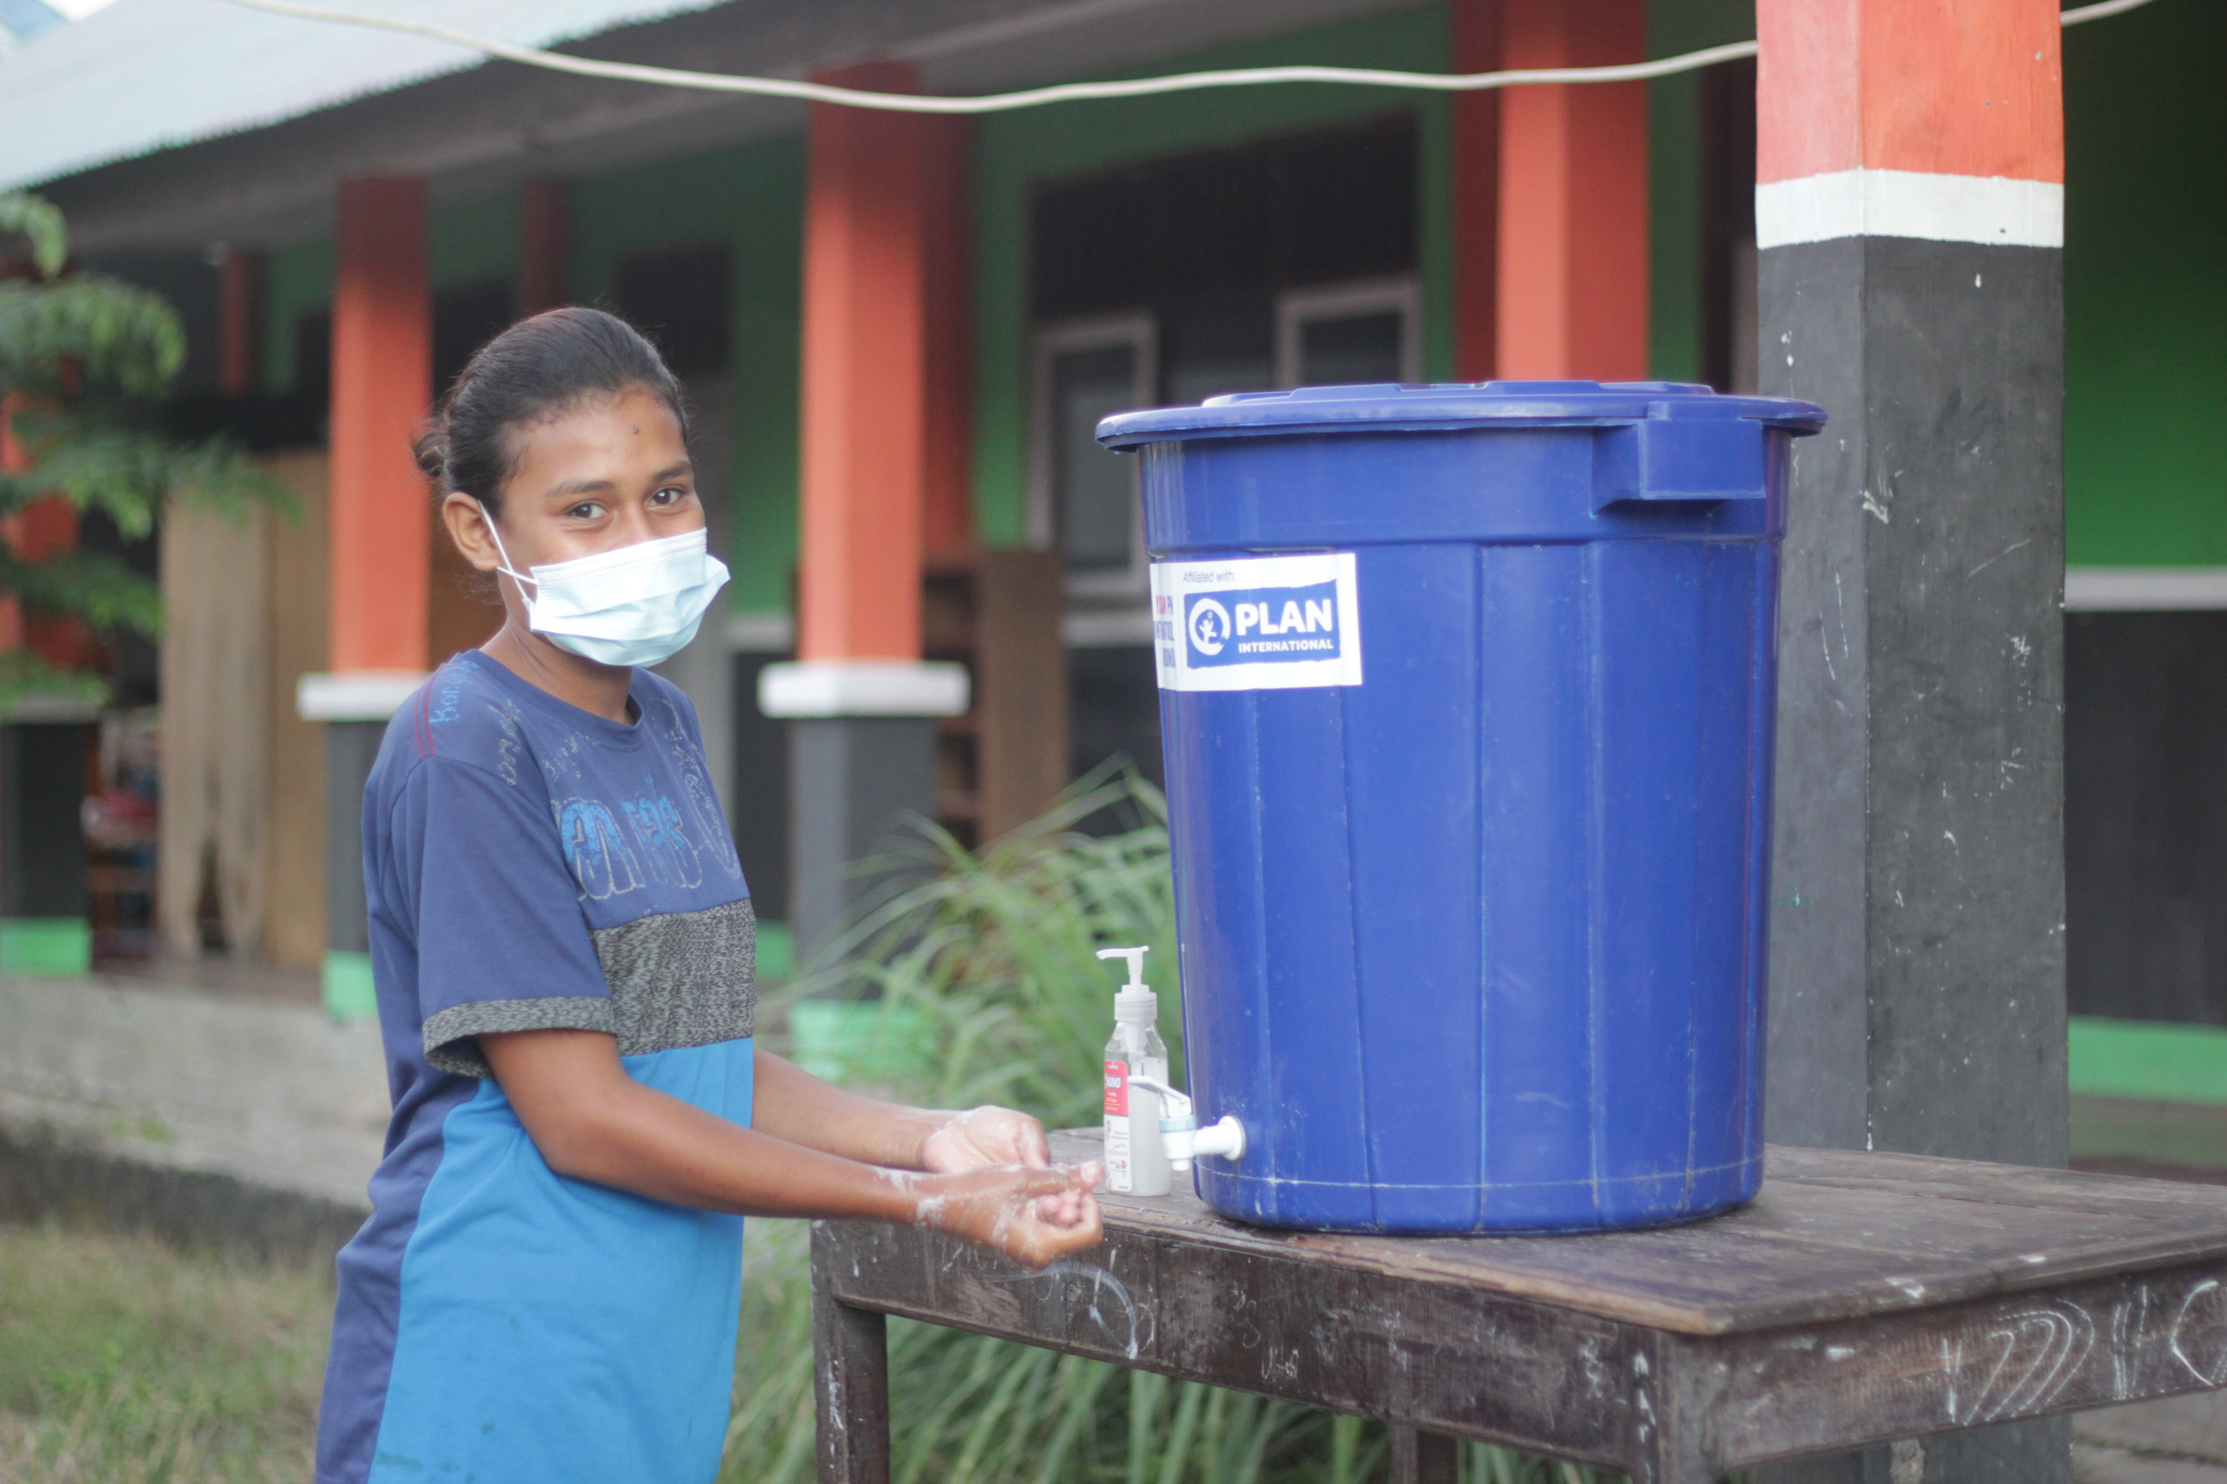

Community Engagement and Accountability (CEA)
in Hygiene Promotion Standards
Ida Ngurah, Yayasan Plan International Indonesia

Slide 2
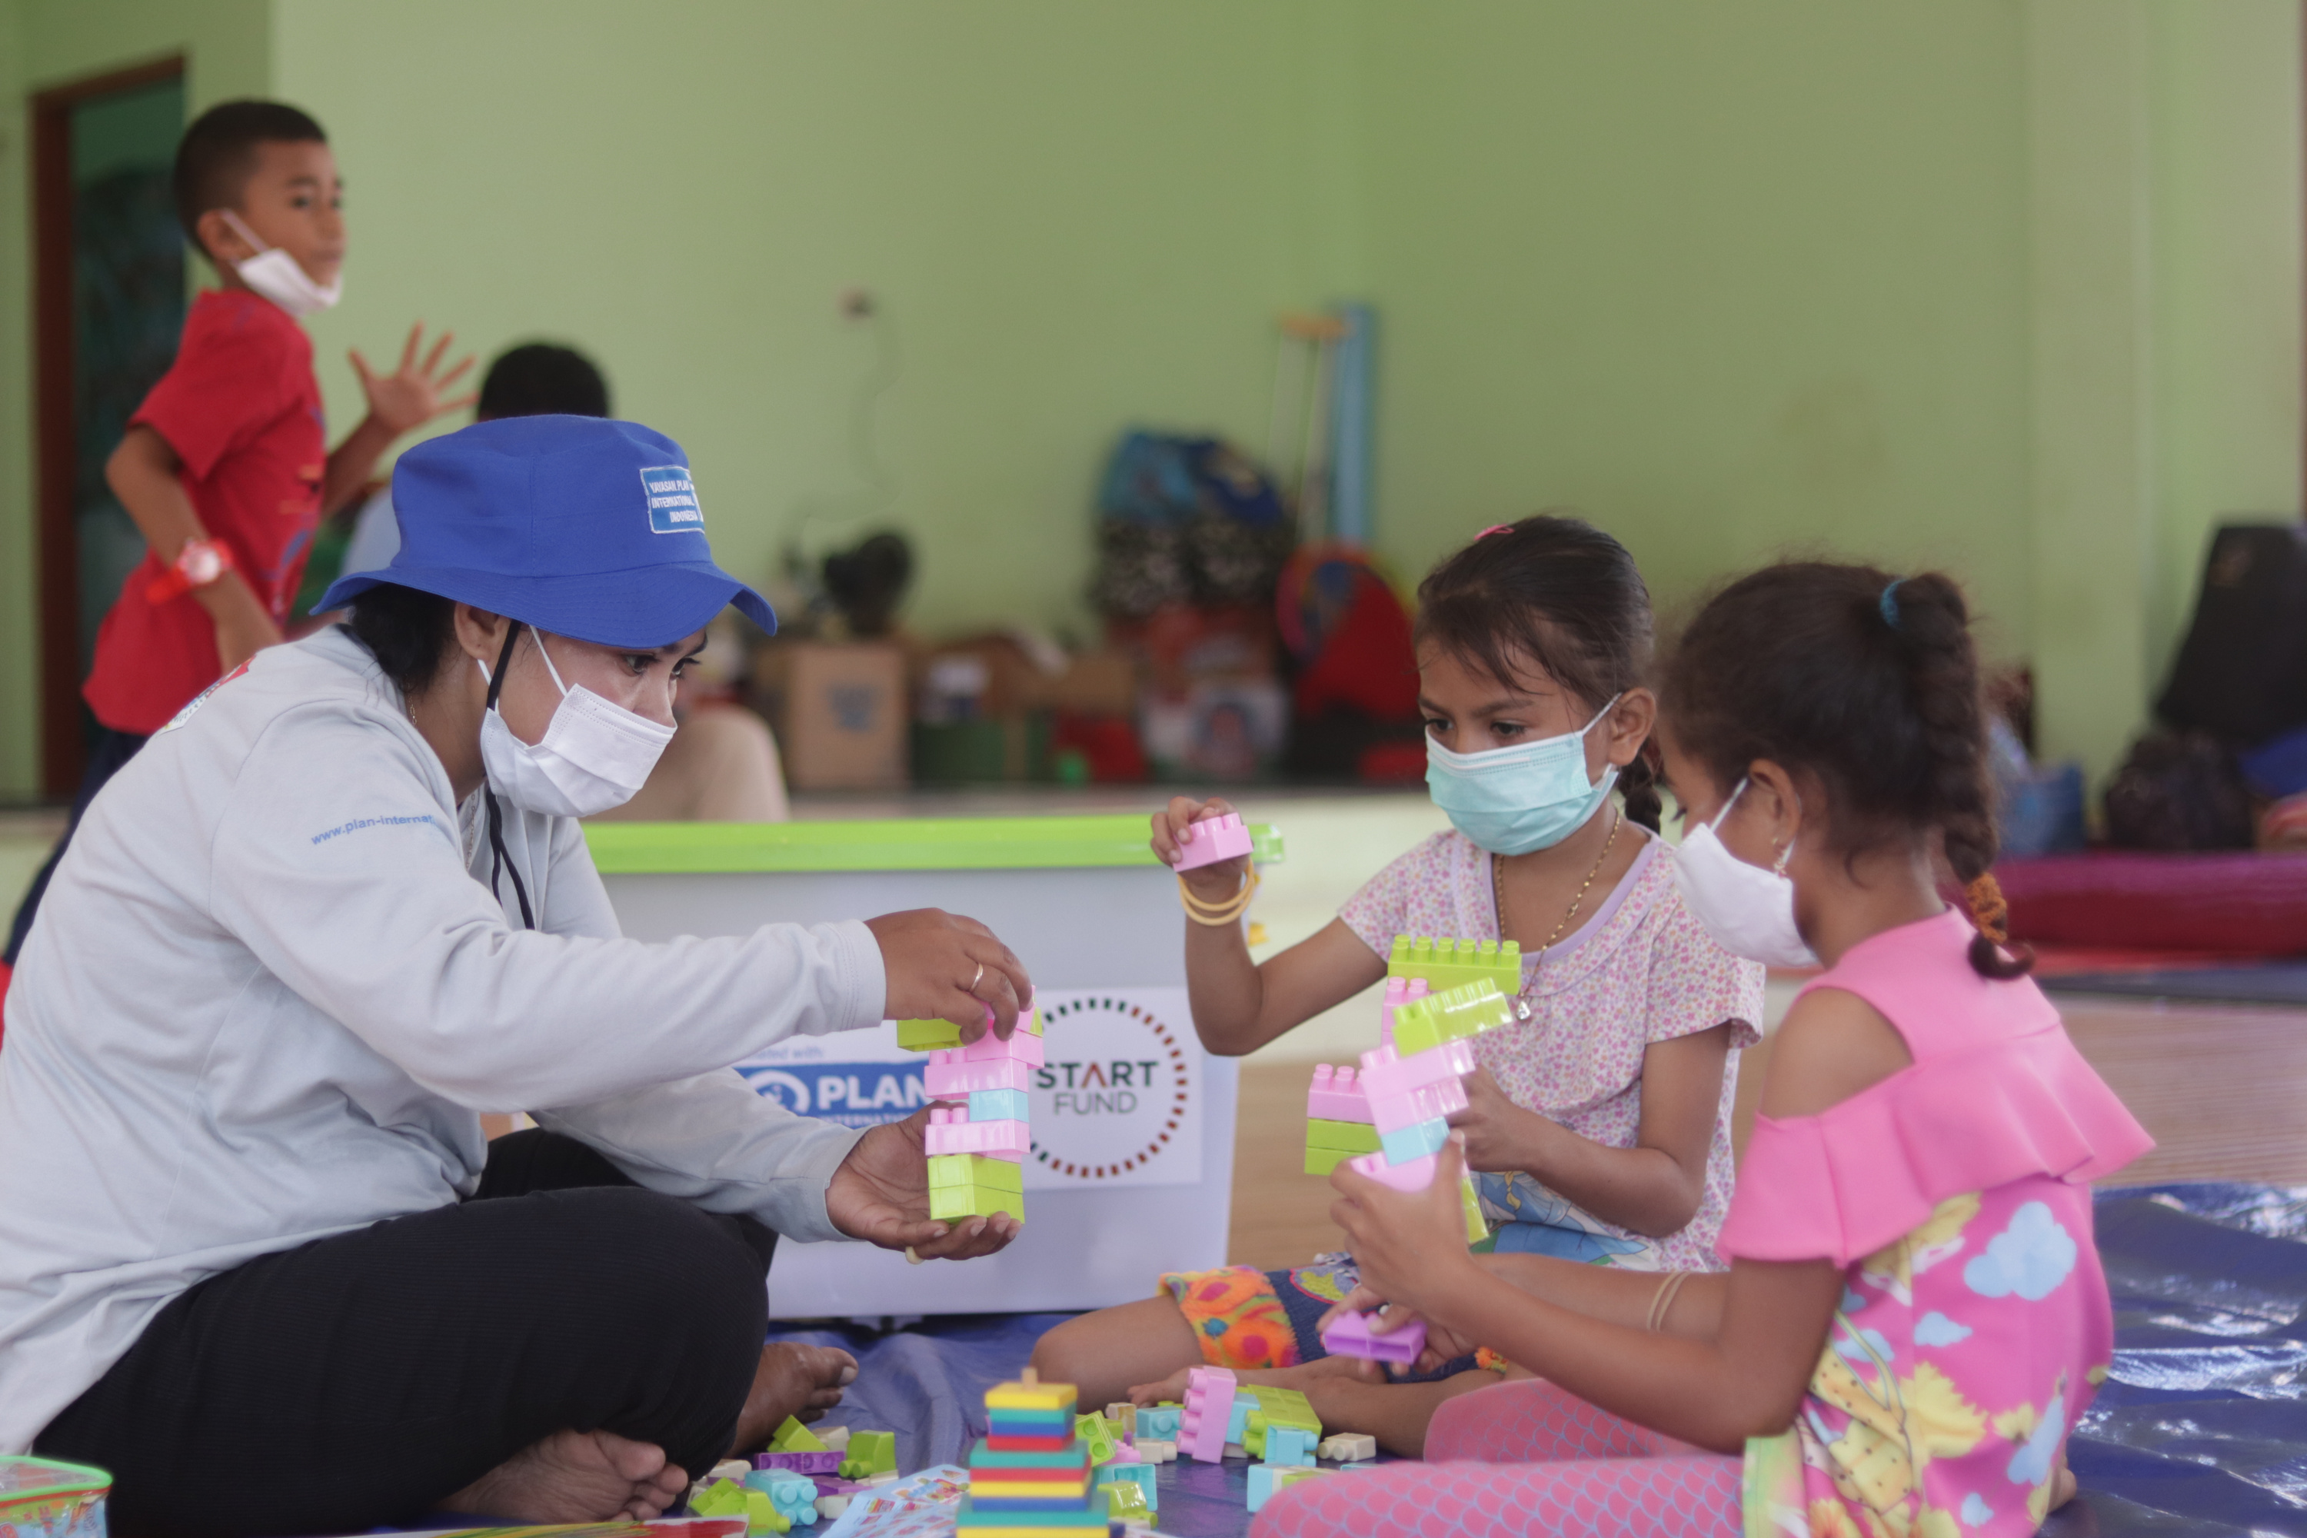


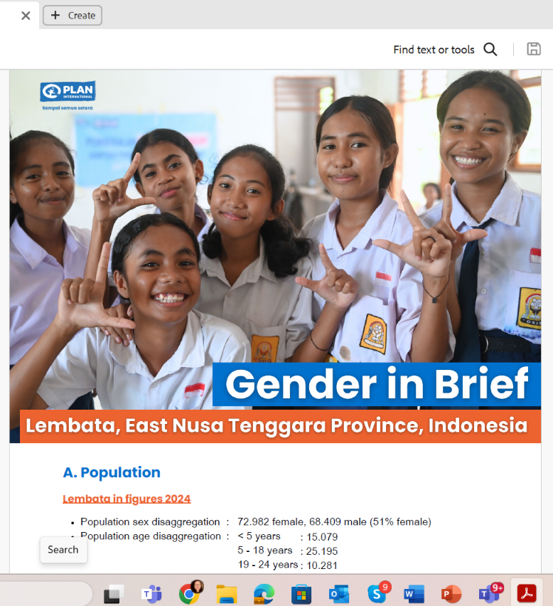
“Flash Flood Lembata Emergency Response in Indonesia:
GEMILANG (Girls and boys affected by Seroja enjoyed multisector intervention of humanitarian assistance in Lembata, NTT province), with response period: 6 months (2021)”
The Response
The Event
Heavy rain with strong wind occurred in Lembata for more than 12 hours in April 2021. Flash floods contain rocks from Ile Ape mountain flowing in the Ile Ape stream, which impacted 2 sub-districts: Ile Ape and Ile Ape Timur.
As of 8 April 2021 at 05pm, BNPB and Indonesia Red Cross reported 43 people died, 25 people missing, 37 people were severely injured, and 49 light-medium injured, with 1065 people are being evacuated in 9 centers across Lewoleba town. Meanwhile, 224 houses are severely damaged, and 90 houses are light-medium damaged.
The Intervention
WASH: Install hand washing stations, including distribution of hygiene kits and MHM kits to affected families and facilitate the promotion of hygiene practices and health protocol to prevent the transmission of COVID-19 will be integrated into this intervention

Slide 3
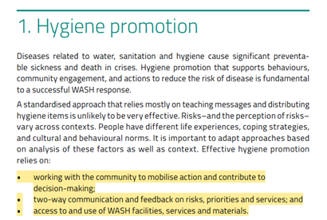
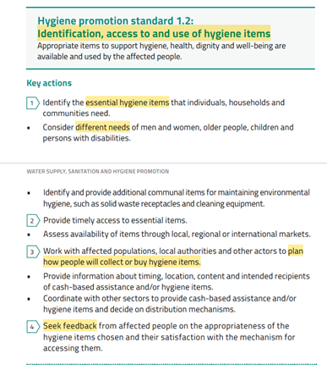
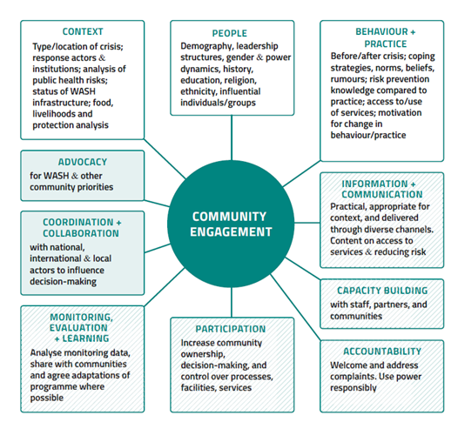
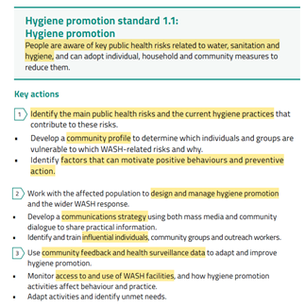

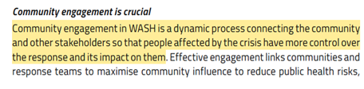
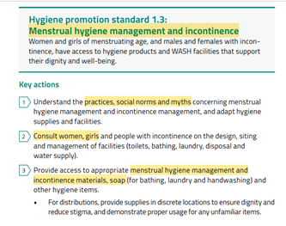
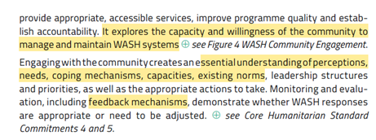

Slide 4
Review Matrix of CEA and Project Cycle Management in Hygiene Promotion Standards
Cycle CEA | Assessment and analysis | Program design and planning | Implementation | MEAL
Two-way information and communication | How do you identify the essential hygiene items that individuals (particularly girls and women), households, and communities need? What criteria do you use for those individuals? What context of people are you targeting (exploring the intersectionality and condition)? | Do you consult women, girls, and people with incontinence on the design, sitting and management of facilities (toilets, bathing, laundry, disposal and water supply)? If yes, how is the consultation carried out? What are the results? Do you use them for planning? | How do you work with the affected population to design and manage hygiene promotion and the wider WASH response? Do you develop a communications strategy using mass media and community dialogue to share practical information? Provide example. Do you develop multiple formats (written, graphic, audio) and using local language to promote hygiene practices? What are the key messages? | Do you identify and train influential individuals, community groups, and outreach workers? If yes, who are those influential individuals? How do they influence others? What topics training do you provide? If not, why? Do you work with children and young people to communicate hygiene practices with their peers or family? If yes, what are the results and challenges? If not, why?
Community engagement | Do you assess the practices, social norms and myths concerning menstrual hygiene management and incontinence management, and adapt hygiene supplies and facilities? Do you involve any particular groups in this assessment? Who are they? How do you involve them? What are the results and challenges? | How do you work with affected populations, local authorities, and other actors to plan how will people collect or buy hygiene items (such as providing information about the timing, location, content, and intended recipients of cash-based assistance and/or hygiene items? | How do you coordinate with other sectors to provide cash-based assistance and/or hygiene items and decide on distribution mechanisms? How do you provide access to (distribute) appropriate menstrual hygiene management and incontinence materials, soap (for bathing, laundry, and handwashing), and other hygiene items? Do you provide equal opportunity for paid voluntary works to both women and men, including young people? If yes, what are their roles? If not, why? | How do you monitor access to and use of WASH facilities, and how do hygiene promotion activities affect behaviour and practice? Who is involved in that monitoring? What are the results and challenges?
Feedback mechanism | How do you identify factors that can motivate positive behaviours and preventive action? | How the feedback mechanisms are being designed? | How do you seek feedback from affected people on the appropriateness of the hygiene items chosen and their satisfaction with the mechanism for accessing them? | How do you monitor the feedback?

Slide 5
Review Result of CEA and Project Cycle Management in Hygiene Promotion Standards
Cycle CEA | Assessment and analysis | Program design and planning | Implementation | MEAL
Two-way information and communication | Essential hygiene needs were identified through rapid need assessment (interview and observation) with children and adults, such as MHM kits, underwear. Targeting representation of different intersectionality of affected people (children, young people, pregnant/lactating women, disabled, and elderly). | Consultation by FGD with different groups, to seek information on specific needs on hygiene kits and sanitation facilities to be accommodated in program and coordination. The program planning is communicated back to community leaders | Plan Indonesia worked with paid community volunteers and health cadres to formulate key messages on hygiene practices. Four communication channels are used: loudspeakers in mosques/churches, video, posters, and community meetings, using five different local languages. Key messages: washing hands before meals, using masks for COVID-19 prevention. | Local youth groups and community leaders (religious, tribe) are trained on assessment, delivering key messages, and feedback mechanisms, to gather and provide information to affected people. Practical learning is used to communicate hygiene practices, such as hand washing with children in the camps.
Community engagement | The assessment involved different traditional groups to identify social norms & myths on hygiene practices, such as menstruation taboo | The design for distributing the hygiene kit (during COVID-19) was developed with authority leaders and the COVID-19 task force. The local WASH cluster and CVA working group were engaged in planning how to reach the most needed and avoid overlapping (for distribution and cash-based modality) | Distribution hygiene (and MHM) kits were supported by a local youth group (karang taruna/tagana) and COVID-19 task force directly to the participants, while cash-based assistance was involved the local suppliers where the participants could access the hygiene items they needed and preferred. | Health cadres/sanitarians used their sanitation assessment tool (health surveillance data) to help monitor the use and condition of sanitation facilities and hygiene practices of people in evacuation camps. The result was then discussed in the local WASH cluster, which was used to re-plan and improve the response.
Feedback mechanism | The factors that motivate affected people on positive behaviors and preventive action drive from appreciation on their needs and dignity in providing the response. | The inclusive feedback channels (including child-friendly) are prepared as part of program planning) – It requires resources to gather, process, and respond to feedback. It is being promoted to participation for use and familarization. | Feedback is obtained through different tools, such as written (on paper or digital forms), verbal (on phone or discussion), and drawing to express one's feelings (for children). Post-distribution monitoring (PDM) results also provided information on the satisfaction of the hygiene items. | Plan Indonesia uses a feedback dashboard to monitor feedback (receive, process, response, closing)

Slide 6
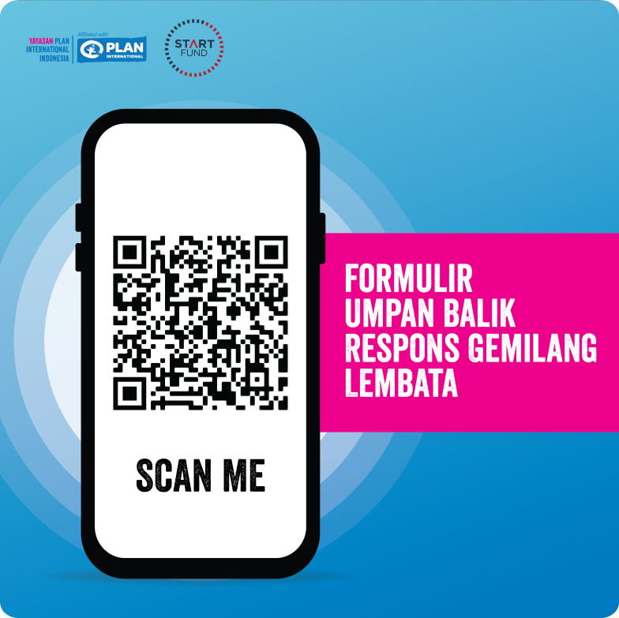
Key Learnings
The Sphere provides clear guidance to the humanitarian actors to develop an appropriate and relevant response (from design, planning, implementation, MEAL)
Respectful and dignified WASH response for the affected people can be obtained by listening to the different groups of people, engaging local leaders and groups, and responding to the feedback

Slide 7
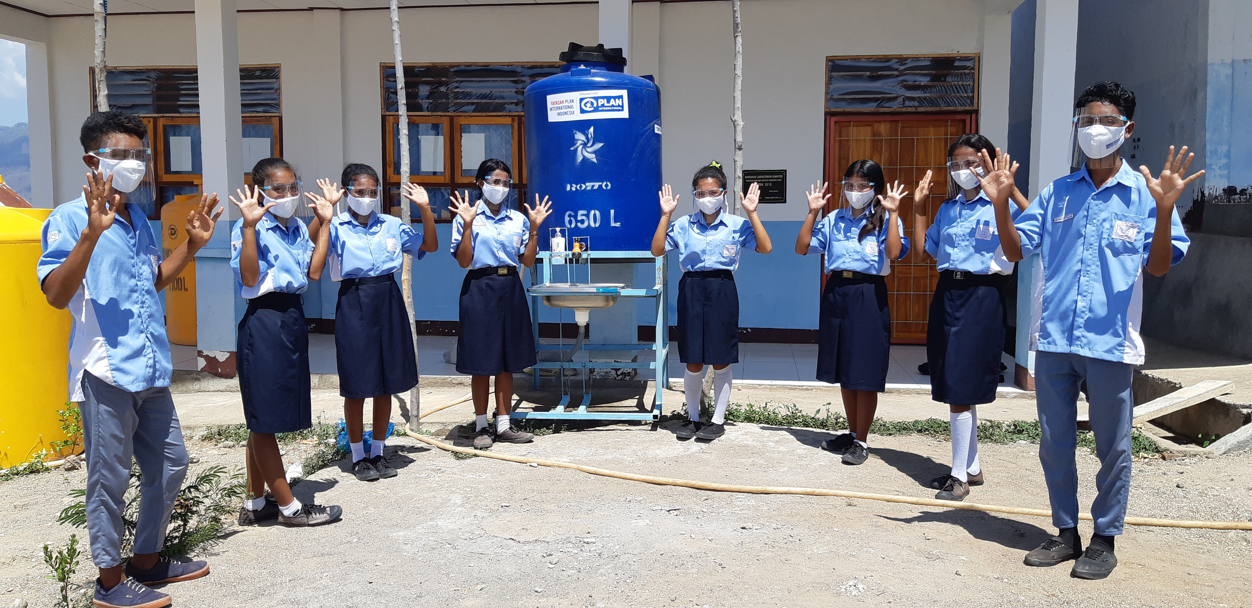








Thank You
@planindonesia
Plan Indonesia Official Channel
www.plan-international.or.id

