Slide 1

Sphere Programme for
Ukraine and Eastern Europe
Key Achievements,
HNPW Geneva, May 2024
Felicity Fallon, Head of Learning and Events
felicity.fallon@spherestandards.org

Slide 2
February 24, 2022

Slide 3
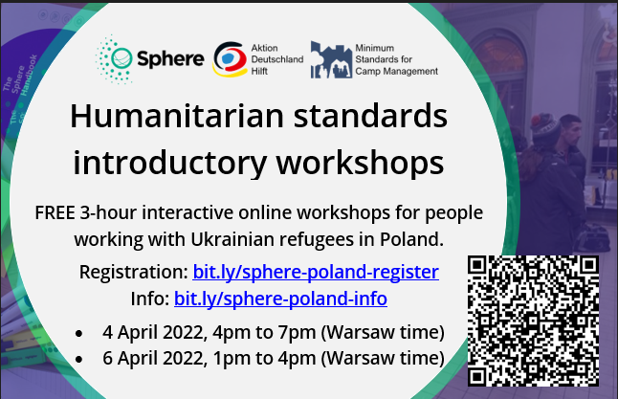
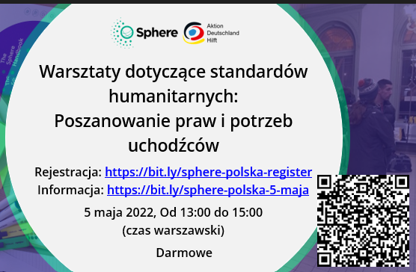
April 2022: Baby steps...

Slide 4
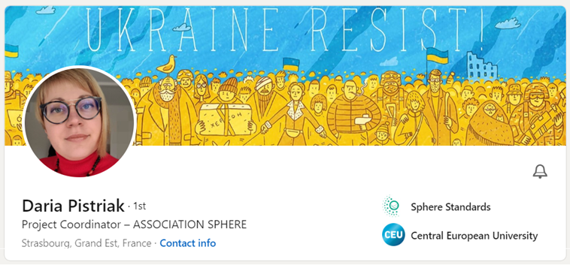
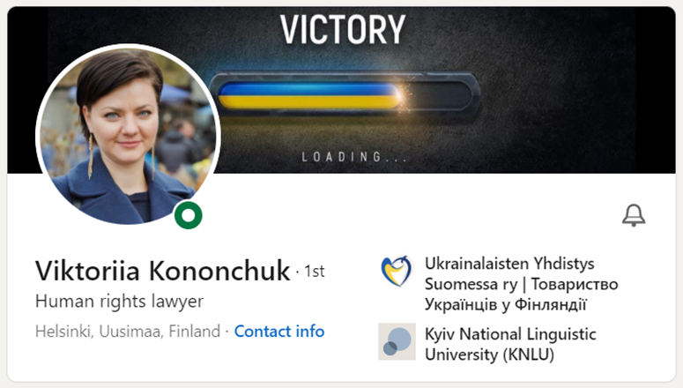
Ukrainian Coordinators x 2

Slide 5
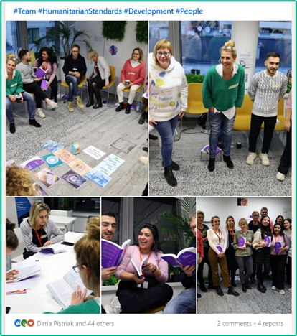

Sphere workshops x 18

Slide 6
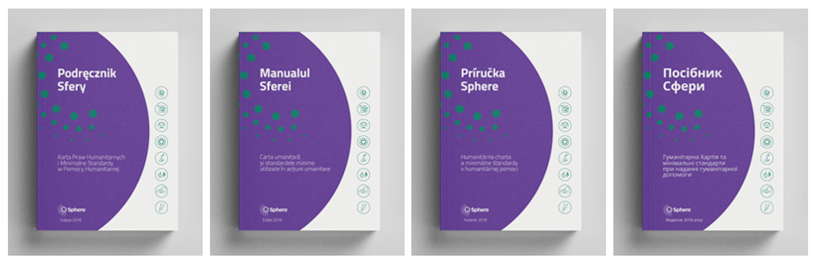
Sphere handbook translations x 4
“Why did nobody give us Sphere handbooks a year ago when we needed them?”
Polish Shelter organiser on Ukraine border, Sphere workshop March 2023
“

Slide 7
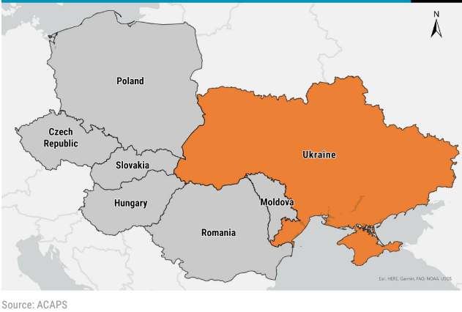







Sphere Focal Points x 5 new countries

Slide 8

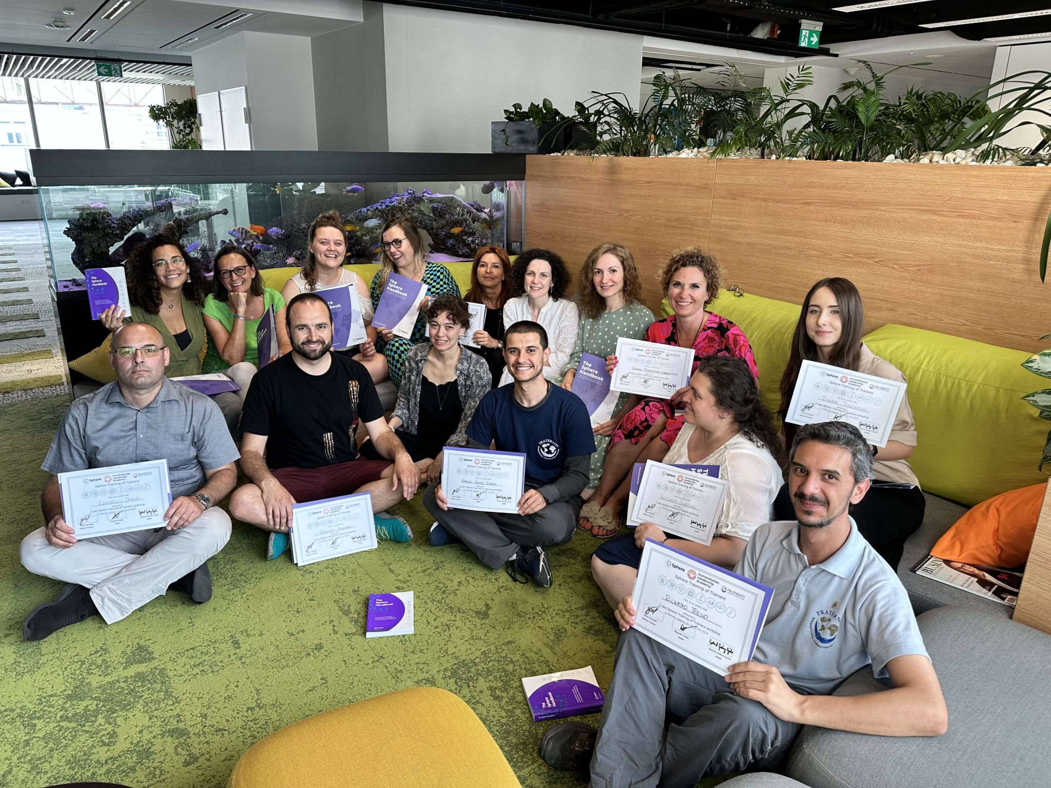
Sphere ToT, Warsaw, June 2023

Slide 9
Ukraine project
315,000 euros awarded by DEC (UK Disasters Emergency Committee)
July 2022 – June 2023 (11 months)
Recruited displaced Ukrainians to coordinate
Handbook translations: Ukrainian, Polish, Slovak, Romanian
In-person workshops: Poland, Slovak Republic, Romania, Moldova
1h e-learning with RedR UK and online facilitated workshops: Ukraine
Focal points: Appointed in Moldova, Poland, Slovak Republic, Ukraine and Romania
Training of Trainers (ToT) held in Warsaw in June 2023

Slide 10
Lessons Learnt (for Magic Whiteboard)
Better record keeping required of previous trainings, especially ToTs
Local coordinators essential
Need to keep adapting our training content – more real-life examples, more room for discussion, new generation of humanitarians requiring facilitation as much as training
More support to new focal points
More support to new trainers
Ran out of money and time for MEAL!

