Slide 1
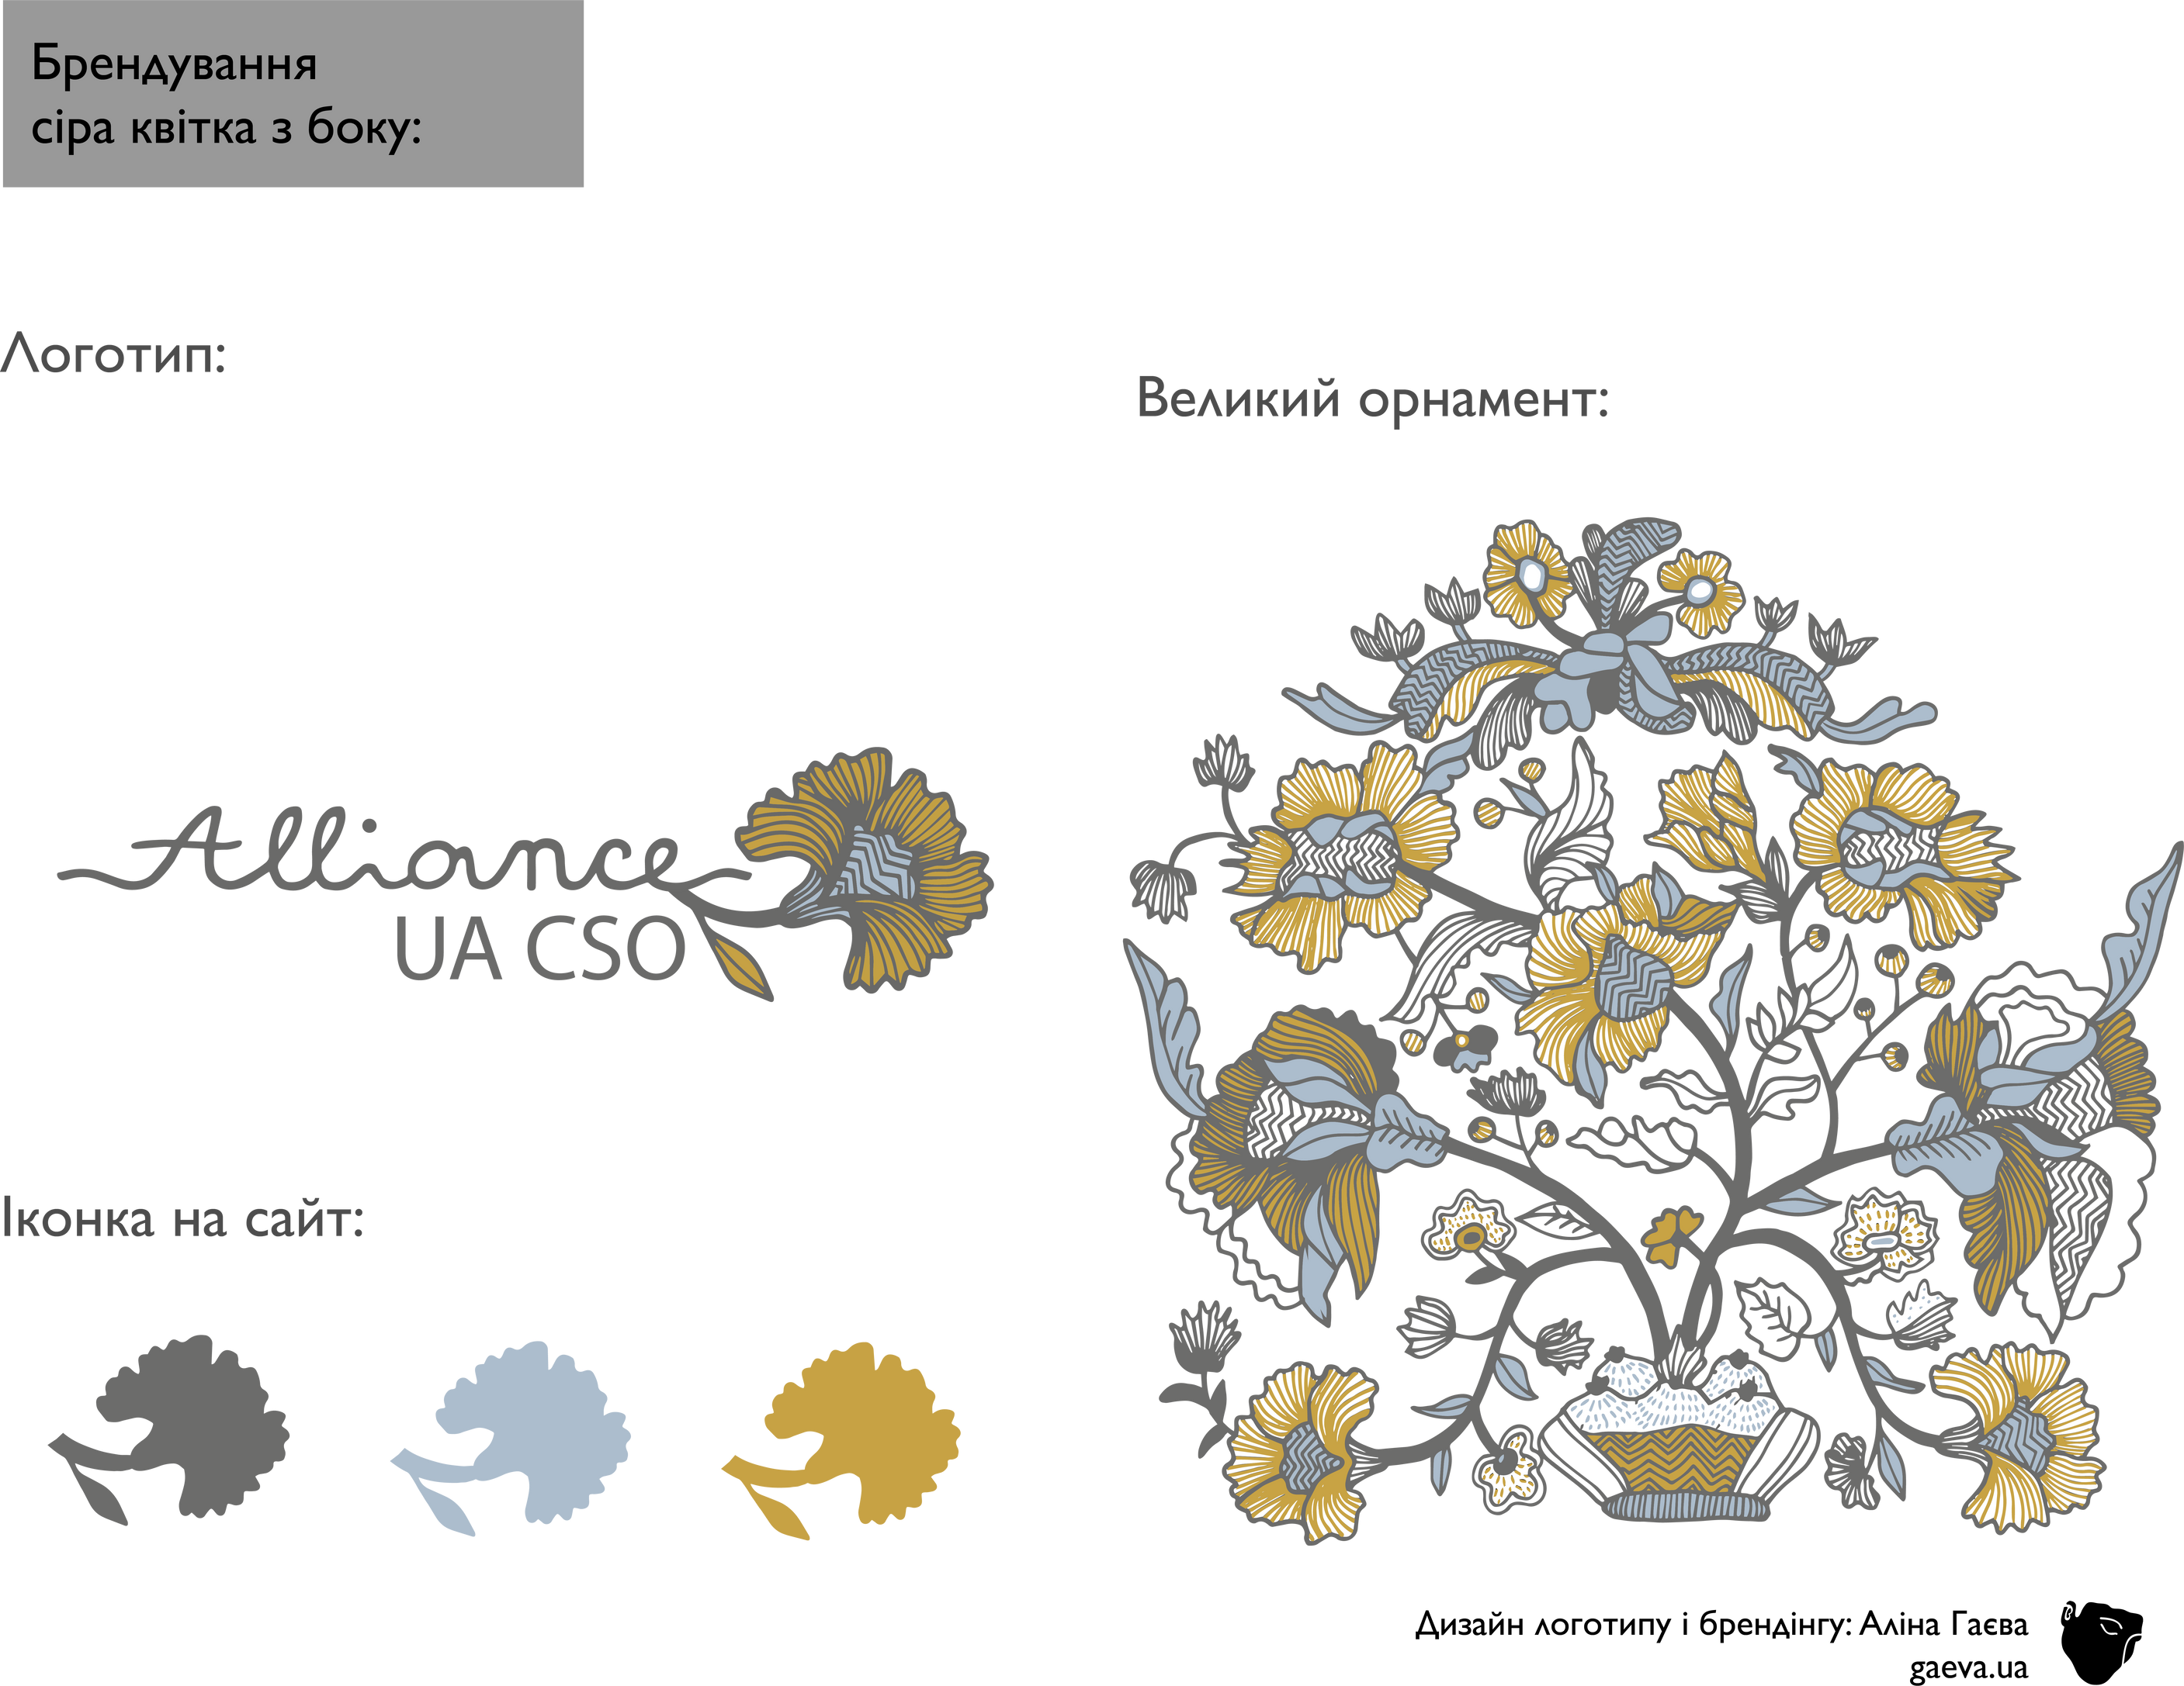
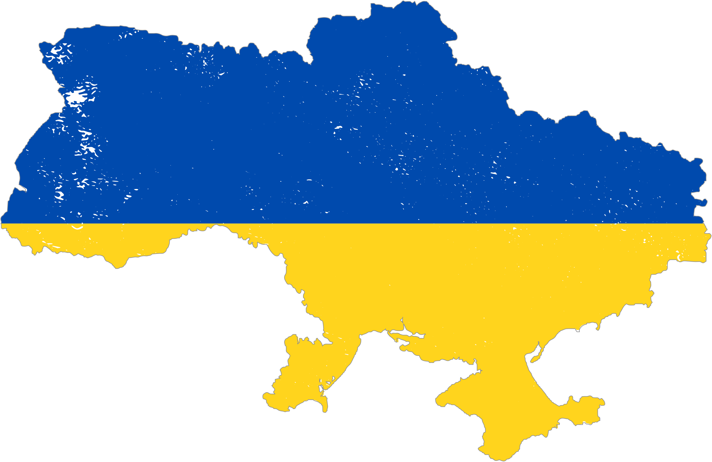
Plus 6,367 new charitable organizations
And plus 2,760 new public organizations in 2022.
In the first months of the full-scale war, the civil society sector of Ukraine and a spontaneous powerful volunteer movement did everything possible and impossible to prevent a humanitarian crisis.
around 130,000 CSOs
are registered in Ukraine
WHO WE ARE

Slide 2
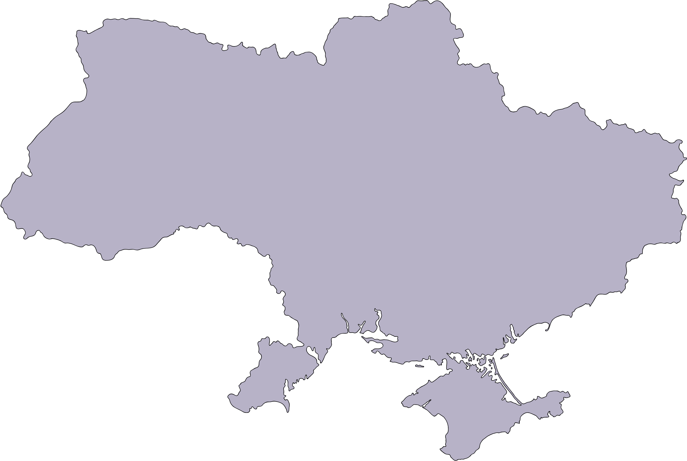

In the new realities of the war, we have a triangle of actors who are working to respond to the humanitarian crisis and will also be working on early recovery and renewal/reconstruction
Ukrainian Government (national and local)
we build bridges
to unite all actors
and learn
how to cooperate
for joint effective
action
International Community
(INGO, UN system, Institutional donors)
Ukrainian
civil society
Private sector

Slide 3
16 Ukrainian CSOs representing various areas of work of Ukrainian civil society - from humanitarian to capacity building and development.
Alliance UA CSO is an initiative group, think tank, focused on ensuring local leadership in responding to humanitarian crises and setting the foundation for recovery processes in Ukraine.
WE ARE WORKING ON
community that networks and creates opportunities for Ukrainian CSOs to
  be visible
  be supported
  be developed
  be effective
  be transparent and understandable
  be participants in a large humanitarian and recovery framework

Slide 4
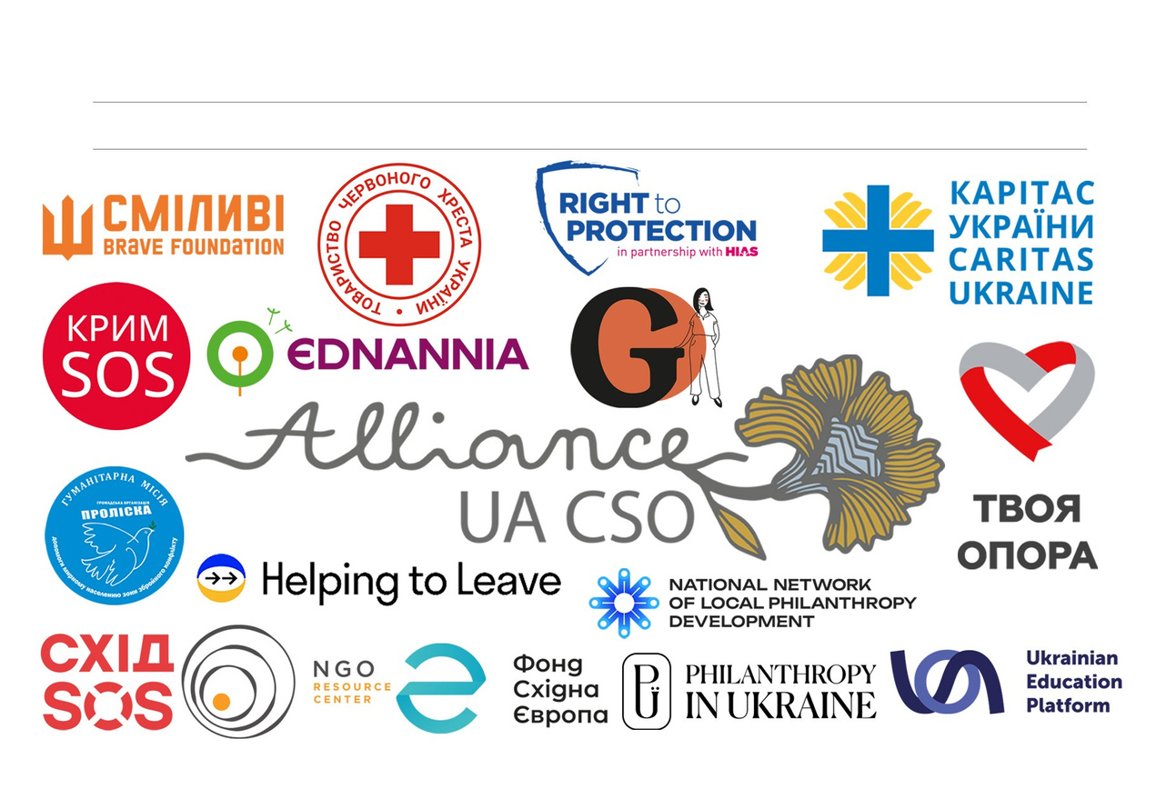

Slide 5
STRATEGY FOR ENSURING LOCAL LEADERSHIP IN RESPONDING TO HUMANITARIAN CRISES AND SETTING THE FOUNDATION FOR RECOVERY PROCESSES IN UKRAINE:
Based on the Ukrainian voice
  on localization studies, statements, communiques from conferences, which were created by Ukrainian organizations and made public starting from 2022.
Inclusive and collaborative
  Before the start of the strategy development discussions were organized to gain a deep understanding of the context.
  Strategy draft proofreading and consultations were organized to ensure the diverse voices of all stakeholders are included.
The goal of this Strategy that locally led response should take into account Ukrainian experience, international knowledge and mandates, developing harmony in efforts to meet needs.

Slide 6
STRATEGIC TASKS OF THE STRATEGY:
  Develop a common and practical vision of the locally led response that corresponds to the Ukrainian context and the potential of civil society and private sector and contributes to strengthening the capacities of the state and local self-government bodies in the field of humanitarian response;
  Development of strategic and long-term platforms and partnerships with all stakeholders, to support the strategy, including coordination, research and monitoring, planning for next phases of response;
  Strengthen the flow of information and capacity building for civil society organizations, local communities and other initiatives to properly participate in locally led response processes;
  Achieve appropriate localisation goals regarding access to funding streams and support for activities and institutional development of local actors (increase in direct funding for local and national actors within a time frame of 2-5 years).

Slide 7
WHAT DO WE WANT?
1. Advocacy and a stronger voice of civil society in cooperation with international actors.
2. Access of Ukrainian organizations to funding streams, including initiative for:
  Verification/Passporting
  Capacity strengthening
  Pooled funding for smaller local organizations with simplified application requirements
  IT solutions where organizations and donors can find one another
  Informing Ukrainian NGOs about the mechanisms of involvement in international funding.
3. Positioning of Ukrainian civil society in Ukraine – building partnership with the Government: to influence Ukrainian legislation, as well as contributing towards the decentralization process.
4. Cross cutting issue: bridge between national and local actors, enabling the voice of local organizations to be heard.

Slide 8




TEACH FOR UKRAINE
2022-2024: Key Achievements,
HNPW Geneva, 06 May 2024
Liudmyla Batsiun, Head of Finance
finance@teachforukraine.org

Slide 9
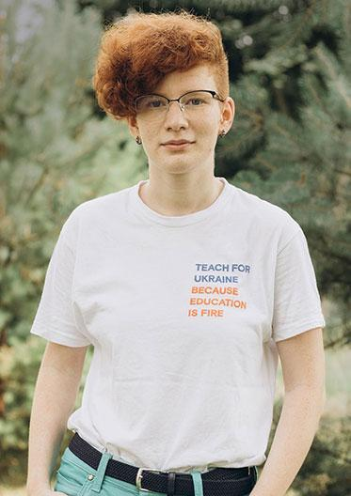
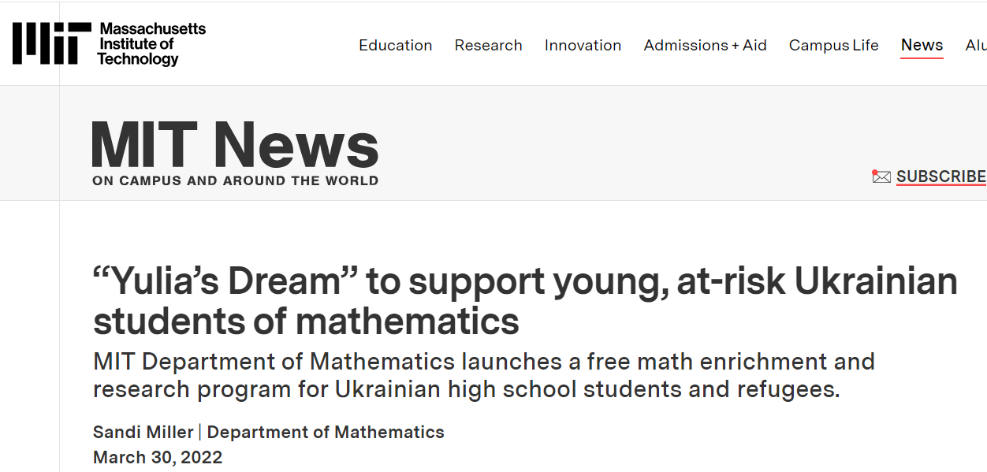
I
Some achievements are sad
Yulia Zdanovska, Kharkiv, 03 Mar 2022

Slide 10
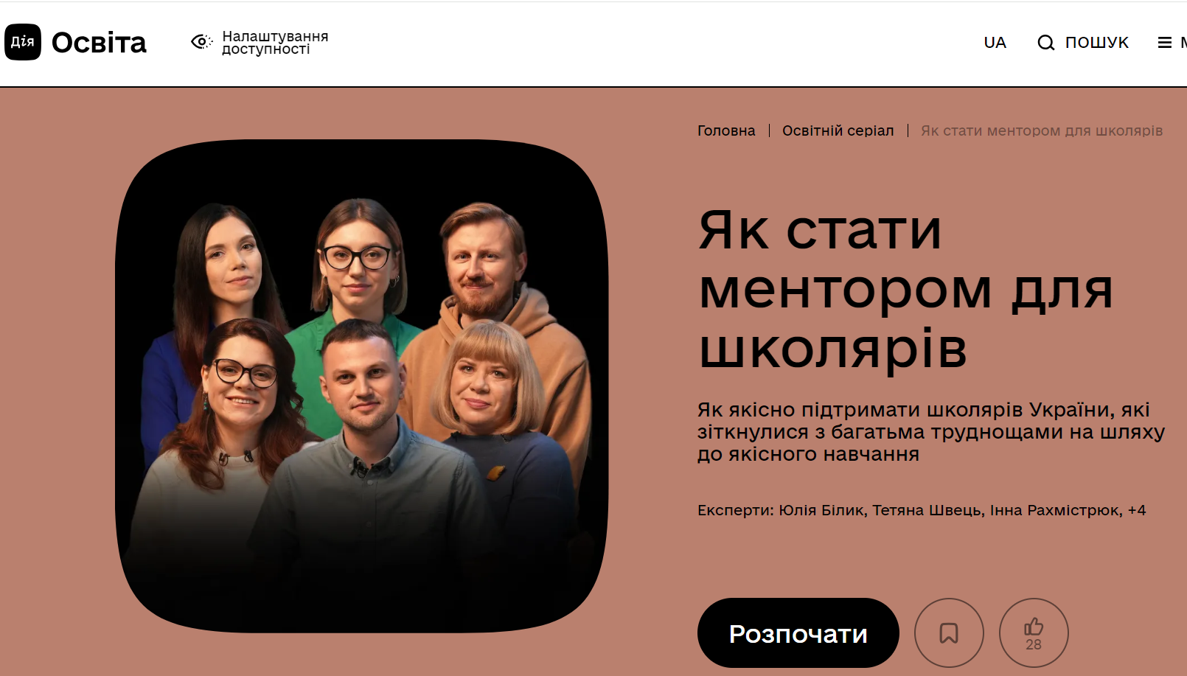
I
Projects in addition to the TFU fellowship
Catch-up
Community of > 600 teachers
Involved >10 000 children
MHPSS
online course > 23 000 teachers
offline visits > 750 teachers
Students as mentors - started
online course on Diia.Osvita
>60 StudMentors

Slide 11
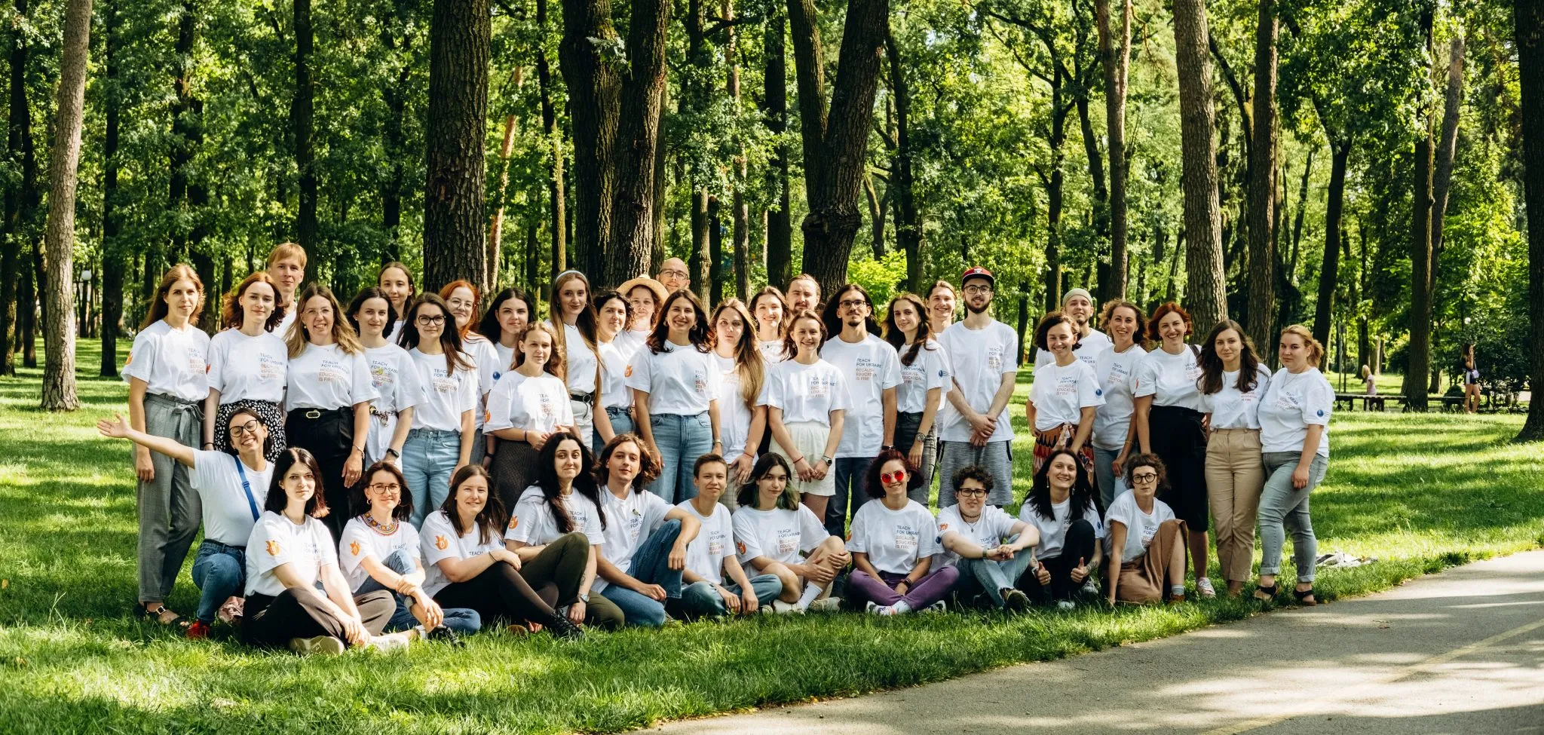
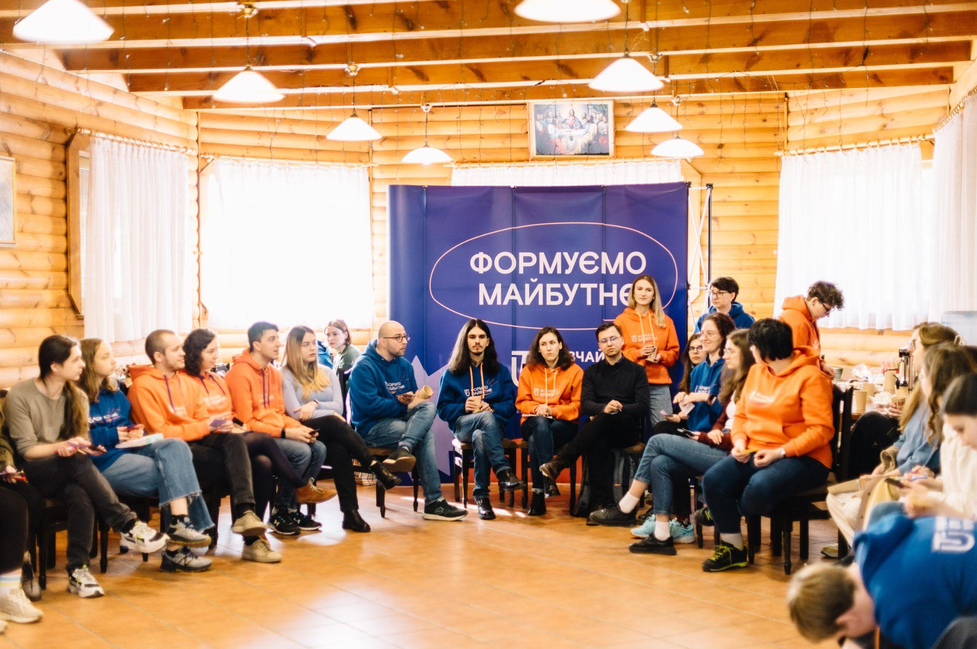
I
Program restart:
new cohort in 2023
Fellows 1st year - 24
Fellows 3rd year - 6
School partners - 19
4 regions:
Kyiv, Lviv, Odesa, Ivano-Frankivsk

Slide 12
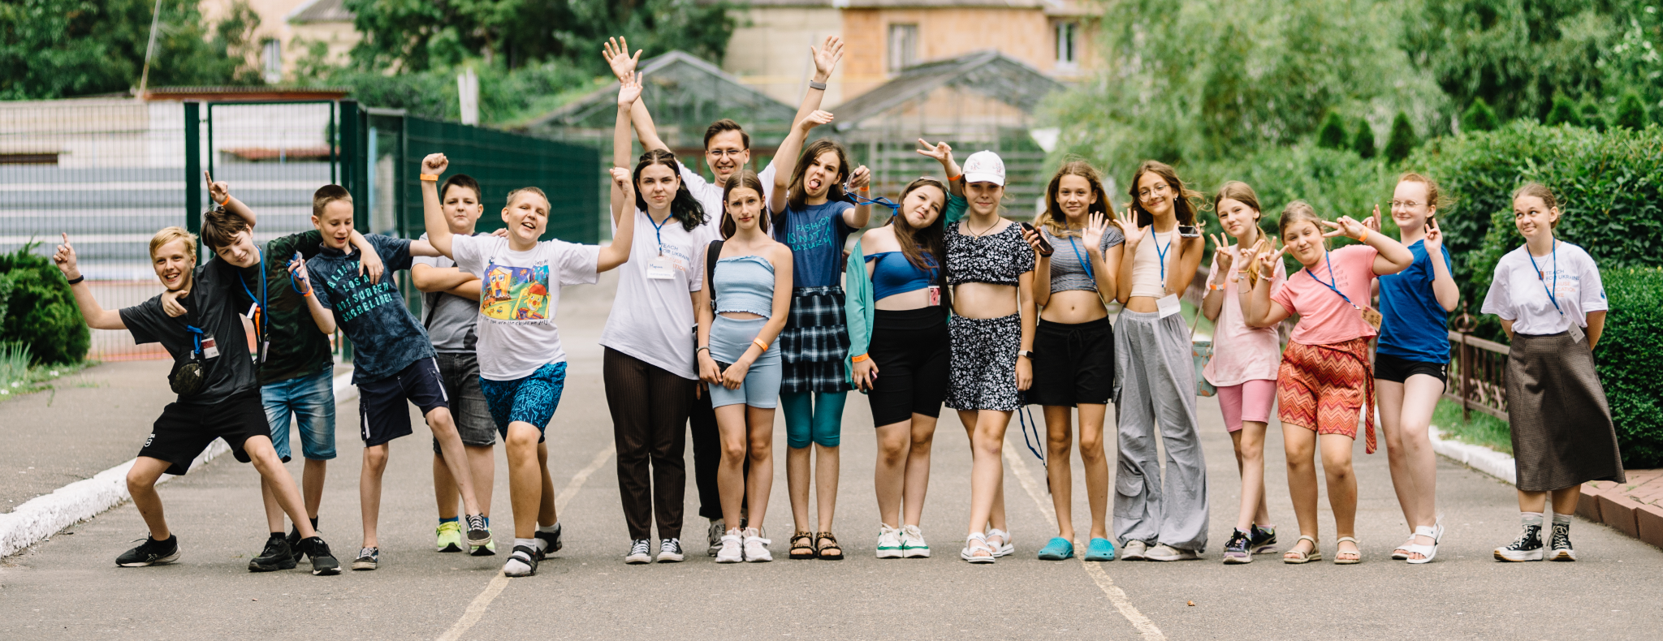
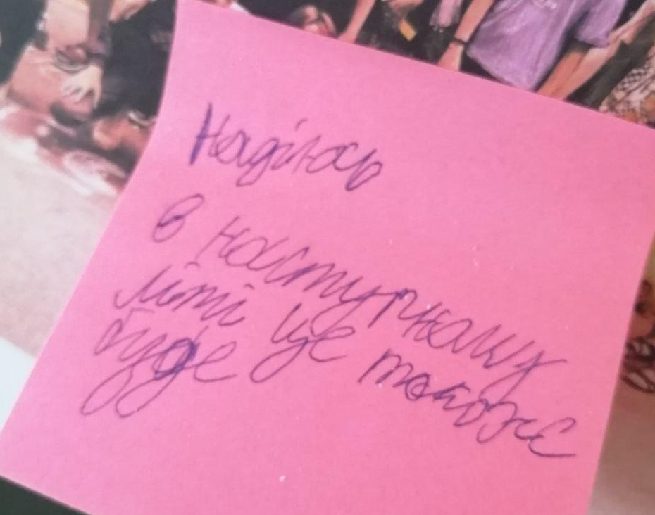

Summer Academy & Training Institute
2022 and 2023
each for over 600 children and over 40 teachers.

Slide 13
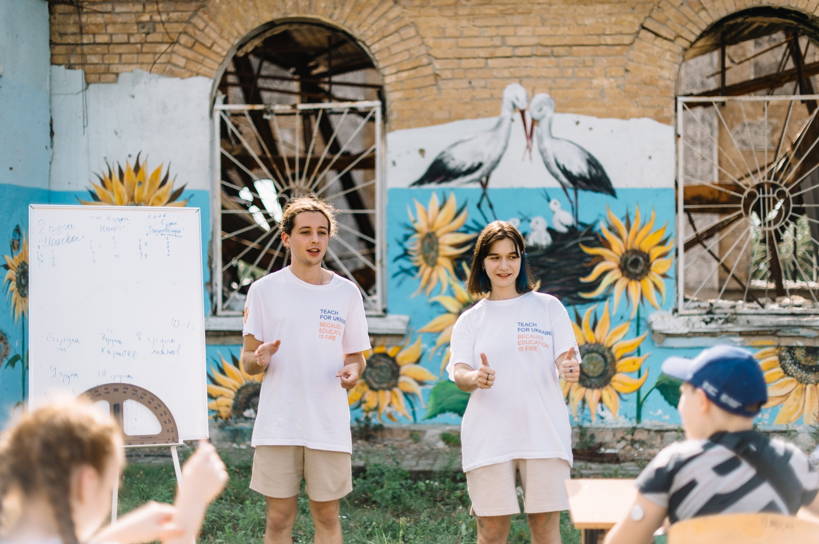
I
Project learning implementation
Project learning for fellows and partner schools administration
- 10 projects of fellows
- 2 projects of alumni
Project sessions, involving school students, school administration and local community
to be continued :)

Slide 14
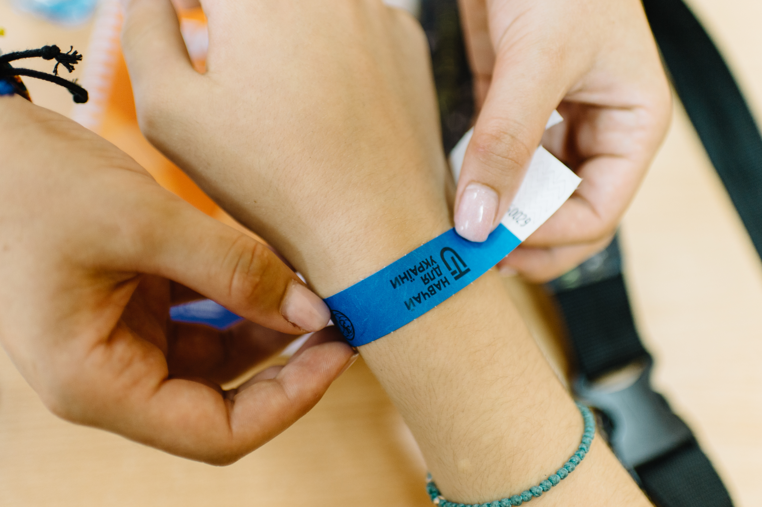
I
Partnership: new level
Ministry of Education
Ministry of Digital transformation
Regional Education Departments
North Educational Subcluster
Donors and NGOs
Secondary schools, Universities
Businesses

Slide 15
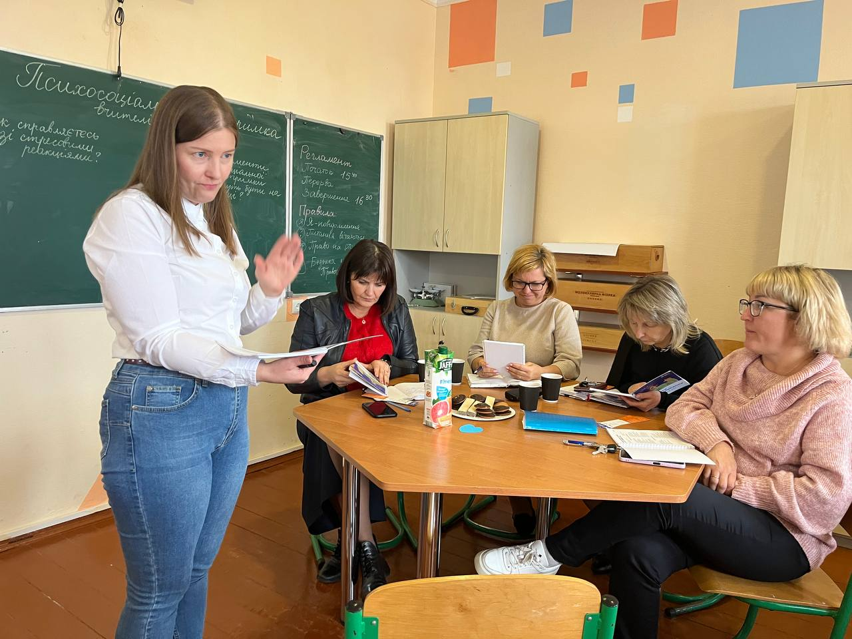
I
Growth: x5 and x2
Digitalization & software - cooperation
Processes and procedures re-set
Donor as equal partner
Agreement modalities
Taxes as expenses
Organization capacity strengthening included into contract

Slide 16

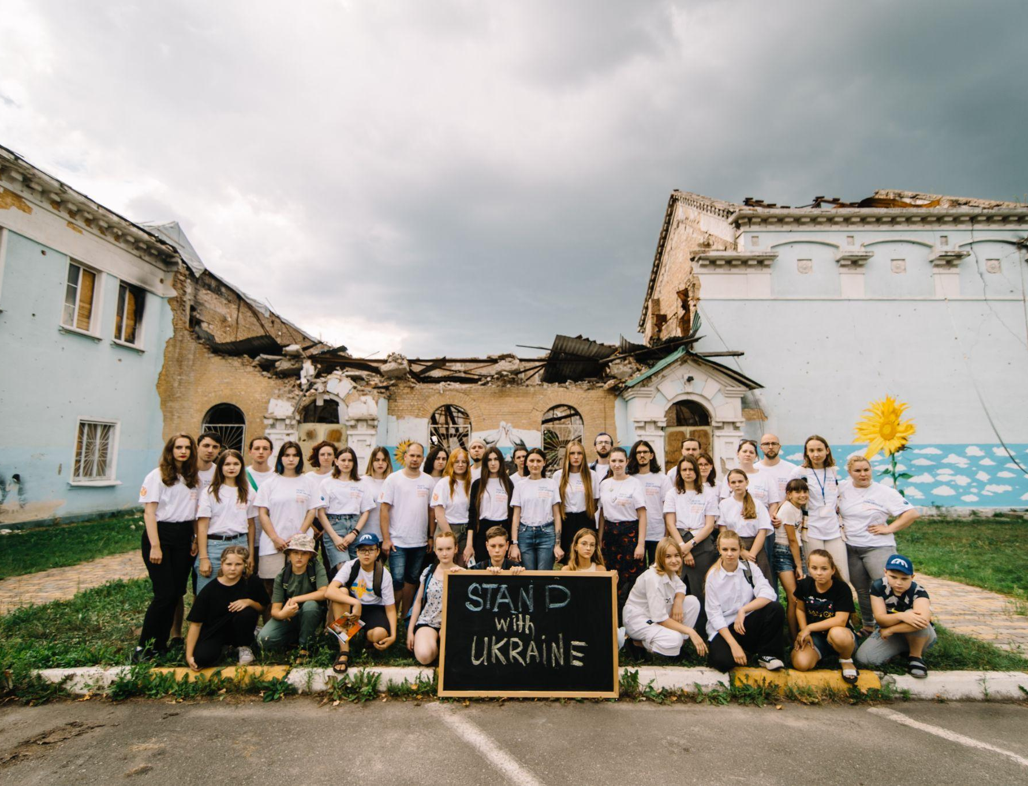


Thank you for your attention

Slide 17
I
Achievements
TFU - 1 program and 2 donors prior 24 Feb 2022, Yulia killed by shelling, Vlad in MFU
Catch up sessions started in April 2022 volunteer initiative of the alumni and fellows. Now Community of > 600 teachers and >10 000 children involved
MHPSS online course developed and launched, recommended by MOE > 23 000 teachers offline visits > 750 teachers
Students as mentors - online course on Diia.Osvita, >60 StudMentors so far
New cohort recruited in 2023
Summer of 2022 and 2023: SA for children and TI for teachers, both years offline, >600 children and >40 teachers
For better focus on local needs launched the project learning course for fellows (teachers) and school administrations
fellows selected from >570 applications
for 2 donors TFU become strategic partners
x5 in 2023 vs 2022, and x2 in 2024 vs 2023
developing the software capacity if it’s not enough for us, especially due to the lack of accounting ERP - mutual benefit
manual proceedings are less effective for 100 records, and don’t work for 300 records. Time and quality. Papers <10%.
negotiating with donors - no service agreement modality, VAT as a part of goods and services covered, taxes for priv.individuals payments are incorporated as project related costs
Org capacity costs - relatively unrestricted cash

Slide 18
I
Lessons learnt
Double cost for processes - backup for people and processes is necessary
Service agreements leads to the VAT for the NGO (20% tax on turnover)
Taxes are treated as ineligible expenses mostly
Payments to the private individuals are taxable
Budget and projects are less predictable (160% of load for 90% of team)
Costs allocation - reality vs budget
Support costs are limited (4%-20%)

Slide 19

WWW.TVOYA-OPORA.ORG

Slide 20


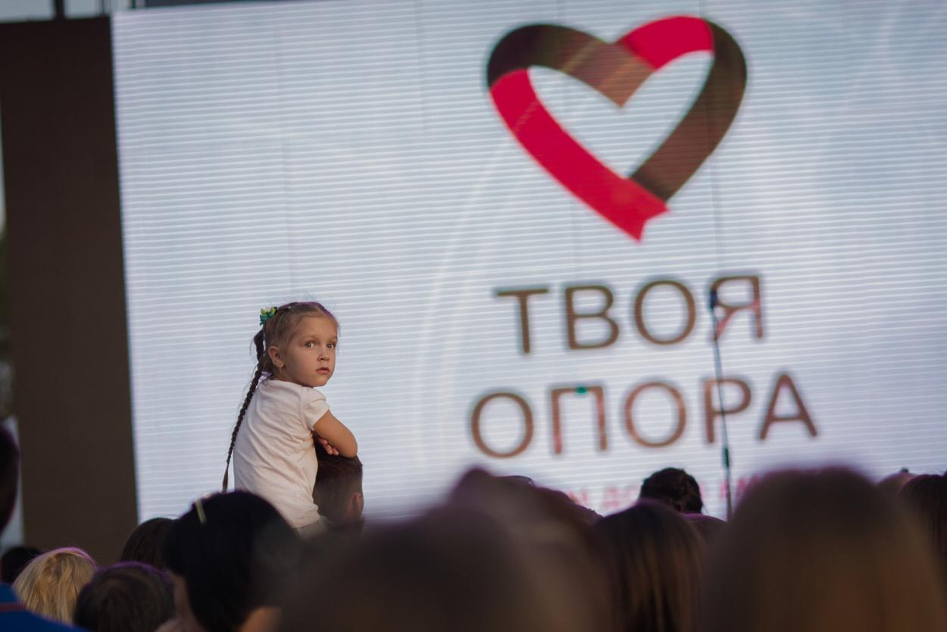


MISSION
We work so that every person in Ukraine who needs help receives it in a timely and high-quality manner
НАША МІСІЯ
WHY WE EXIST
To systematically assist people who need help
WHAT WE DO
We restore, strengthen and/or create systems that guarantee social and humanitarian assistance to those who need it
HOW WE DO IT
We carry out charitable activities within the current legislation and promote the idea of ​​transparency and accountability of the charitable sector

Slide 21


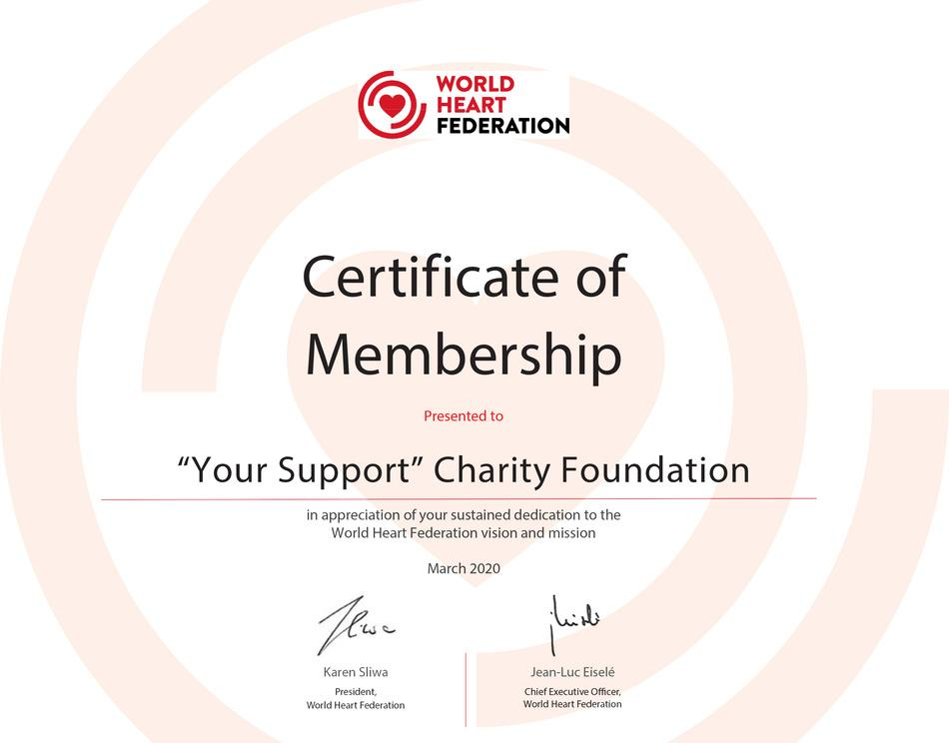
CAF VALIDATED
SPHERE FOCAL POINT IN UKRAINE
WORLD HEART FEDERATION MEMBER
(ONLY ONE IN UKRAINE)

Slide 22
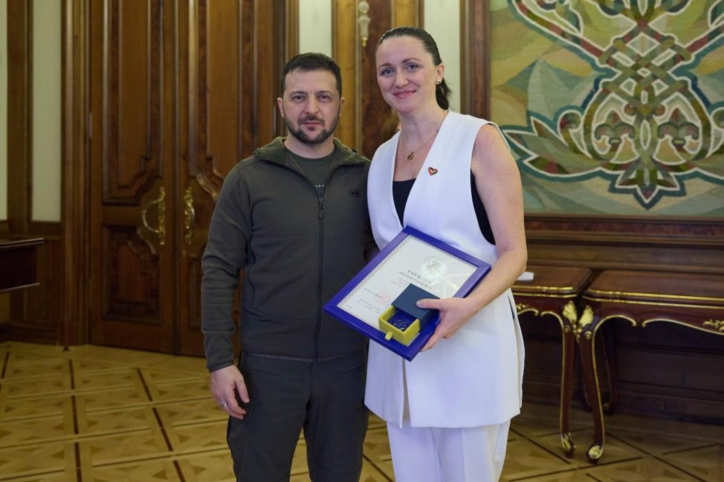
The fund was awarded the "Golden Heart" award of the President of Ukraine

Slide 23
5000
over
Children with congenital heart and developmental diseases
2500
over
IDPs had been accommodated in our Shelter in Lviv
137
WHO WE SUPPORT
Healthcare institutions
55
over
Orphanages
4000
Affected children in Bucha region who require MHPSS
approx

Slide 24
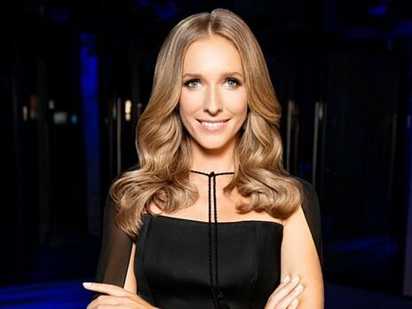
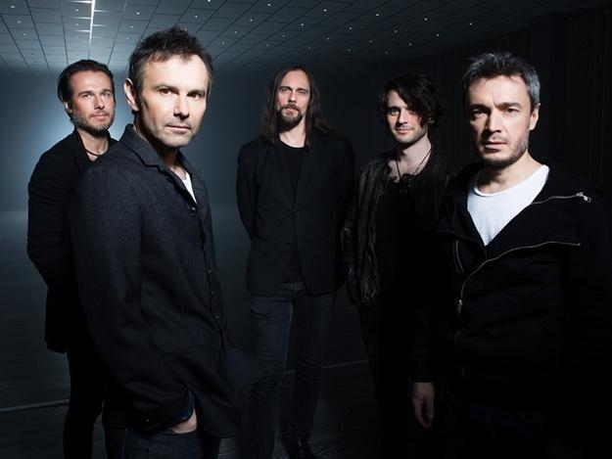
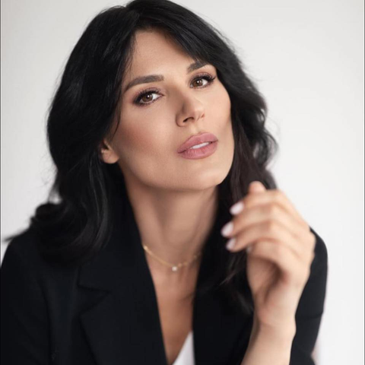
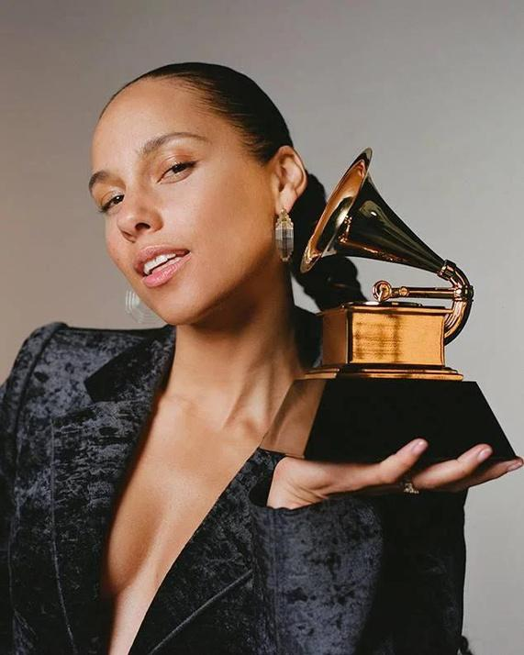
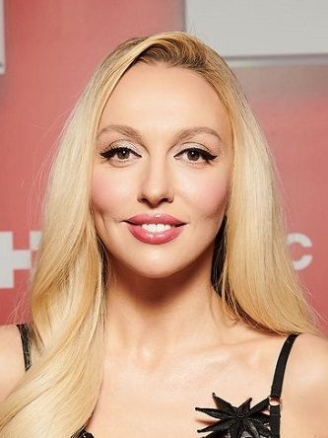
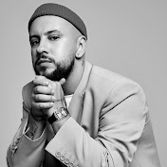
Our foundation constantly cooperates with Ukrainian and world celebrities to help children and victims of the war in Ukraine.

Slide 25




























OUR PARTNERS

Slide 26

FUNDRAISED SINCE 2014
680 MLN UAH
APPROX 20 MLN USD

Slide 27
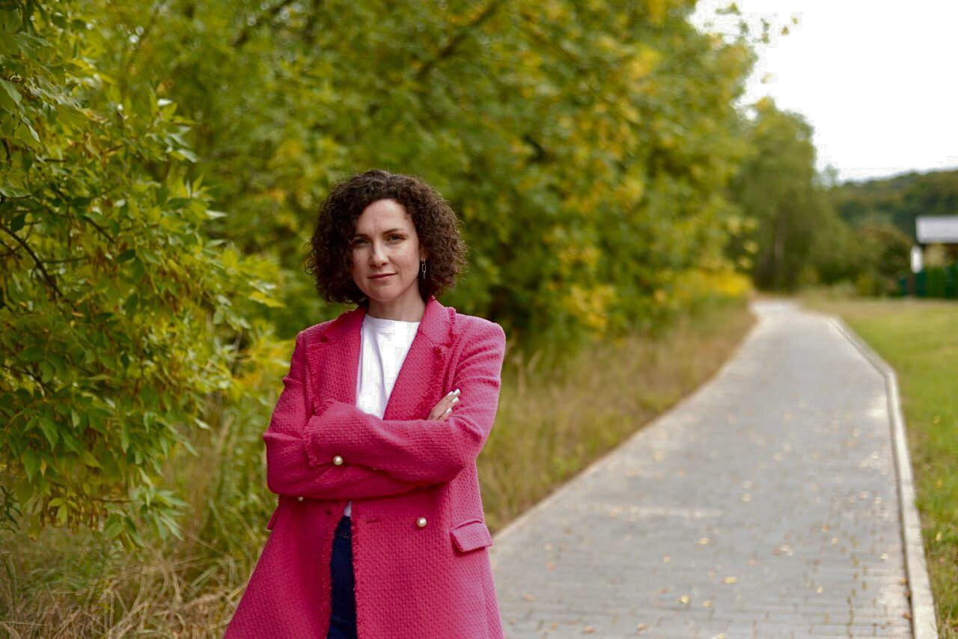
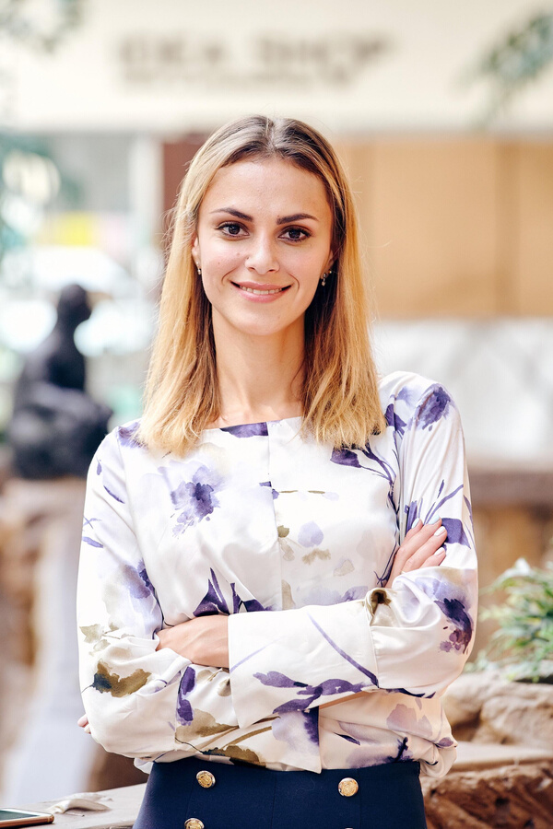
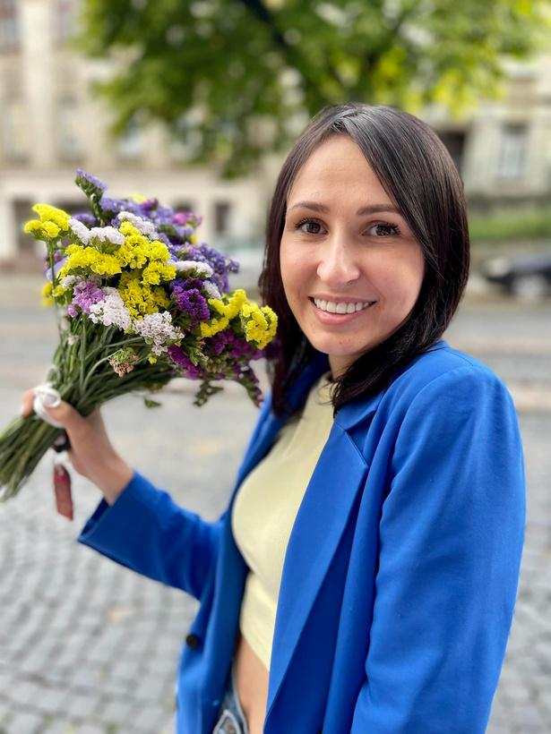
SUPERVISORY BOARD
DINA VOLYNETS
DARIIA SUKHENKO
IRYNA ZASLAVETS
Organizational development & strategy consultant
Sphere Listed Trainer
Co-founder and creative director of the Trembita PR agency
Development Director of the First Medical Association in Lviv, public activist, journalist

Slide 28






The fund annually undergoes an independent audit, which confirms the transparent and accountable use of donor funds
2016
2017
2018
2019
Done
Done
Done
Done
2020
2021
2022-2023
Done
Done

Slide 29
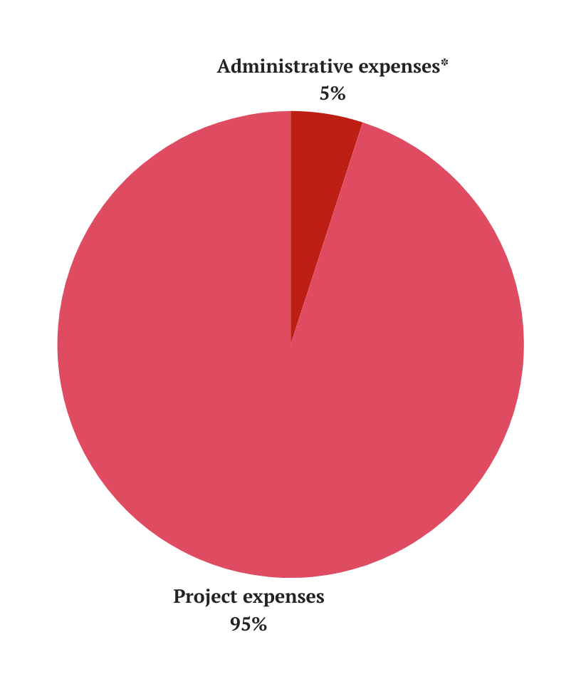


ALLOCATION OF EXPENSES
FOUNDATION ADMINISTRATIVE COSTS THAT MAKE OUR MISSION POSSIBLE*
PROJECT EXPENSES
*twelve months average

Slide 30


CONTACTS
VALERIIA TATARCHUK
CEO
tatarchuklera@tvoya-opora.org.ua
DINA VOLYNETS
HEAD OF SUPERVISORY BOARD
dinavolynets@gmail.com
info@tvoya-opora.org.ua
www.tvoya-opora.org
tvoyaopora
tvoyaopora

