Slide 1
Introduction to Sphere
Van Hall Larenstein University, Holland
29 February 2024
Felicity Fallon,
Head of Learning and Events, Sphere

Slide 2
Agenda
Introductions
What is Sphere?
Deep dive into Sphere Handbook
Deep dive into a Technical Standard
WASH Haiti Case Study
Notes:
Introduce yourself, then run through the agenda stressing that this is an interactive session where the students will be asked asked questions, asked to find answers in the handbook, work in groups and watch a video.

Slide 3
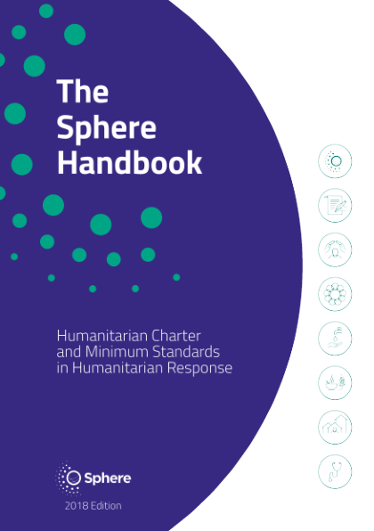
The Sphere Handbook
Notes:
Ask the students to raise their hand if they a) have heard of Sphere b) have read any of the Sphere Handbook c) have ever used the Sphere Handbook.
If any of them respond positive to the questions, ask them to share their experiences.
Ask the students what they think Sphere is.
If they say it is a handbook or a set of standards, say yes – but it is also a worldwide community of standards users and practitioners.

Slide 4
The Sphere movement
Started in 1997 by NGOs and the International Red Cross and Red Crescent Movement.
Developed a Humanitarian Charter and humanitarian standards to be applied in humanitarian response.
The Sphere Handbook is a primary reference tool for national and international NGOs, volunteers, UN agencies, governments and donors.
Sphere is a worldwide community working to improve the quality and accountability of humanitarian assistance.
Notes:
This is just a quick background to explain the origins of Sphere and its status in the humanitarian community today.
Can also talk here about why Sphere was created, after the Rwanda genocide and cholera outbreak.

Slide 5
The Sphere philosophy
The Sphere philosophy is based on two core beliefs:
1. People affected by disaster or conflict have the right to life with dignity and, therefore, the right to assistance.
2. All possible steps should be taken to alleviate human suffering arising out of disaster or conflict.
Notes:
This is just a quick background to explain the origins of Sphere and its status in the humanitarian community today.
Can also talk here about why Sphere was created, after the Rwanda genocide and cholera outbreak.

Slide 6
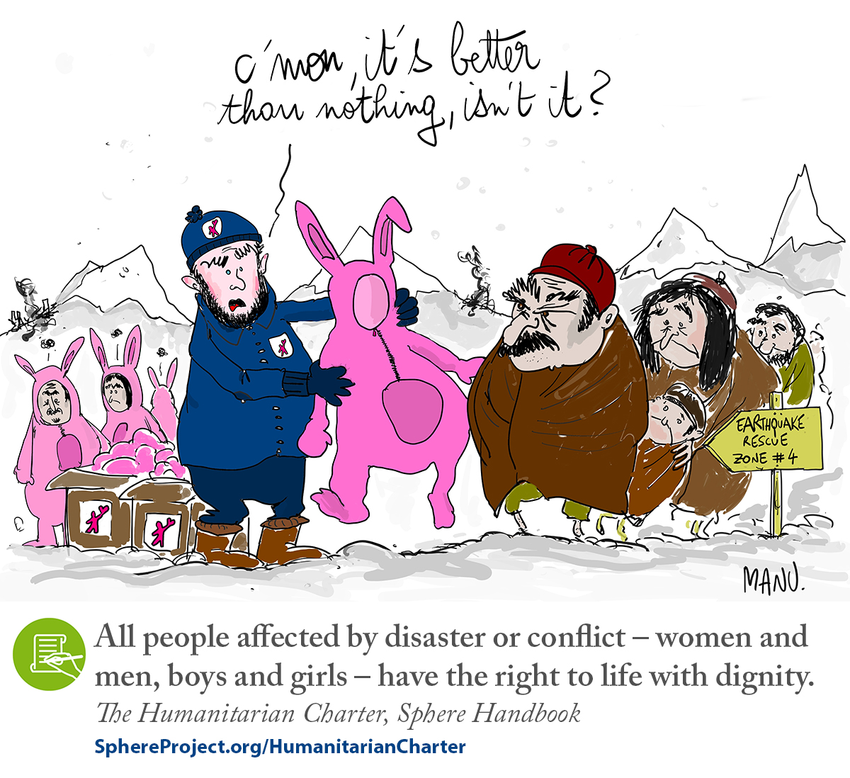
Notes:
Ask one of the students to describe what they can see in the cartoon. Observe that the aid provided is not dignified or appropriate. Stress the need to consult with affected populations, to check what capacities they have before making assumptions.

Slide 7
Why are humanitarian standards needed?
Quality: efficient, effective and appropriate
Accountability: answerable for actions
Inclusive: people affected by crisis are involved in decisions that affect them
Coordinated: "A common language"
7
Notes:
Ask the students why they think humanitarian standards are necessary, then reveal the text to see if answers match up.

Slide 8
What is in the Handbook?
The Handbook is Sphere’s flagship publication. It includes the Humanitarian Charter, the Protection Principles, the Core Humanitarian Standard, and Minimum Standards in four vital areas of response:
Water supply, sanitation and hygiene promotion (WASH)
Food security and nutrition
Shelter and settlement
Health
Notes:
The need for standards led to the Sphere Project and ultimately to the Sphere Handbook, which has evolved to its current form and wide acceptance.
Before revealing the four technical chapters, can ask the students what they think the four life-saving areas in the technical chapters are. Stress the importance of the Foundation Chapters and that we will be coming back to them later.

Slide 9
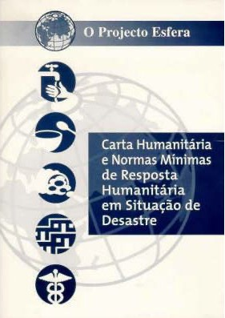
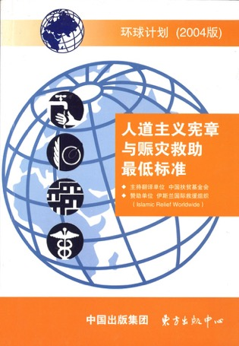


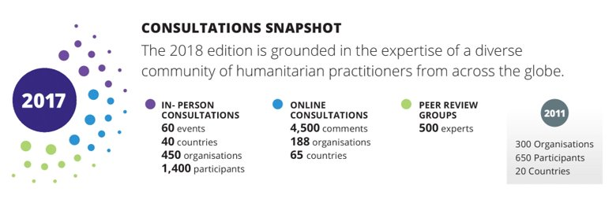
Written by humanitarians, for humanitarians
Notes:
The handbook is not written by a group of out of touch people sitting behind desks in Geneva, but is written in consultation with the whole humanitarian community, with technical experts leading on each chapter, and is updated every 8-10 years.

Slide 10
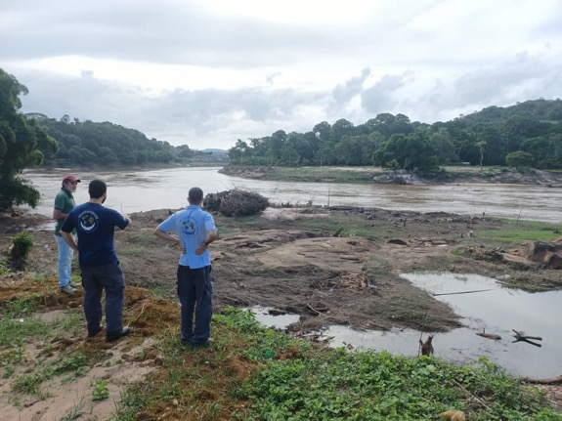
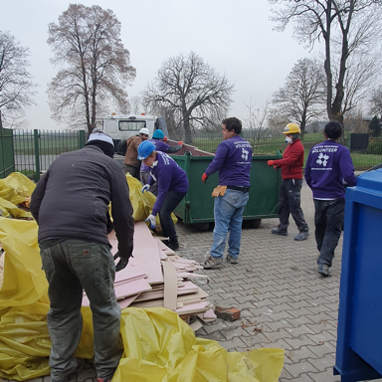
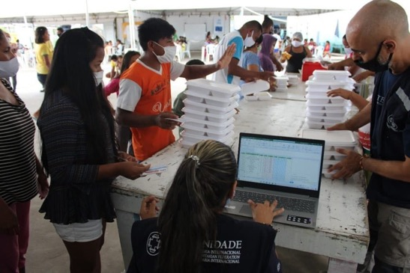
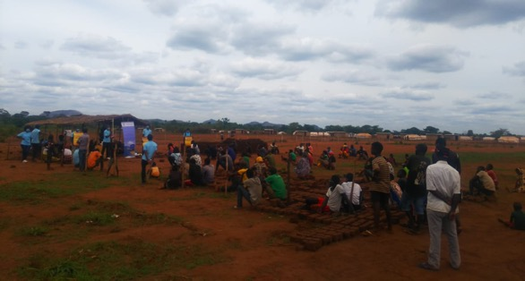
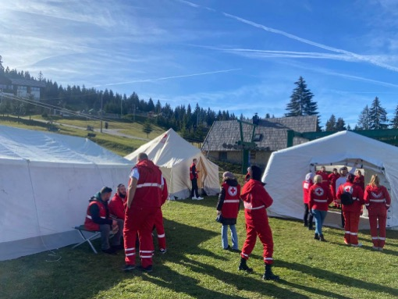
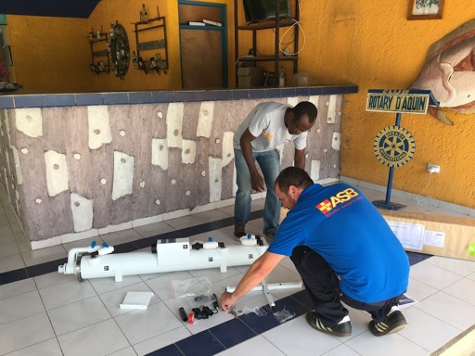
A worldwide community of 100,000+ humanitarian practitioners...
Notes:
We don’t know how know exactly how many people in the world use Sphere, but it is in the hundreds of thousands. Examples above come from renovating a shelter for refugees in Ukraine, a food distribution in Latin America, a flood response in Latin America, post-cyclone camps for refugees in Mozambique, Red Cross training in Bosnia, and installing water filters post-earthquake in Haiti. Stress the different kinds and stages of response in which Sphere is useful.

Slide 11
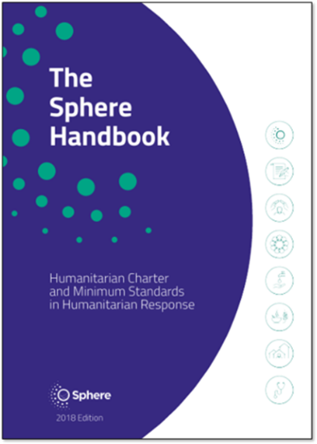
...All using the Sphere Handbook
The 2018 Sphere Handbook is available in 24 languages: Arabic, Bahasa Indonesia, Chinese (Standard), Chinese (Traditional), Congo Swahili, Dari, English, French, German, Japanese, Kikongo, Korean, Lingala, Nepali, Polish, Portuguese (Brazil), Portuguese (Portugal), Romanian, Slovak, Spanish, Tshiluba, Turkish, Ukrainian and Urdu.
Discover all access options here:
https://spherestandards.org/handbook-2018/
Notes:
Explain that language translations are led by the Sphere community and demonstrate the demand for local versions of the handbook.

Slide 12
Deep dive into the Sphere Handbook
You are working on a new transit camp for refugees. You are asked for advice on the following issues:
Organising the living space in the shelter
Promoting good hygiene practices in the shelter
Protecting the shelter’s most vulnerable residents
Ensuring residents can participate in decisions that affect them, and give feedback
  List 10 references in the Sphere Handbook that will help you find the answers, and note which sections of the Handbook you found them in.
  You have 15 minutes.
Notes:
Enough talking about the handbook, let’s dive in and see how useful it really is. Put the students into groups and ask them to look in the handbook to find advice on these issues. After 15 minutes or so, ask each group to feedback. Try to sort their findings into e.g. Standards, indicators, guidance notes etc. Ask them if they found the handbook useful? Tell them there is lot of information in there, 406 pages, so it is worth them looking in more depth at the handbook after the session.

Slide 13
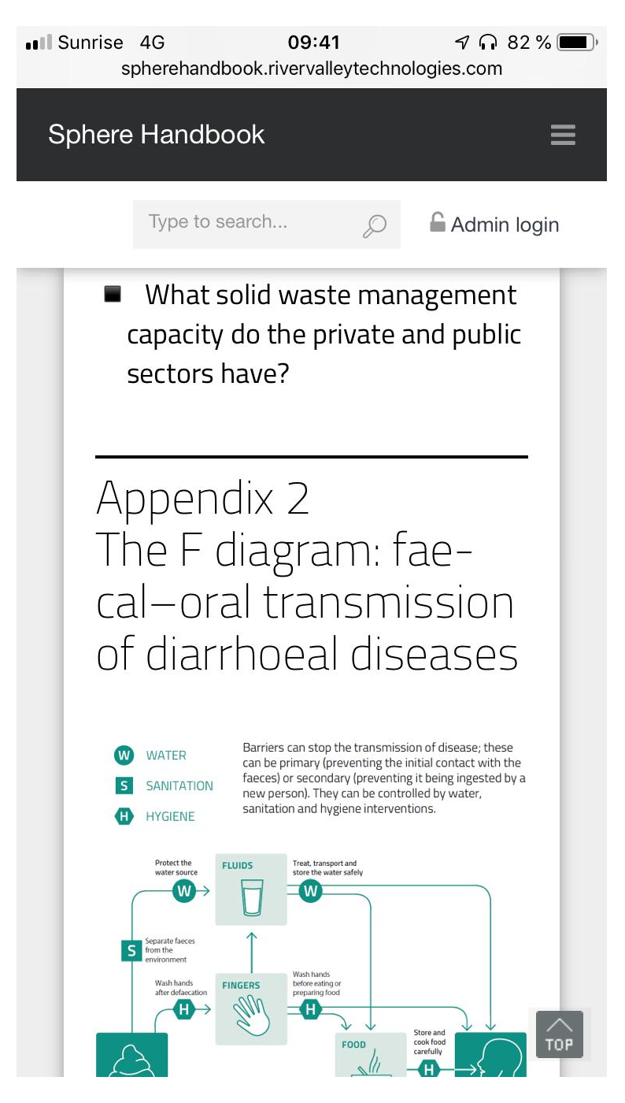
WAYS TO ACCESS SPHERE HANDBOOK and OTHER STANDARDS
Sphere Handbook is available in 43 languages and more are underway! Other Handbooks have also been translated into other languages.
Buy paper copies
Read interactive handbook online
Download PDF
HSP Mobile application
13
Notes:
Explain the different ways the students can access the handbook before asking them to do the exercise on the slide before.

Slide 14

The Sphere Handbook – eight interdependent chapters
What is Sphere?
The Humanitarian Charter
Protection Principles
Core Humanitarian Standard
Water Supply, Sanitation and Hygiene Promotion (WASH)
Food Security and Nutrition
Shelter and Settlement
Health
FOUNDATION
CHAPTERS
TECHNICAL
CHAPTERS
Notes:
In the previous exercise, the students will have found answers from lots of different parts of the handbook. The key point of this slide is to highlight the fundamental point that informed use of Sphere means the use of all of Sphere – not just the four technical chapters if you are a field worker, and not just the foundation chapters if you are a protection officer.

Slide 15
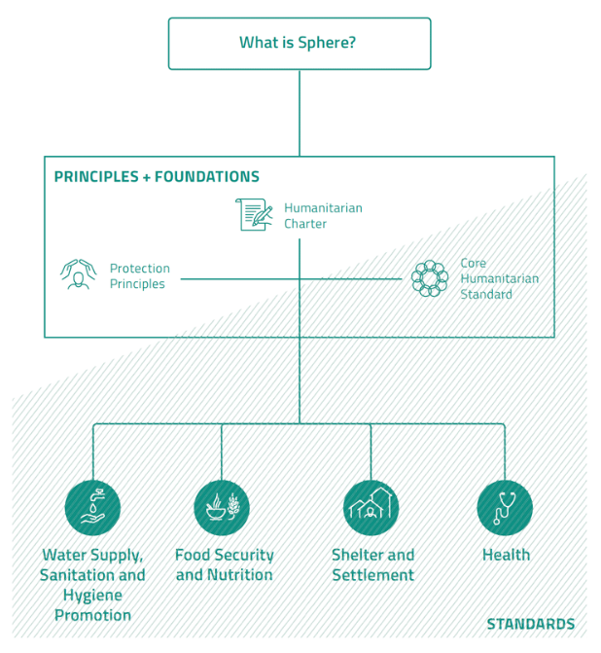
TECHNICAL
CHAPTERS
Notes:
This is an alternative way of presenting the information in the previous slide. The key point of this slide is to highlight the fundamental point that informed use of Sphere means the use of all of Sphere – not just the four technical chapters if you are a field worker, and not just the foundation chapters if you are a protection officer.

Slide 16

The Humanitarian Charter
is the cornerstone of the Sphere approach;
recognises that people have a right to protection and assistance with dignity; and
provides the ethical and legal foundation for the Protection Principles, the Core Humanitarian Standard, and the Sphere Minimum Standards.
See pages 27–32
Notes:
Take a few moments for participants to locate this chapter in their Handbooks. Highlight the two core points underpinning the Sphere philosophy and approach – the right to assistance, and provision of that assistance with dignity.
Make a point that in one sense, the Charter answers the question of why we do humanitarian work. (What and how come next.)
If no time for the students to read now, ask them to take the time to read this after the session.

Slide 17

Protection Principles
A practical translation of the Humanitarian Charter into four principles to guide humanitarian response:
Enhance people’s safety, dignity, and rights and avoid exposing them to further harm.
Ensure people’s access to impartial assistance, according to need and without discrimination.
Assist people to recover from the physical and psychological effects of …
Help people to claim their rights.
See pages 33–47
Notes:
Ask participants to locate this part of the Handbook. Ask them to quickly read the four principles, and relate these to the two fundamental philosophical points just discussed. They should see how these four principles flow from those two concepts by adding more detail. The two philosophical points about what people (affected people and people in general) should have are restated as four actions that humanitarians should take (enhance, ensure, assist, and help).
Make a point that the Protection Principles answer the question of what we are supposed to do (in broad terms). (How we go about this comes next.)

Slide 18

The Core Humanitarian Standard on Quality and Accountability (CHS)…
describes essential organisational responsibilities for quality and accountability in humanitarian response.
See pages 49–88
Notes:
Explain that as of the 2018 edition of the Handbook, the CHS is an integral part of the overall Sphere approach (replacing the earlier Sphere Core Standards).
Make a point that the CHS answers the question of how we conduct ourselves in humanitarian work (from a management perspective).
The technical “how” comes in the four technical chapters, though it should be noted that Sphere does not claim to be “a “how to” guide, but a description of what must be in place as a minimum for people to survive and recover from crisis with dignity (page 8). The key actions and guidance notes offer suggestions and advice, but it is up to practitioners to determine the best actions to take in the contexts in which they operate.

Slide 19
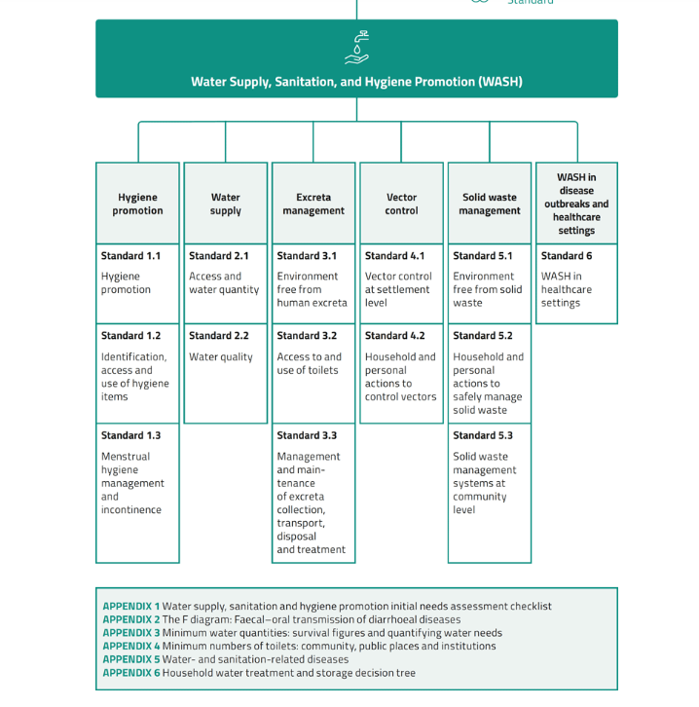
Deep dive into a Technical Chapter: WASH
Notes:
Now we are going to dive a bit deeper into the WASH chapter of the handbook. Explain the different sections.

Slide 20
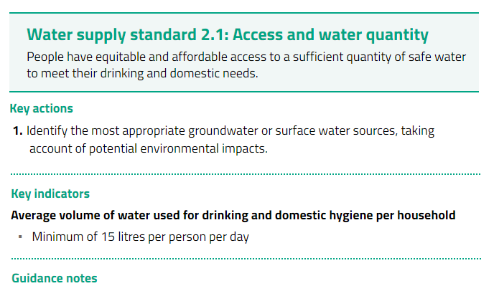
20
Notes:
Ask a student to read this standard. Ask the students what they think about the indicator. Is that a lot of water or a little. Compare it to the average daily consumption in their country. Use this slide to talk about the fact that standards are universal, but indicators need to be contextualised to the context. Ask the students if they can think of any groups of people who might need more water than others. Stress the importance of reading the guidance notes in each section which will help you to adapt the indicators to context.

Slide 21
Guidance Notes to Water Supply Standard 2.1
The quantity of water needed for drinking, hygiene and domestic use depends upon the context and phase of a response. It will be influenced by factors such as pre-crisis use and habits, excreta containment design and cultural habits
A minimum of 15 litres per person per day is established practice. It is never a “maximum” and may not suit all contexts or phases of a response.
For example, it is not appropriate where people may be displaced for many years.
In the acute phase of a drought, 7.5 litres per person per day may be appropriate for a short time.
In an urban middle-income context, 50 litres per person per day may be the minimum acceptable amount to maintain health and dignity.

Slide 22
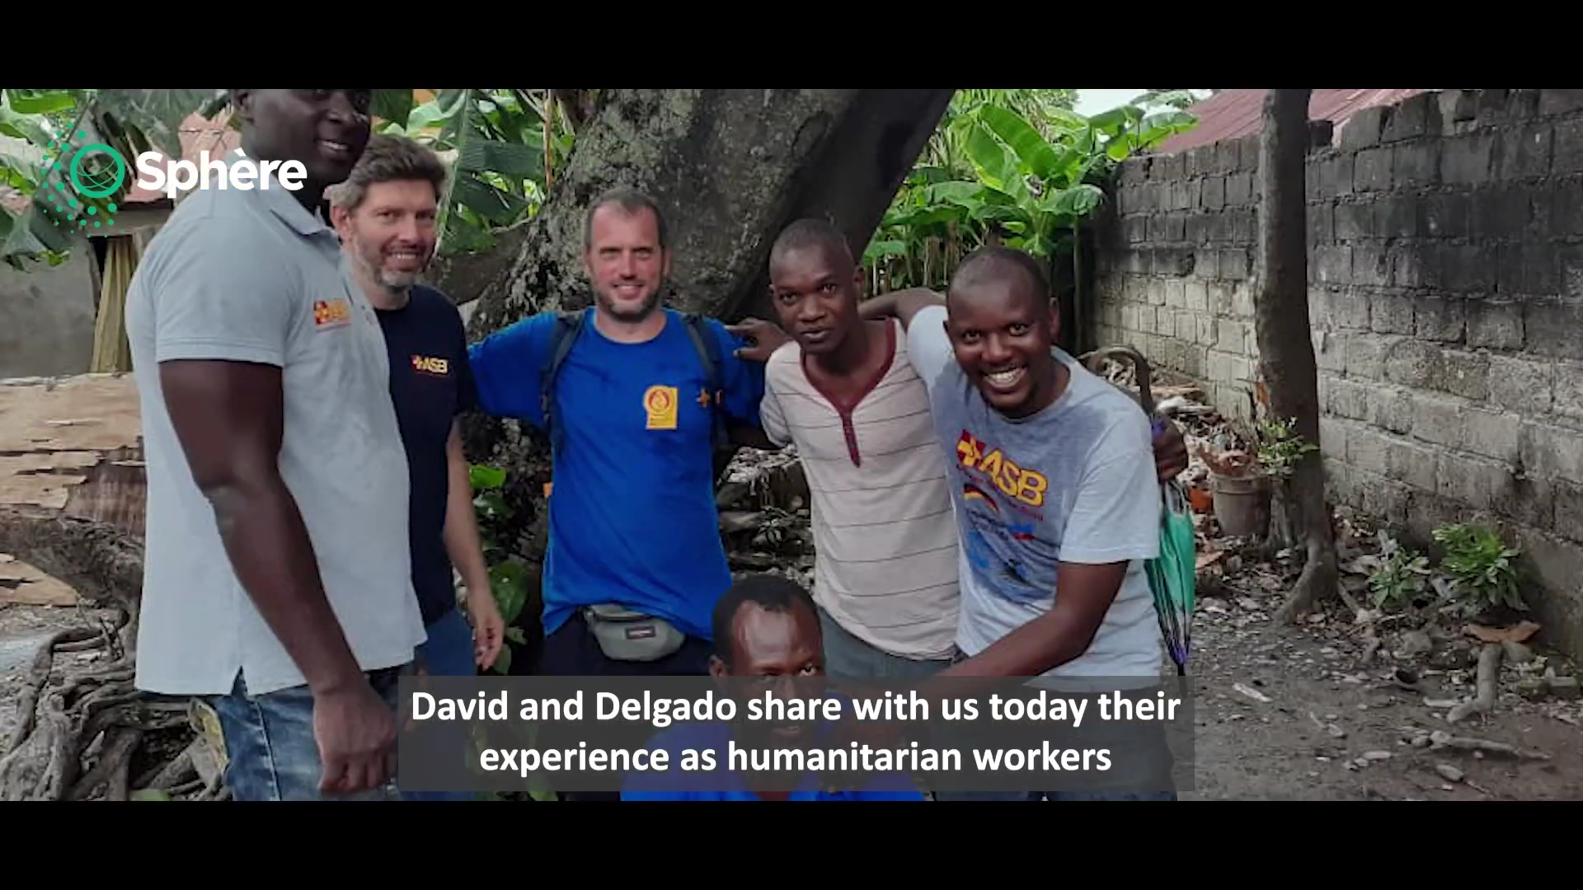
Haiti case study
Notes:
Present the video, which is about using Sphere standards in Haiti to provide clean water after an earthquake. Show the students the questions on the next slide before asking them to watch the video. Give them time after the video to answer the questions in small groups, before debriefing.

Slide 23
Groupwork
Watch Sphere in Action Video from Haiti:https://www.youtube.com/watch?v=QVpVrKBQc7w
After the video, you will be put into small groups for 20 minutes to answer the following questions:
Which parts of the Sphere handbook are referenced, both explicitly and implicitly, in the video?
Which technical standards from the Sphere handbook can you see being put into practise in the video?
Which CHS (Core Humanitarian Standard) commitments can you see being put into practise in the video?

Slide 24
Video Debrief
Humanitarian Charter:
We offer our services in the belief that the affected population is at the centre of humanitarian action, and recognise that their active participation is essential to providing assistance in ways that best meet their needs, including those of vulnerable and socially excluded people
Notes:
Listen to the students answers, then complete them with these slides if necessary. Stressing the importance of applying humanitarian principles as well as technical solutions.

Slide 25
Video Debrief
Protection Principle 1:
Enhance people’s safety, dignity and rights and avoid exposing them to further harm
Supporting the capacity of people to protect themselves
Notes:
Listen to the students answers, then complete them with these slides if necessary. Stressing the importance of applying humanitarian principles as well as technical solutions.

Slide 26
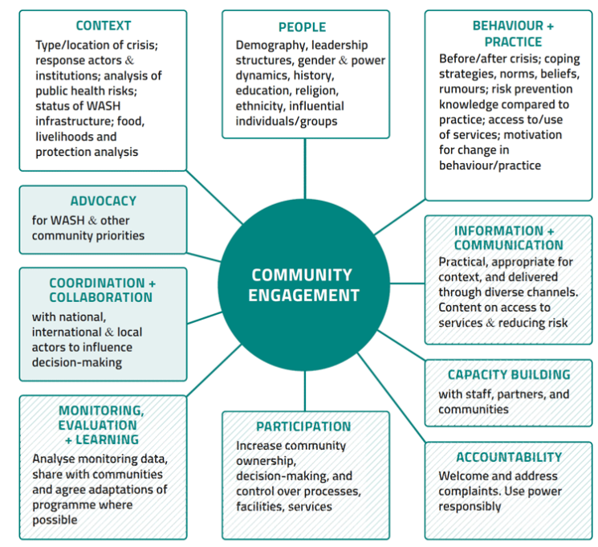
Debrief
Sphere
Handbook
WASH chapter:

Slide 27
Debrief
Water Supply Standard 2.1:
Access and Water Quality
People have equitable and affordable access to a sufficient quantity of safe water to meet their drinking and domestic needs.

Slide 28
Debrief
Water Supply Standard 2.1:
Water Quality
Water is palatable and of sufficient quality for drinking and cooking, and for personal and domestic hygiene, without causing a risk to health

Slide 29
Debrief
Hygiene promotion standard 1.1:
Hygiene promotion
People are aware of key public health risks related to water, sanitation and hygiene, and can adopt individual, household and community measures to reduce them.

Slide 30
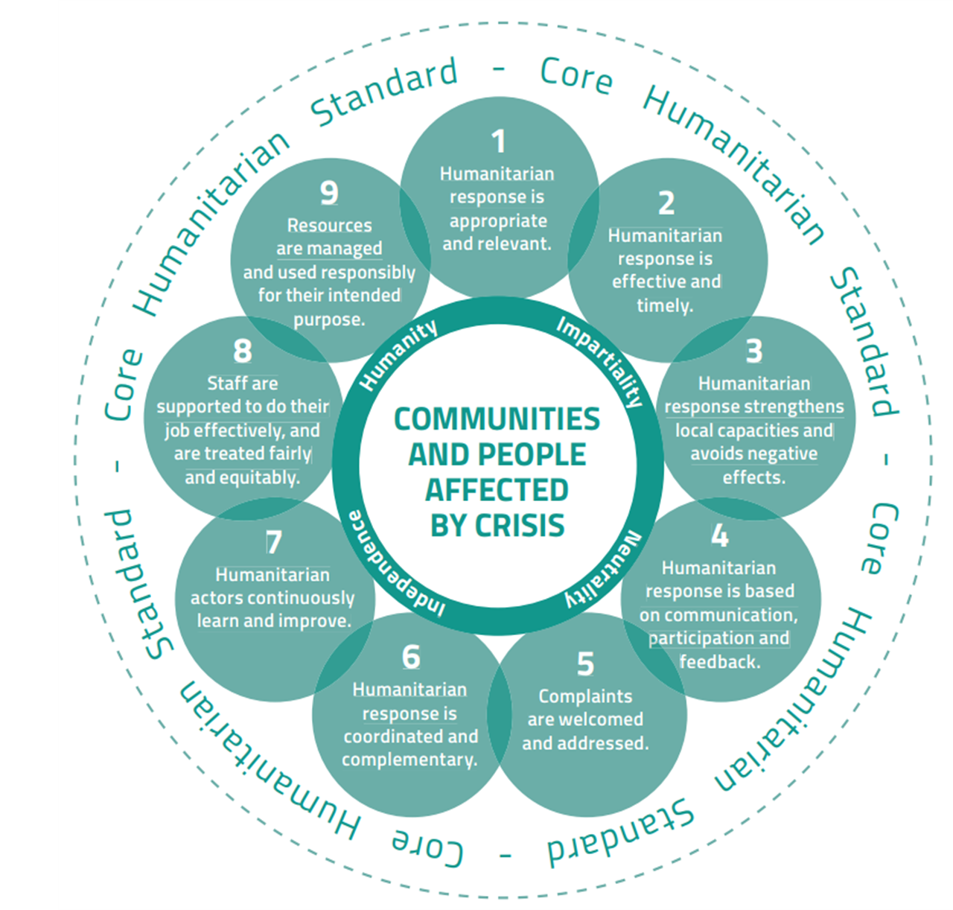

Debrief
Core
Humanitarian
Standard:

Slide 31
Conclusions
If you remember one thing from today...
Notes:
Finish the session by thanking the students for their engagement. Ask them if they have any questions for you. Conclude by asking them the one thing they will take home or remember from this workshop. Thank them again and encourage them to keep using the handbook and to stay in touch with Sphere.

