Slide 1
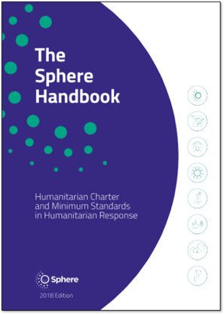
Significance of Sphere Standards
Session for Graduates of International Diploma in Humanitarian Assistance (IDHA)
Feb 07, 2024
Amman, jordan
Facilitated by: Rizwan Iqbal | ACT Alliance
Global Coordinator - Accountability & Safeguarding

Slide 2

Introductions
Your Name
Role, Organization
Country

Slide 3
What is Humanity & its purpose?
Human suffering must be addressed wherever it is found. The purpose of humanitarian action is to protect life and health and ensure respect for human beings.
(One of the fundamental principles of ICRC)
Notes:
The principles of humanity, impartiality, independence and neutrality are derived from: the Fundamental Principles of the International Red Cross and Red Crescent Movement proclaimed in Vienna in 1965 by the 20th International Conference of the Red Cross and Red Crescent; United Nations (UN) General Assembly Resolution 46/182, 19 December 1991; and UN General Assembly Resolution 58/114, 5 February 2004. 5 Some organisations, while committed to giving impartial assistance and not taking sides in hostilities, do not consider that the principle of neutrality precludes undertaking advocacy on issues related to accountability and justice.

Slide 4
History of Humanitarian Action?
The concept of appropriate treatment of wounded soldiers was put forth by Swiss activist Henry Dunant in “A Memory of Solferino”
Creation of the Red Cross in 1863; one of the first true international aid organizations.
Notes:
The principles of humanity, impartiality, independence and neutrality are derived from: the Fundamental Principles of the International Red Cross and Red Crescent Movement proclaimed in Vienna in 1965 by the 20th International Conference of the Red Cross and Red Crescent; United Nations (UN) General Assembly Resolution 46/182, 19 December 1991; and UN General Assembly Resolution 58/114, 5 February 2004. 5 Some organisations, while committed to giving impartial assistance and not taking sides in hostilities, do not consider that the principle of neutrality precludes undertaking advocacy on issues related to accountability and justice.

Slide 5
Why are humanitarian standards needed?
Quality: efficient, effective and appropriate
Accountability: answerable for actions
Inclusive: people affected by crisis are involved in decisions that affect them
Coordinated: "A common language"
5

Slide 6

The Sphere movement
Started in 1997 by NGOs and the International Red Cross and Red Crescent Movement.
Developed a Humanitarian Charter and humanitarian standards to be applied in humanitarian response.
The Sphere Handbook is a primary reference tool for national and international NGOs, volunteers, UN agencies, governments, donors, and the private sector.
Sphere is a worldwide community working to improve the quality and accountability of humanitarian assistance.
Notes:
This is just a quick background to explain the origins of Sphere and its status in the humanitarian community today.

Slide 7
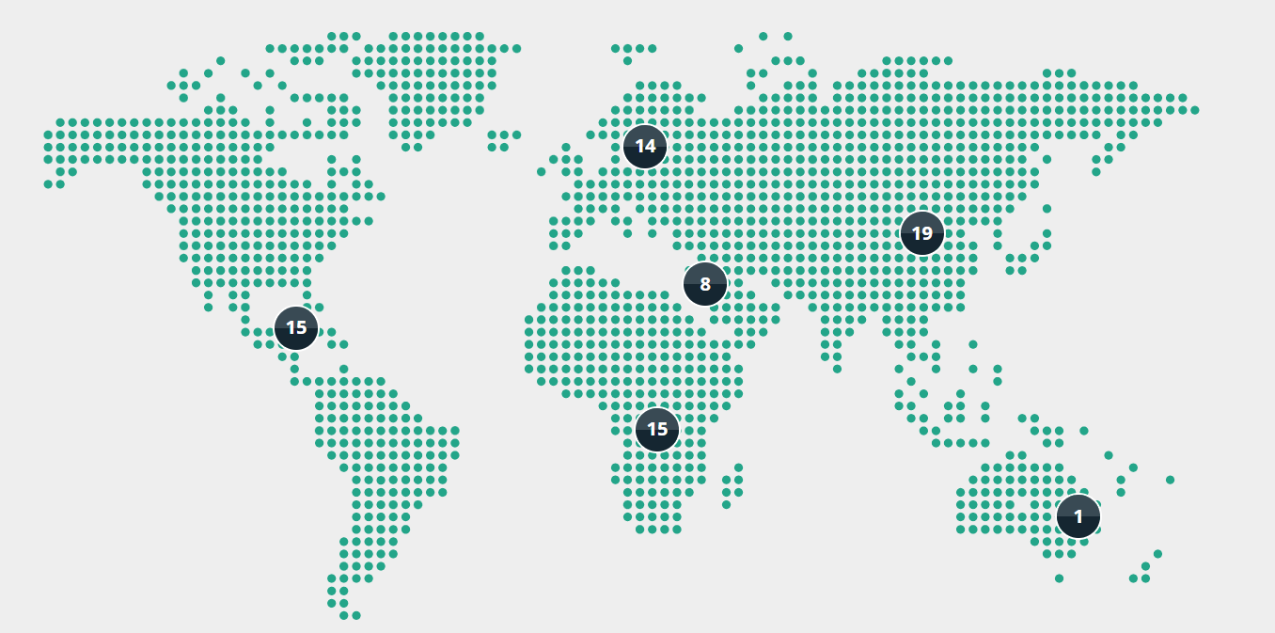
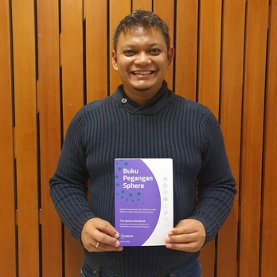
73 Focal Points

Slide 8

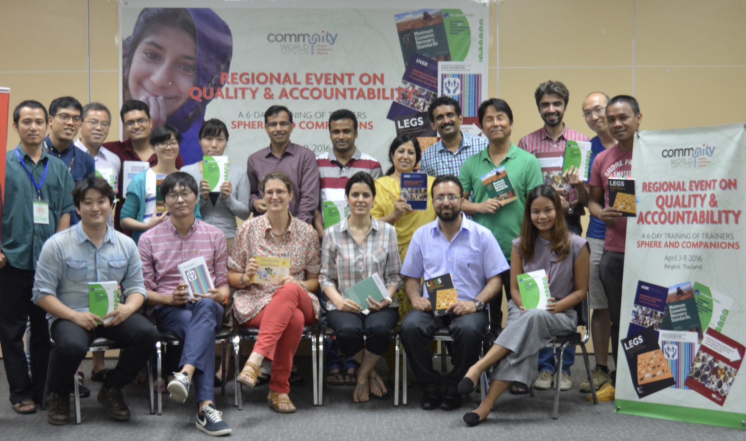
141 listed trainers

Slide 9

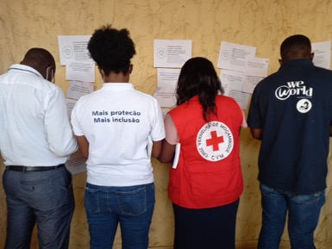
50 Organisational members

Slide 10
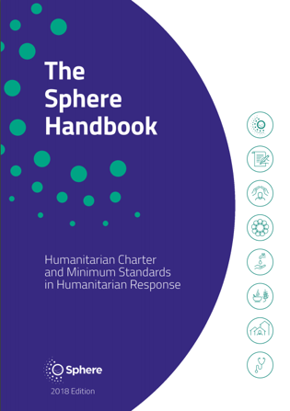

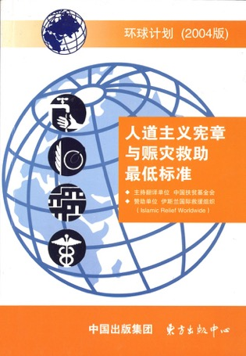
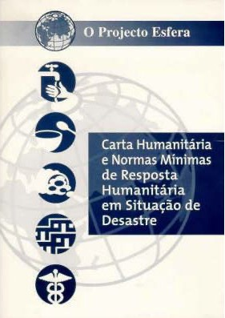

Written by humanitarians, for humanitarians

Slide 11
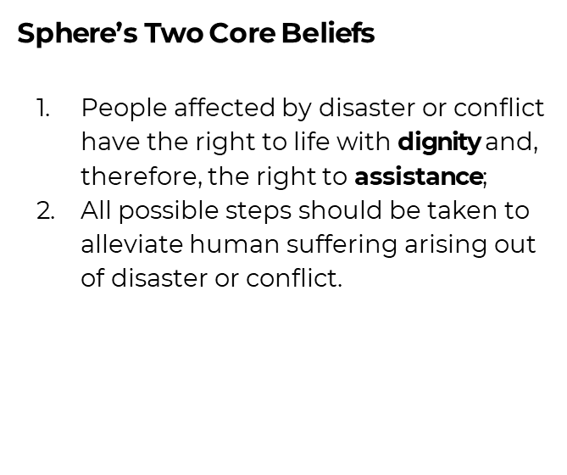
What is Sphere?

Slide 12
What’s the most important human’s need to live?
Notes:
Refer to the WASH, Food, Shelter & Health. Bring the four Sphere technical chapters into the discussion.

Slide 13
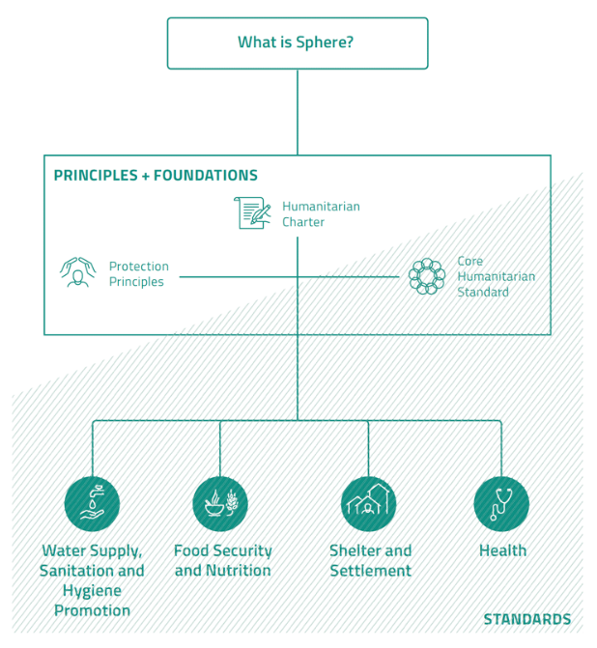
A holistic approach
Why? The Humanitarian Charter establishes the ethical and legal framework for humanitarian action, applying humanitarian principles, and draws on the RC/RC/NGO Code of Conduct
How? Protection principles translate the legal framework into strategies and actions so that assistance and protection are equal pillars in any response
Core Humanitarian Standard provides the framework for organizational responsibilities and fundamental accountability
What? Minimum standards in four key sectors give quantitative and qualitative indicators, actions, and guidance based on evidence and expert practice.

Slide 14
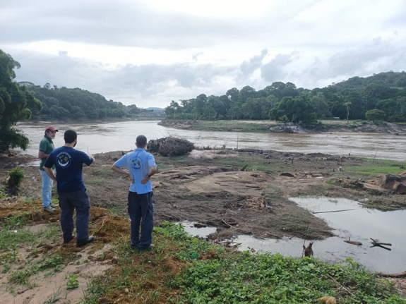
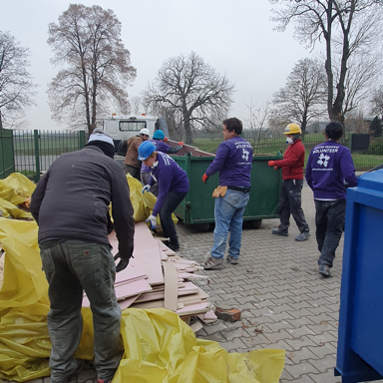
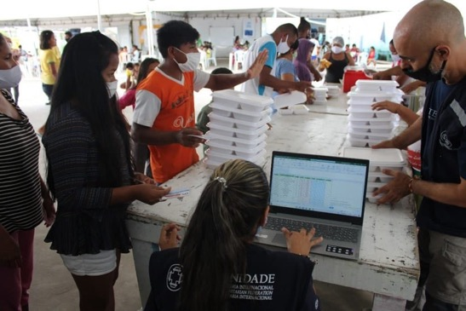
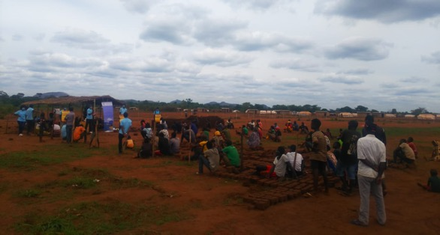
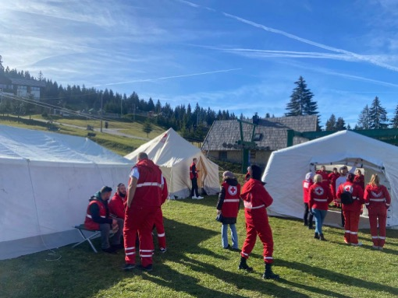
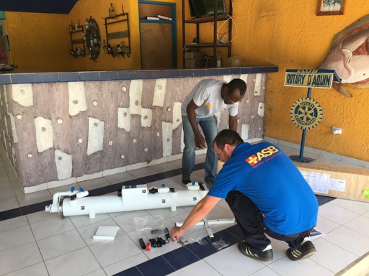
A worldwide community of 100,000+ humanitarian practitioners...

Slide 15
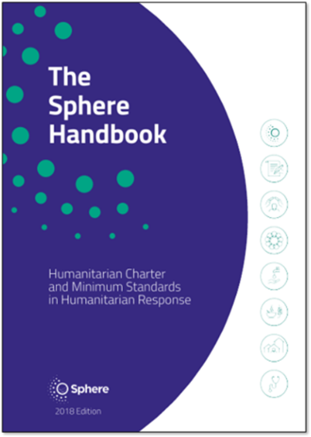
...All using the Sphere Handbook
The 2018 Sphere Handbook is available in 24 languages: Arabic, Bahasa Indonesia, Chinese (Standard), Chinese (Traditional), Congo Swahili, Dari, English, French, German, Japanese, Kikongo, Korean, Lingala, Nepali, Polish, Portuguese (Brazil), Portuguese (Portugal), Romanian, Slovak, Spanish, Tshiluba, Turkish, Ukrainian and Urdu. Discover all access options here:
https://spherestandards.org/handbook-2018/

Slide 16

Sphere Introductory Video
YouTube link to access video: https://www.youtube.com/watch?v=01PHMGrmpWE&t=5s

Slide 17
General structure of the Sphere Standards*
Introduction including “essential concepts”
Links with other standards
THE STANDARDS
Key actions
Key indicators
Guidance notes
*The CHS chapter has a structure comparable with the technical chapters.
Appendices
References and further reading
Notes:
Refer participants to the second half of the Handbook – the four technical chapters. Call for a show of hands of people who have used information from these chapters in their work. Call for a few examples. Briefly explain the overall structure of the technical chapters using the diagram as a guide.

Slide 18
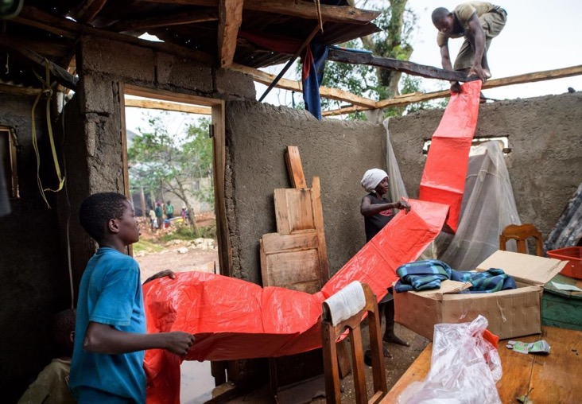
Key Actions
Key actions outline practical steps to attain the Minimum Standard. These are suggestions and may not be applicable in all contexts. Users should select those most relevant to the situation.
See page 6
Haiti, 2016. Lutheran World Services
18
Notes:
Review the text and ask participants to quickly find and cite one or two actions from the Shelter chapter to guide the activity shown in the photograph from Haiti (post-disaster home repair).
ALTERNATIVELY: If this is the first time that participants are required to search the Handbook for content related to a particular topic, this can be a daunting task. It may be better to work through this together then let participants search for themselves on the following three slides.
Step 1: Navigate to the chapter structure diagram at the start of the Shelter chapter (page 238).
Step 2: The task being undertaken is home repair following a disaster (Hurricane Matthew), so deduce that the most likely sections in which to find relevant key actions would be Living space or Technical assistance.
Step 3: Turn to page 254 to find the key actions for standard 3.
Step 4: Because the picture seems to show repairs being made to an existing shelter (rather than building a new shelter), the third key action seems to be the most relevant.
You could then ask participants to check standard 5 for relevant actions.
Possible answers: standard 3 – key actions 3, standard 5 – all key actions.

Slide 19
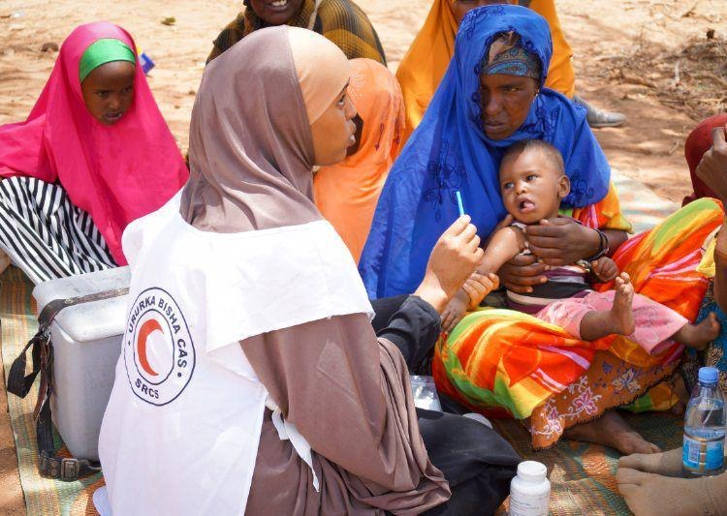
Key Indicators
Key indicators serve as signals to indicate whether the standard they support is being attained.
Specific numbers (targets) are only included where there is sectoral consensus or scientific evidence.
IFRC/Alison Freebairn
19
Notes:
Review the text and ask participants to locate and cite an indicator from the health chapter that would be useful for monitoring this measles vaccination campaign.
Possible answer: standard 2.2.1 – first key indicator.

Slide 20
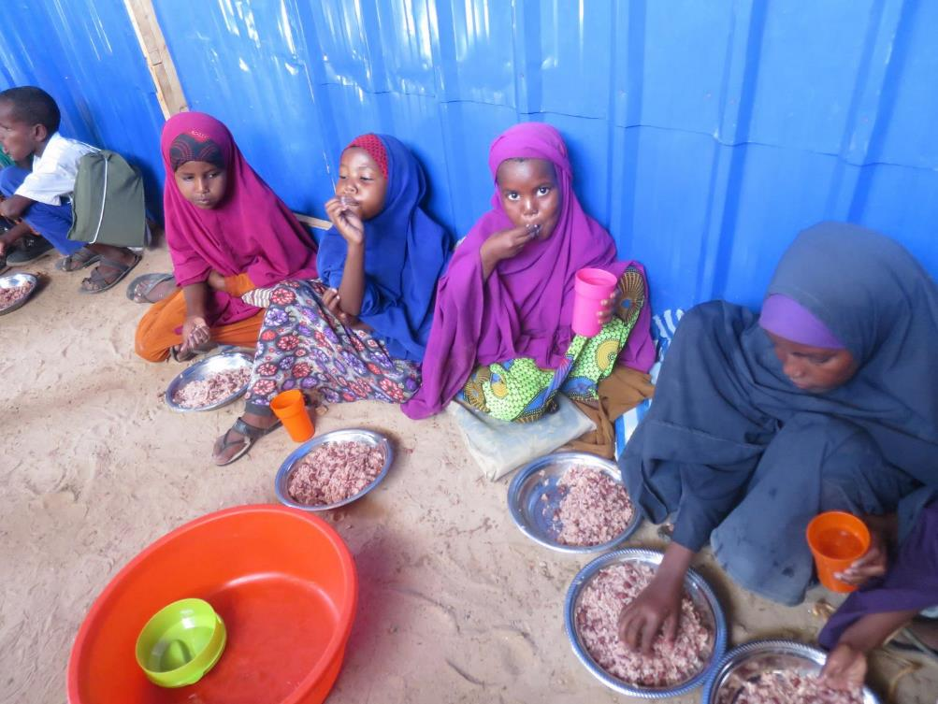
Guidance Notes
Guidance notes provide additional information to support the key actions, with cross-references to the Protection Principles, the Core Humanitarian Standard, other standards in the Handbook and other standards of the Humanitarian Standards Partnership.
Kenya, 2017. Lutheran World Federation
20
Notes:
Review the definition provided and ask participants to find and cite one guidance note that would be useful to apply to this school feeding programme.
Possible answer: WASH standard 1.1: Hygiene promotion – Working with children: “Children can promote healthy behaviours to their peers and family. The department of education or social services can identify opportunities to promote hygiene in schools, residential care and child-headed households, and to children living on the street…”
This is the most challenging of these search tasks, and is best achieved using digital versions of the Handbook. If you search the interactive Handbook for “schools” then this piece of advice can be found quickly.

Slide 21

Using the indicators
The Sphere key indicators are a way to measure whether a standard is being achieved; they should not be confused with the standard itself. The standard is universal, but the key indicators, like the key actions, should be considered in light of both the context and phase of the response.
Bangladesh. Lutheran World Federation
Notes:
This is an important slide to spend a few minutes on. Advise participants to not confuse success or failure in achieving a single indicator with success or failure in meeting the related standard. They are only indicators. Their benefit is that they are quantifiable and measurable. When any one indicator is measured to fall short (particularly a process or target indicator), responders should immediately look to other indicators and other standards to confirm if indeed the standard is not being met. In some situations where an indicator is not met, the related standard can be met by compensating in other areas. For example, if water collection is less than 15 litres per day (page 106), but there is increased distribution and use of soap, adequate living space, and sufficient toilets, there may be no increased rate of diarrhea or other adverse effects on public health usually associated with inadequate water supply, i.e. despite having less than 15 litres per day, people have a sufficient quantity of water to meet their most important needs. (WASH standard 2.1, page 105)

Slide 22

Three types of indicators
Process indicators
Target indicators
#
Progress indicators
%
Provide observable criteria to be met (yes or no)
Provide units or scales, but without benchmarks
Provide specific measurable benchmarks
See page 7
Notes:
This may need careful explanation. Refer participants to page 7 and ask them to read the definitions there. Then explain the same ideas in simpler terms using the prepared slide. Ask participants to find an example of each type as you describe each one.
A few examples are provided below:
Example process indicators:
There are no cases of scurvy, pellagra, beriberi, or riboflavin deficiency (page 183)
All healthcare workers clean their hands, using soap or alcohol rub, before and after every patient contact (page 134)
Example progress indicators:
Percentage of public markets with appropriate and adequate waste storage (page 129)
Percentage of shelters and/or settlement sites that have safe access to essential services within an acceptable amount of time or distance (page 250)
Example target indicators:
Distance from dwellings to final distribution points or markets (in case of vouchers or cash) – target <5 kilometres (page 205)
Number of accessible toilets – minimum: 1 per 20 inpatients (page 135)

Slide 23
Process, progress, or target indicator?
“Percentage of shelters that meet agreed technical and performance standards and are culturally acceptable.” (page 255)
?
“There are no human faeces present in the environment in which people live, learn and work.” (page 114)
?
“Number of days essential medicines for non-communicable diseases were not available in the past 30 days – less than four days.” (page 344)
?
“Percentage of targeted households that receive the minimum food energy requirements (2,100 kcal per person per day) and recommended daily micronutrient intake.” (page 198)
?
Notes:
Use the slide animation to bring up each statement then the correct answer one at a time. Show each statement and ask for a show of hands to determine the group consensus on what kind of indicator is being shown.
Note: the final item is presented as a progress indicator although it contains a numeric indicator. Measuring current kcal per person per day and comparing with 2,100 is also valid. The categorisation of indicators is less important than knowing how to use them.

Slide 24
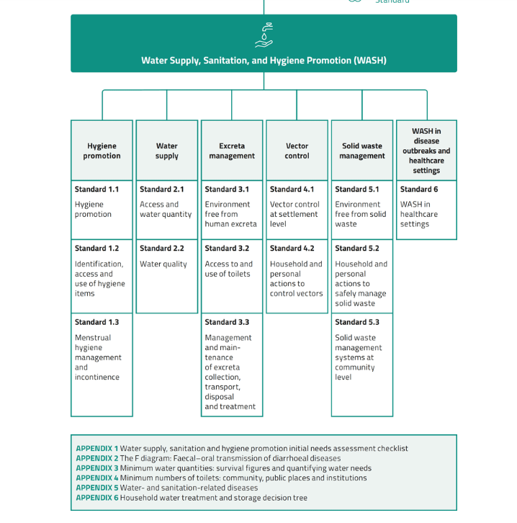
Deep dive into a Technical Chapter

Slide 25
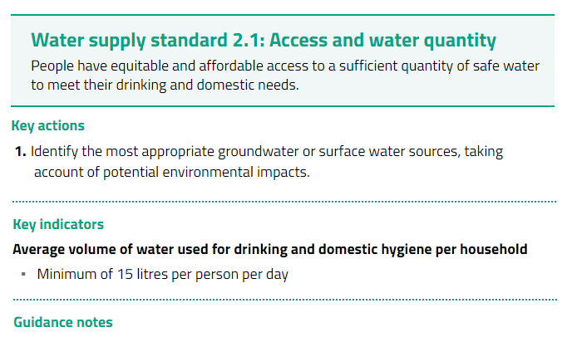
25

Slide 26
Group Activity (15 minutes)
Step 1: Divide into Groups
Step 2: Go to MS 1.2 on page 99-101: Identification, access to and use of hygiene items
Read it & list down the “hygiene kit items” for one family as per Sphere Standard
Step 3: Identify a group member to present
Notes:
Divide the participants into five working groups. Assign each group one of the following five commitments: 5, 6, 7, 8 and 9.
Explain that each small group is to review the text for their assigned commitment and identify any one key action or organisational responsibility that they believe can be difficult for organisations or individuals to follow (at least in some situations). Welcome real-life examples as they will hold more weight.
Once participants have identified a challenging key action or organisational responsibility, they should propose advice for helping humanitarian organisations or individuals achieve it.
Leave this on screen during the group work so that participants are clear on what they need to do. If some groups will leave the room to complete this assignment, give them a copy of STP 6 Handout for CHS Activity.docx.
During feedback from the group exercise, ask the group to confirm what phase(s) of the humanitarian programme cycle (introduced in STP session 3 if following the overall workshop plan) their action or responsibility belongs to (if not obvious/volunteered). To aid the flow of the session, make a note of the Programme Cycle phases, examples of accountability to different stakeholders, and collaboration/participation suggested in the advice. These can be used to wrap up the session on the penultimate slide.

Slide 27
Sphere in national policy around the world
Bangladesh: Water quality standards adopted in the National Plan for Disaster Management.
Bolivia: National disaster law has changed because of Sphere: minimum standards in relation to early warning systems and preparedness have been integrated into national law.
Chile: 35 Standards for Emergency Response tailored to the Chilean context and needs were produced based on the Sphere WASH, shelter, food security and nutrition technical chapters.
Colombia: Focal points updated the Manual for the Standardization of Humanitarian Aid in Colombia.
Ecuador: Sphere minimum standards were adopted in 2013 as the standards to comply with in regard to humanitarian response, including the provision of shelter services. As a result, several different government ministries and departments have included Sphere Standards in their own policies and guidelines.
Guatemala: The National Disaster Co-ordination Agency has formally adopted the Sphere Standards in 2009 and requires that all requests for assistance address the Sphere Standards.

Slide 28

Sphere convenes the Humanitarian Standards Partnership (HSP)
A network of standard-setting initiatives and organisations
Install ‘HSP App’ for accessing these standards on your phone

Slide 29
Questions/Comments
For any further details please connect via e-mail:
rizwan.Iqbal@actalliance.org

