Slide 1

Sphere Programme for
Ukraine and Eastern Europe
Engine 2 lessons Learned Workshop
London, October 2023
Felicity Fallon, Learning and Events Manager
felicity.fallon@spherestandards.org

Slide 2
February 24, 2022

Slide 3
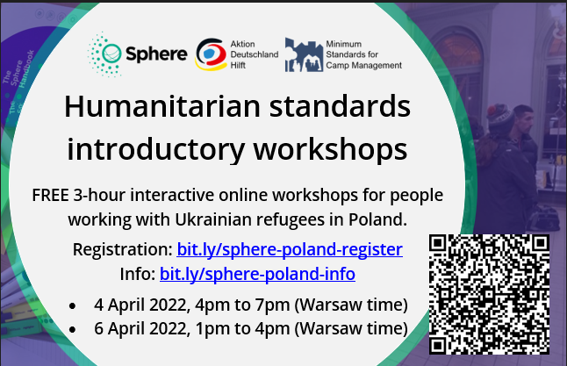
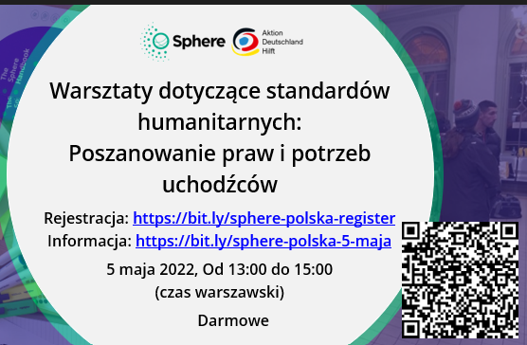
April 2022: Baby steps...

Slide 4
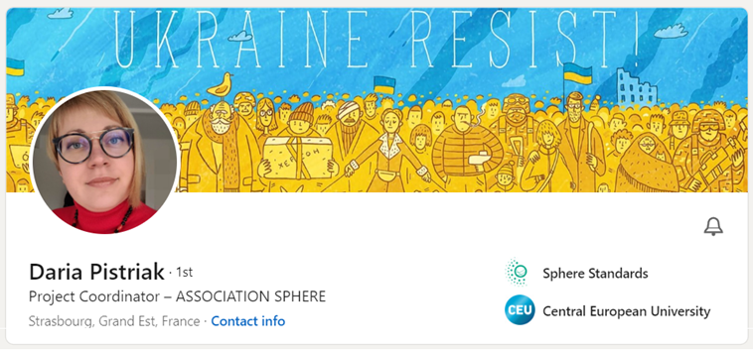
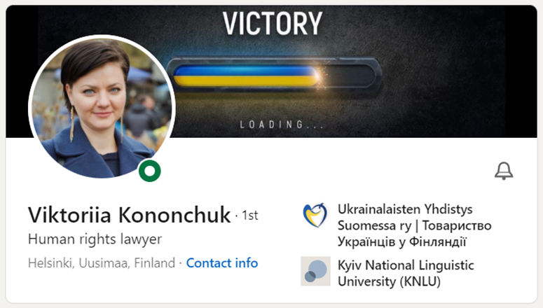
Ukrainian Coordinators x 2

Slide 5
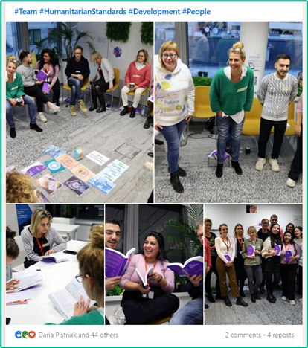
Sphere workshops x 18

Slide 6
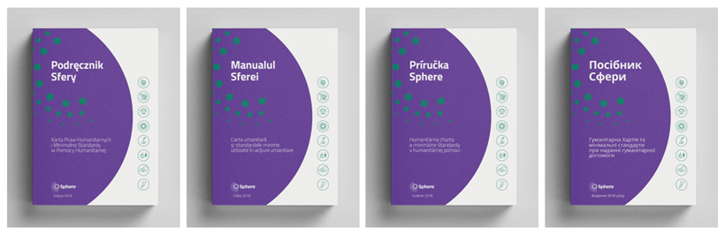
Sphere handbook translations x 4
“Why did nobody give us Sphere handbooks a year ago when we needed them?”
Polish Shelter organiser in Warsaw, Sphere workshop February 2023
“

Slide 7
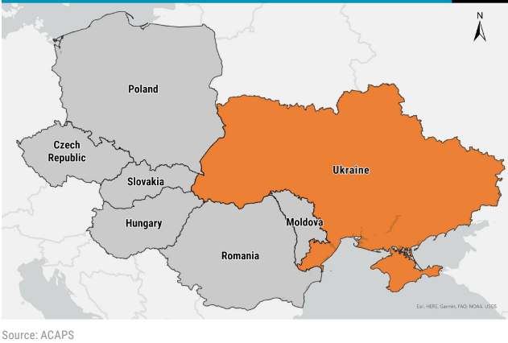




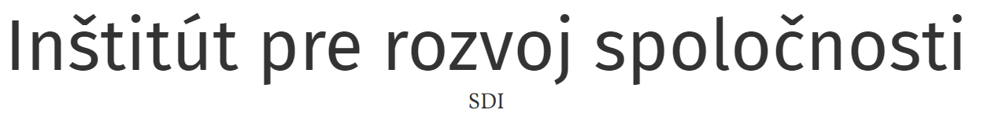


Sphere Focal Points x 5 new countries

Slide 8

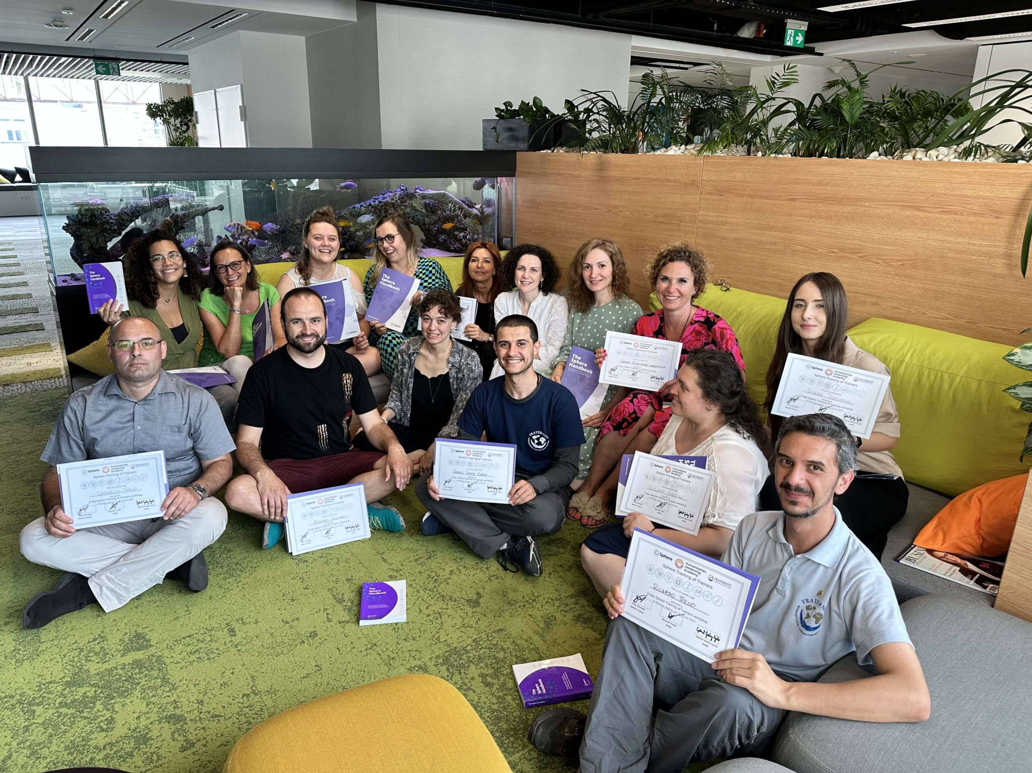
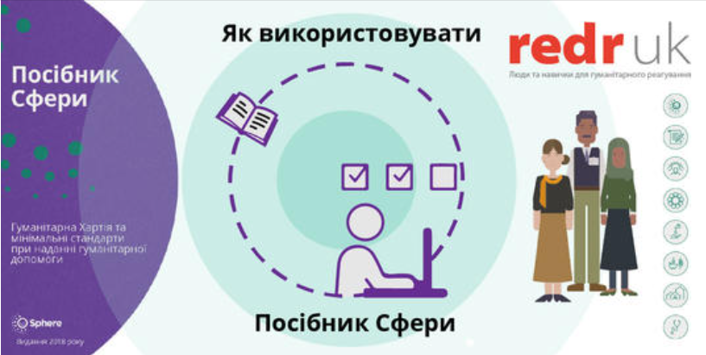
As well as some surprise successes!

Slide 9

As well as some surprise successes!

Slide 10
Ukraine project
Award from DEC (UK Disasters Emergency Committee)
July 2022 – June 2023 (11 months)
Recruited displaced Ukrainians to coordinate
Handbook translations: Ukrainian, Polish, Slovak, Romanian
In-person workshops: Poland, Slovak Republic, Romania, Moldova
1h e-learning with RedR UK and online facilitated workshops: Ukraine
Focal points: Appointed in Moldova, Poland, Slovak Republic, Ukraine Application pending from Romania
Training of Trainers (ToT) held in Warsaw in June 2023

