Slide 1
Introduction to Sphere
Van Hall Larenstein University, Holland
6 March 2023

Slide 2
Agenda
Introductions
Deep dive into Sphere Handbook
Deep dive into a Technical Standard
Using Indicators
Q&A

Slide 3
By the end of this session you will be able to:
Explain the history and philosophy of Sphere
Use the Sphere Handbook to deliver people-centred and accountable humanitarian assistance

Slide 4
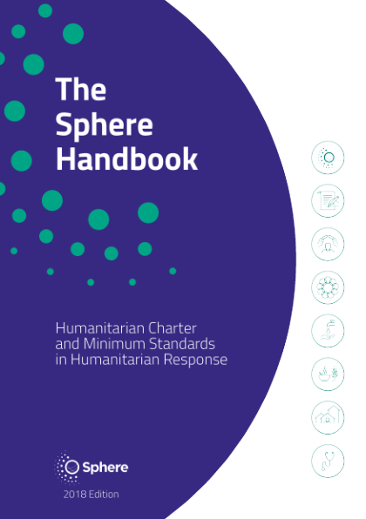
The Sphere Handbook
Notes:
Ask the students to raise their hand if they a) have heard of Sphere b) have read any of the Sphere Handbook c) have ever used the Sphere Handbook
Ask the students what they think Sphere is.

Slide 5
The Sphere movement
Started in 1997 by NGOs and the International Red Cross and Red Crescent Movement.
Developed a Humanitarian Charter and humanitarian standards to be applied in humanitarian response.
The Sphere Handbook is a primary reference tool for national and international NGOs, volunteers, UN agencies, governments and donors.
Sphere is a worldwide community working to improve the quality and accountability of humanitarian assistance.
Notes:
This is just a quick background to explain the origins of Sphere and its status in the humanitarian community today.

Slide 6
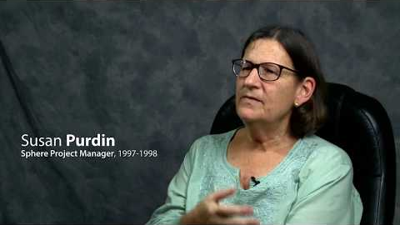
How it all began…
Notes:
Play the short video clip. Ask participants to listen closely for the discussion of why the Sphere Project was started.
Stop the video at 1m34s. Click “cc” in the video to view subtitles.

Slide 7
The Sphere philosophy
The Sphere philosophy is based on two core beliefs:
1. People affected by disaster or conflict have the right to life with dignity and, therefore, the right to assistance.
2. All possible steps should be taken to alleviate human suffering arising out of disaster or conflict.
Notes:
If you used STP session 1 then this is a reminder and a revisit.
Ask participants for their definition of dignity. If there isn’t clarity on this, call for examples (in lieu of a definition) of programmes where dignity was preserved, or where it was diminished in humanitarian response.
Note that most dictionary definitions include language such as “the state or quality of being worthy of honour or respect” or “a sense of pride in oneself; self-respect”. This can be quite nuanced. In one sense dignity is self-defined – humanitarians can neither bestow it nor remove it, however we endeavour to treat people with honour and respect.
If the participants do not have adequate examples to share, these could be offered:
Providing shelter from the sun and distributing water to beneficiaries while they are waiting in line to receive hygiene kits
Providing people cash to buy the food they prefer (and decide to buy) instead of providing in-kind dried rations
At a registration centre, providing child-friendly spaces so their time and interests are respected

Slide 8
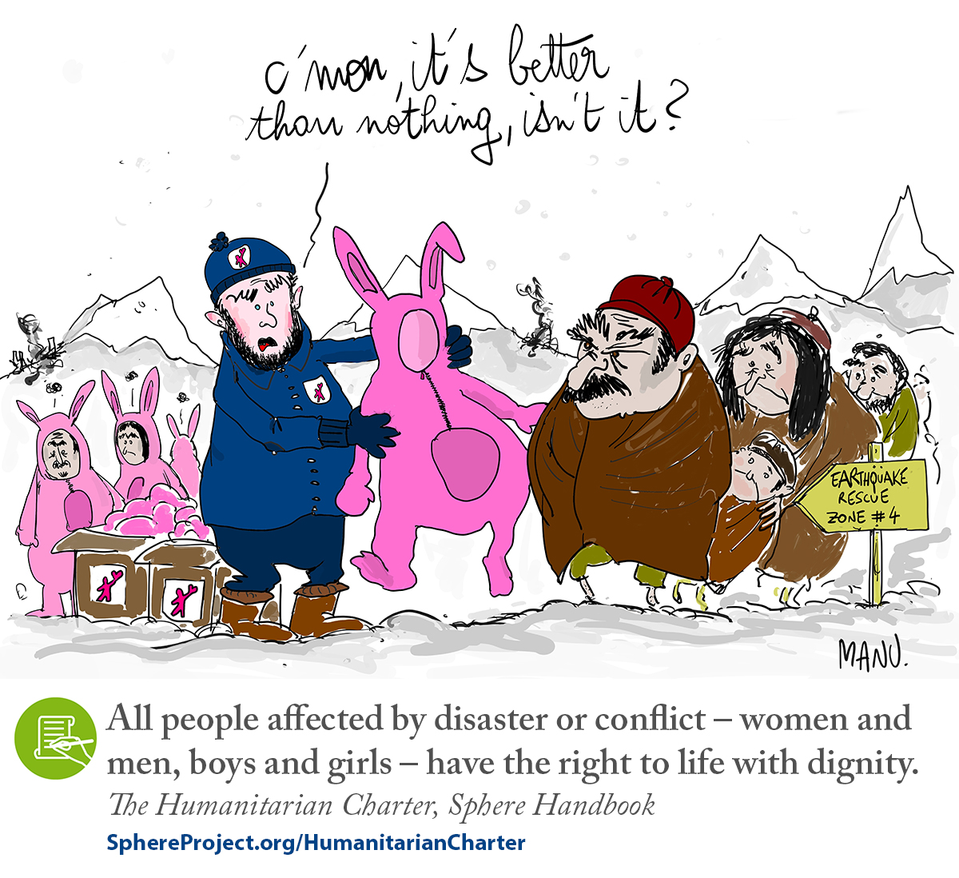

Slide 9
What is in the Handbook?
The Handbook is Sphere’s flagship publication. It includes the Humanitarian Charter, the Protection Principles, the Core Humanitarian Standard, and Minimum Standards in four vital areas of response:
Water supply, sanitation and hygiene promotion (WASH)
Food security and nutrition
Shelter and settlement
Health
Notes:
These beliefs led to the Sphere Project and ultimately to the Sphere Handbook, which has evolved to its current form and wide acceptance.

Slide 10
Deep dive into the Sphere Handbook
You are working on a new transit camp for refugees. You are asked for advice on the following issues:
Organising the living space in the shelter
Promoting good hygiene practices in the shelter
Protecting the shelter’s most vulnerable residents
Ensuring residents can participate in decisions that affect them, and give feedback
Find 10 references in the Sphere Handbook that will help you find the answers.
You have 20 minutes.
Notes:
This is just a quick background to explain the origins of Sphere and its status in the humanitarian community today.

Slide 11
4 ways to access the Handbook
As a printed book
As a PDF
https://www.spherestandards.org/handbook-2018/
Online via the Interactive Handbook
https://www.spherestandards.org/handbook-2018/
Via the HSP App on your phone
https://hspstandards.org/handbooks/#section-3

Slide 12

The Sphere Handbook – eight interdependent chapters
What is Sphere?
The Humanitarian Charter
Protection Principles
Core Humanitarian Standard
Water Supply, Sanitation and Hygiene Promotion (WASH)
Food Security and Nutrition
Shelter and Settlement
Health
FOUNDATION
CHAPTERS
TECHNICAL
CHAPTERS
Notes:
The key point of this slide is to highlight the fundamental point that informed use of Sphere means the use of all of Sphere – not just the four technical chapters if you are a field worker, and not just the foundation chapters if you are a protection officer.

Slide 13
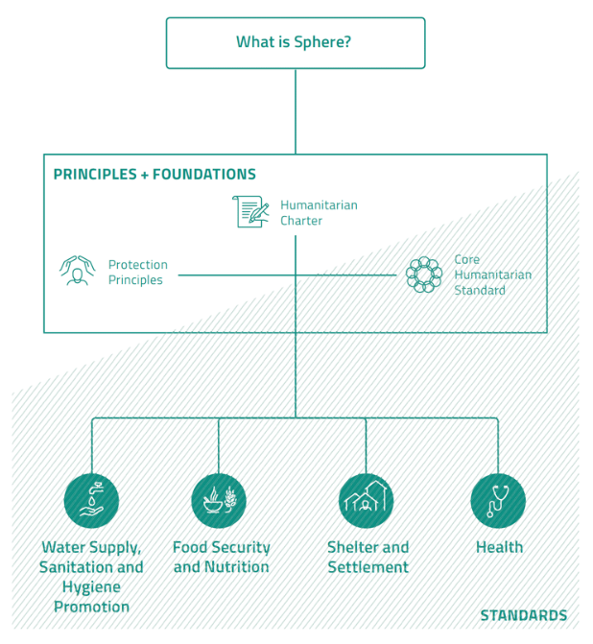
TECHNICAL
CHAPTERS
Notes:
The key point of this slide is to highlight the fundamental point that informed use of Sphere means the use of all of Sphere – not just the four technical chapters if you are a field worker, and not just the foundation chapters if you are a protection officer.

Slide 14

The Humanitarian Charter…
is the cornerstone of the Sphere approach;
recognises that people have a right to protection and assistance with dignity; and
provides the ethical and legal foundation for the Protection Principles, the Core Humanitarian Standard, and the Sphere Minimum Standards.
See pages 27–32
Notes:
Take a few moments for participants to locate this chapter in their Handbooks. Highlight the two core points underpinning the Sphere philosophy and approach – the right to assistance, and provision of that assistance with dignity.
Make a point that in one sense, the Charter answers the question of why we do humanitarian work. (What and how come next.)

Slide 15

Protection Principles
A practical translation of the Humanitarian Charter into four principles to guide humanitarian response:
Enhance people’s safety, dignity, and rights and avoid exposing them to further harm.
Ensure people’s access to impartial assistance, according to need and without discrimination.
Assist people to recover from the physical and psychological effects of …
Help people to claim their rights.
See pages 33–47
Notes:
Ask participants to locate this part of the Handbook. Ask them to quickly read the four principles, and relate these to the two fundamental philosophical points just discussed. They should see how these four principles flow from those two concepts by adding more detail. The two philosophical points about what people (affected people and people in general) should have are restated as four actions that humanitarians should take (enhance, ensure, assist, and help).
Make a point that the Protection Principles answer the question of what we are supposed to do (in broad terms). (How we go about this comes next.)

Slide 16

The Core Humanitarian Standard on Quality and Accountability (CHS)…
describes essential organisational responsibilities for quality and accountability in humanitarian response.
See pages 49–88
Notes:
Explain that as of the 2018 edition of the Handbook, the CHS is an integral part of the overall Sphere approach (replacing the earlier Sphere Core Standards).
Make a point that the CHS answers the question of how we conduct ourselves in humanitarian work (from a management perspective).
The technical “how” comes in the four technical chapters, though it should be noted that Sphere does not claim to be “a “how to” guide, but a description of what must be in place as a minimum for people to survive and recover from crisis with dignity (page 8). The key actions and guidance notes offer suggestions and advice, but it is up to practitioners to determine the best actions to take in the contexts in which they operate.

Slide 17
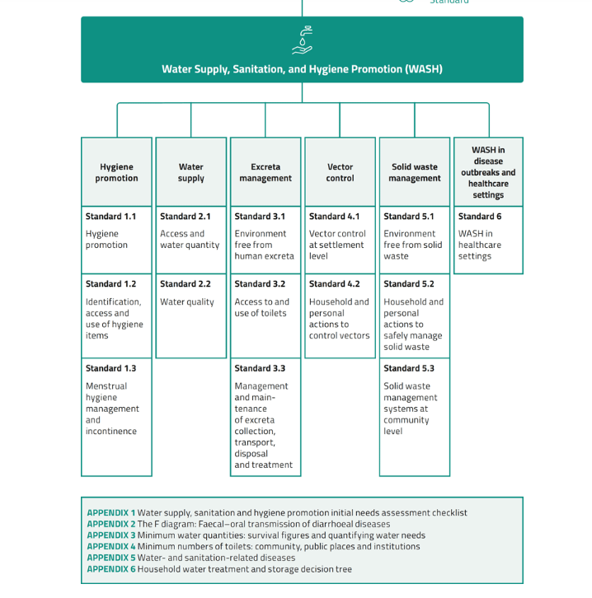

Deep dive into a Technical Chapter: WASH

Slide 18
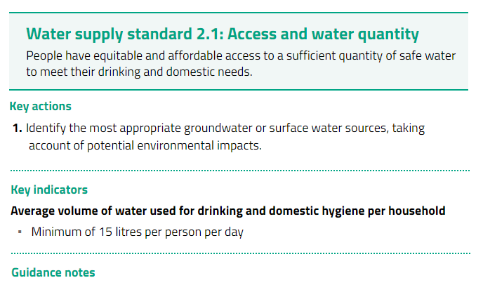
18

Slide 19
Guidance Notes to Water Supply Standard 2.1
…The quantity of water needed for drinking, hygiene and domestic use depends upon the context and phase of a response. It will be influenced by factors such as pre-crisis use and habits, excreta containment design and cultural habits
...A minimum of 15 litres per person per day is established practice. It is never a “maximum” and may not suit all contexts or phases of a response.
For example, it is not appropriate where people may be displaced for many years.
In the acute phase of a drought, 7.5 litres per person per day may be appropriate for a short time.
In an urban middle-income context, 50 litres per person per day may be the minimum acceptable amount to maintain health and dignity.

Slide 20
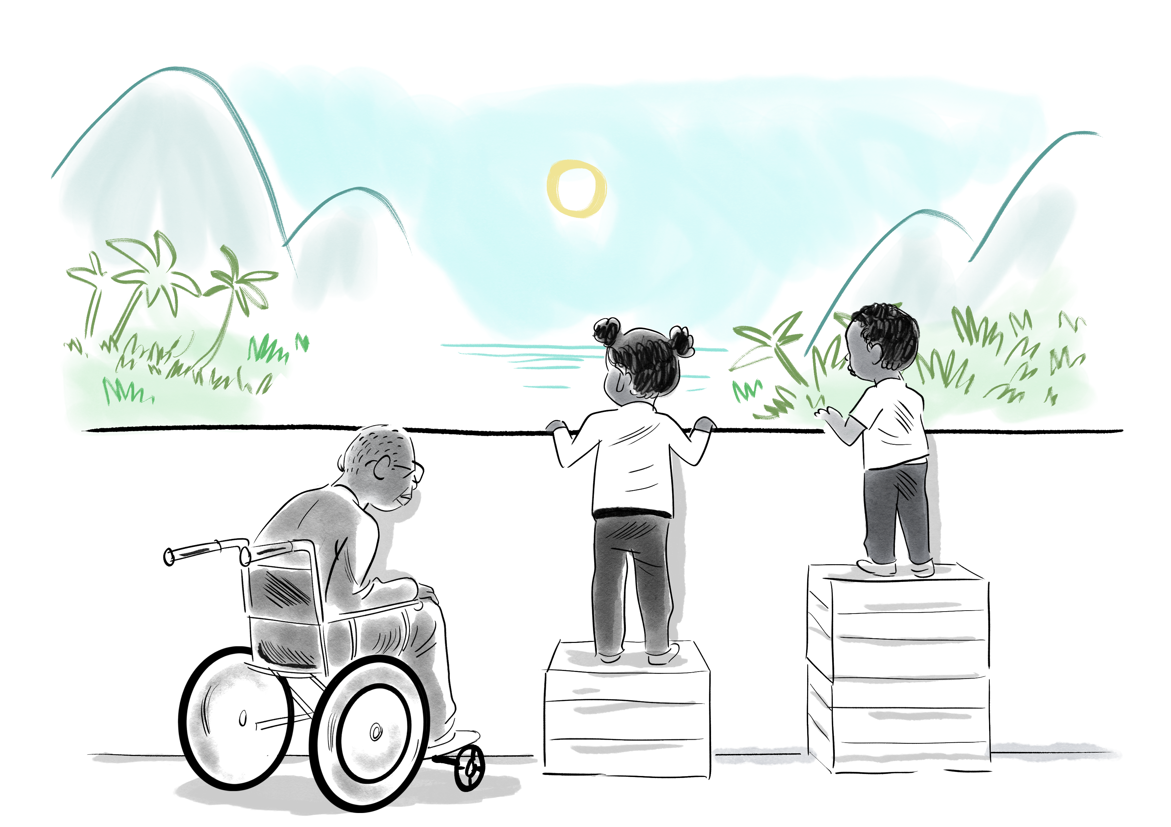
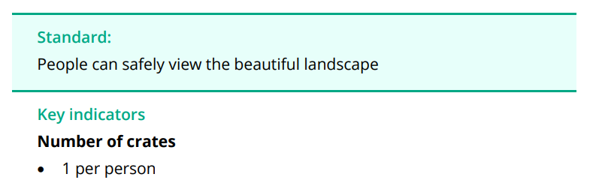
But do crates meet the needs of all our different users ?
Is the standard being met?
What is the indicator reading, i.e., the number of crates?
Is the indicator appropriate for the context?
What actions might you take to achieve the standard?
What is
happening?

Slide 21

But do crates meet the needs of all our different users ?
Is the standard being met?
What is the indicator reading, i.e., the number of crates?
Is the indicator appropriate for the context?
What actions might you take to achieve the standard?
What is
happening?

Slide 22

But do crates meet the needs of all our different users ?
Is the standard being met?
What is the indicator reading, i.e., the number of crates?
Is the indicator appropriate for the context?
What actions might you take to achieve the standard?
What is
happening?

Slide 23

But do crates meet the needs of all our different users ?
Is the standard being met?
What is the indicator reading, i.e., the number of crates?
Is the indicator appropriate for the context?
What actions might you take to achieve the standard?
What is
happening?

Slide 24

Standards v. indicators
Pursuing indicators rather than standards is to assume that everyone is born with equal needs, rather than equal rights, which is a potentially harmful error.
Always consider the context, including the needs, capacities and vulnerabilities of the people you are trying to assist.
People affected by crisis should participate actively at every stage of the response.

Slide 25


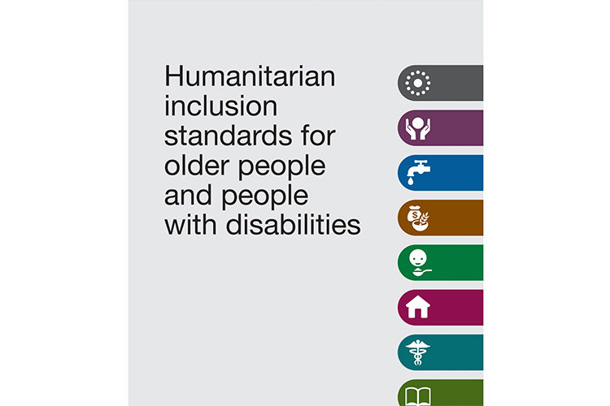
The Humanitarian Standards Partnership (HSP) is a network of 9 standard-setting initiatives and organisations – 8 Handbooks – 10+ sectors and themes .
25

Slide 26

Why have humanitarian standards?
Notes:
Please have a look at this citation and at this picture

Slide 27
So… why have humanitarian standards ?
Quality of assistance provided
Effectiveness: timely, relevant, agreed in advance
Professionalization of the sector
Accountability for resources and to people
Transparency
Predictability
Coordination
Assessment and evaluation
Advocacy
27

Slide 28
Key terms
“Accountability refers to the responsible use of power (resources, decision making) by humanitarian actors, combined with effective and quality programming that recognizes a community of concern's dignity, capacity, and ability to be independent.” UNHCR
Quality: A good quality humanitarian programme is one that is effective, efficient and appropriate. Assessments are required to ensure initial appropriateness. Regular monitoring and evaluations are required to check the response is meeting its targets (effectiveness)
Dignity: the right of a person to be valued and respected for their own sake, and to be treated ethically.
Inclusion: Everyone affected by crisis must be given opportunities to participate actively. Seek out hidden voices. “Nothing about us without us”.

Slide 29
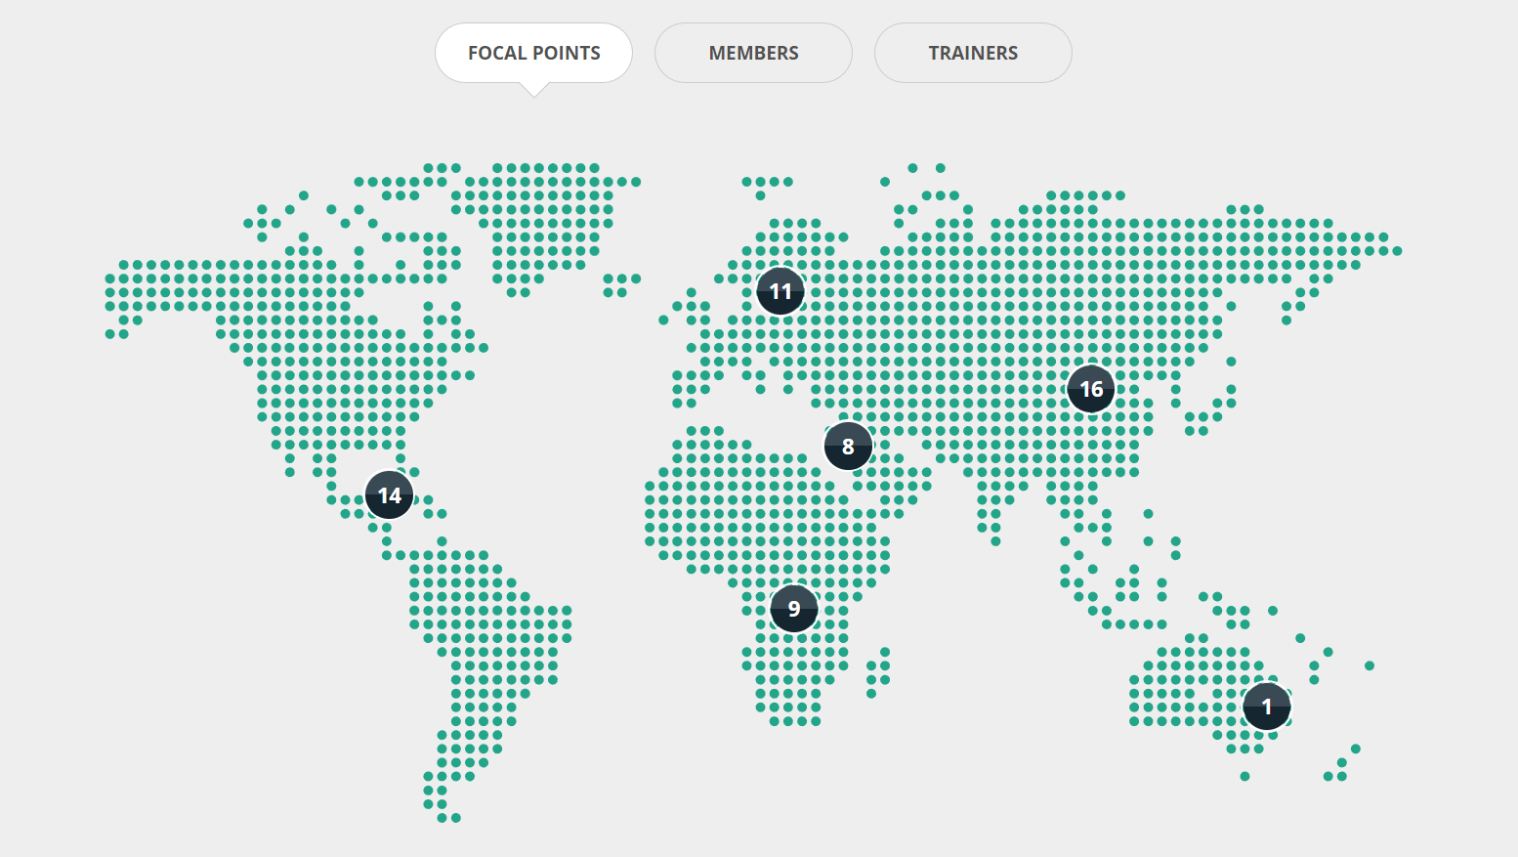

Slide 30
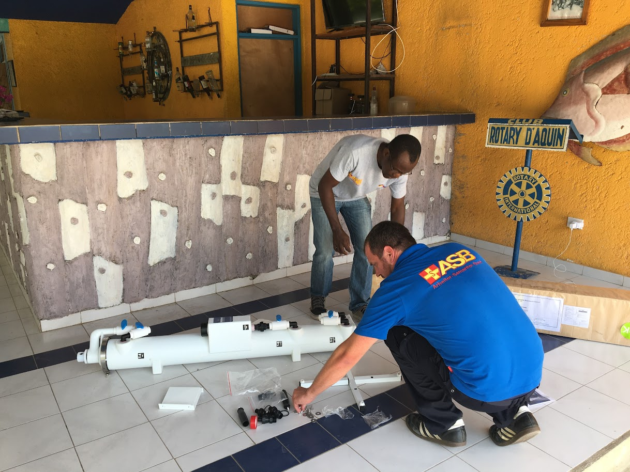
Notes:
ASB – focal point in Germany . Set up a water fil

Slide 31
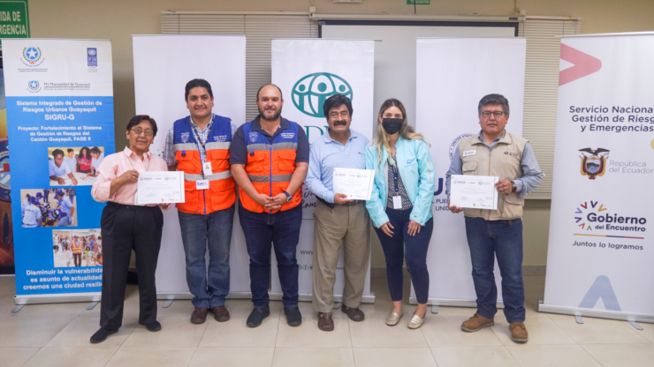
Notes:
Focal point in Bolivia created a Sphere training pack for working with National Disaster Management Agencies

Slide 32
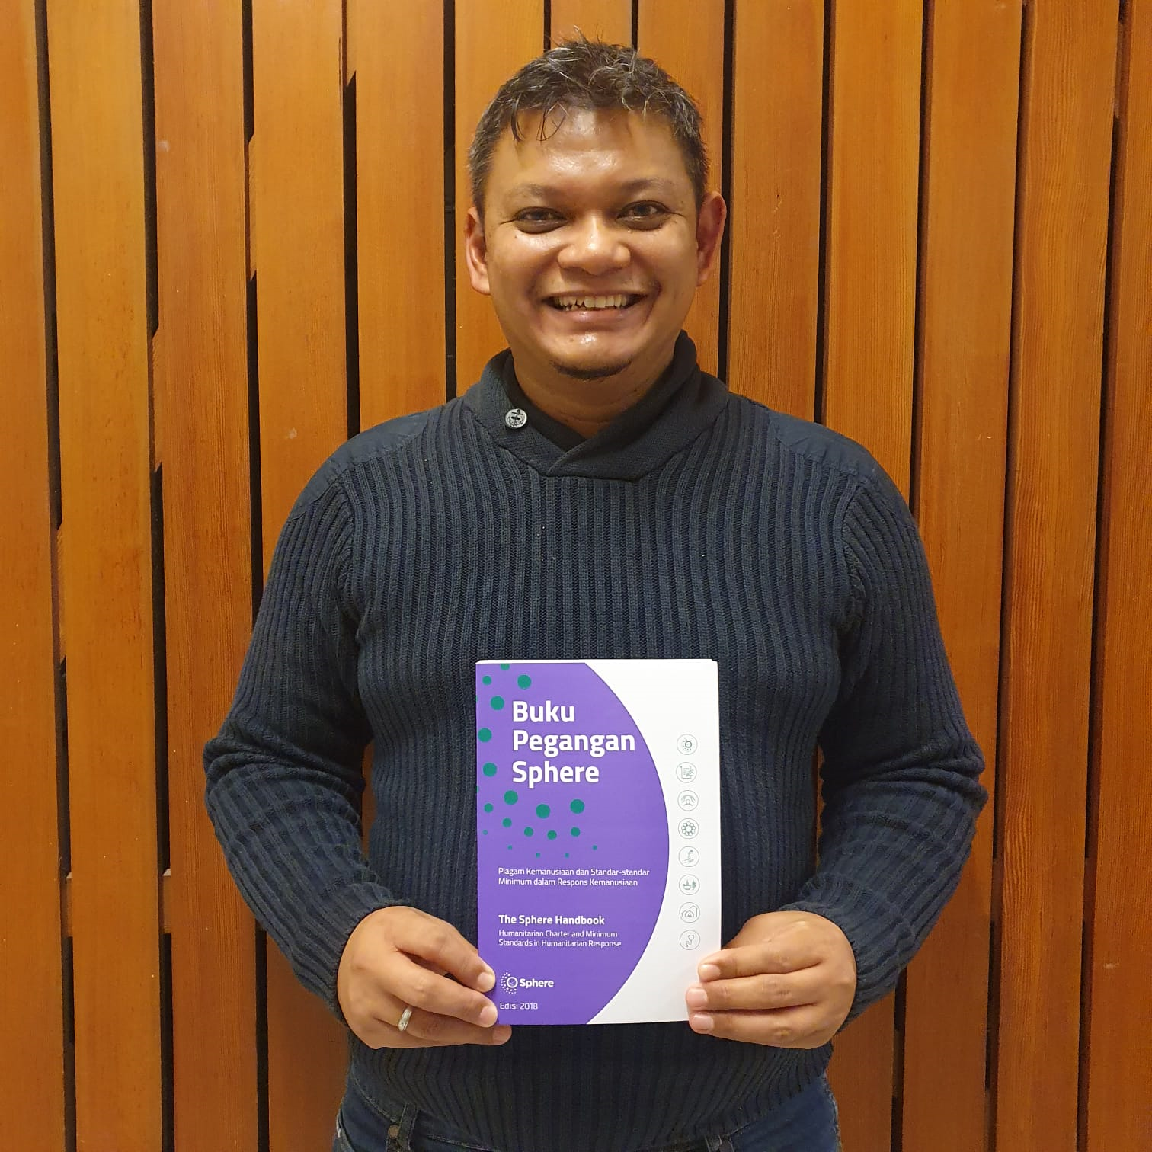
Notes:
MBPI (Indonesian society for Disaster Management) translated the handbook

Slide 33
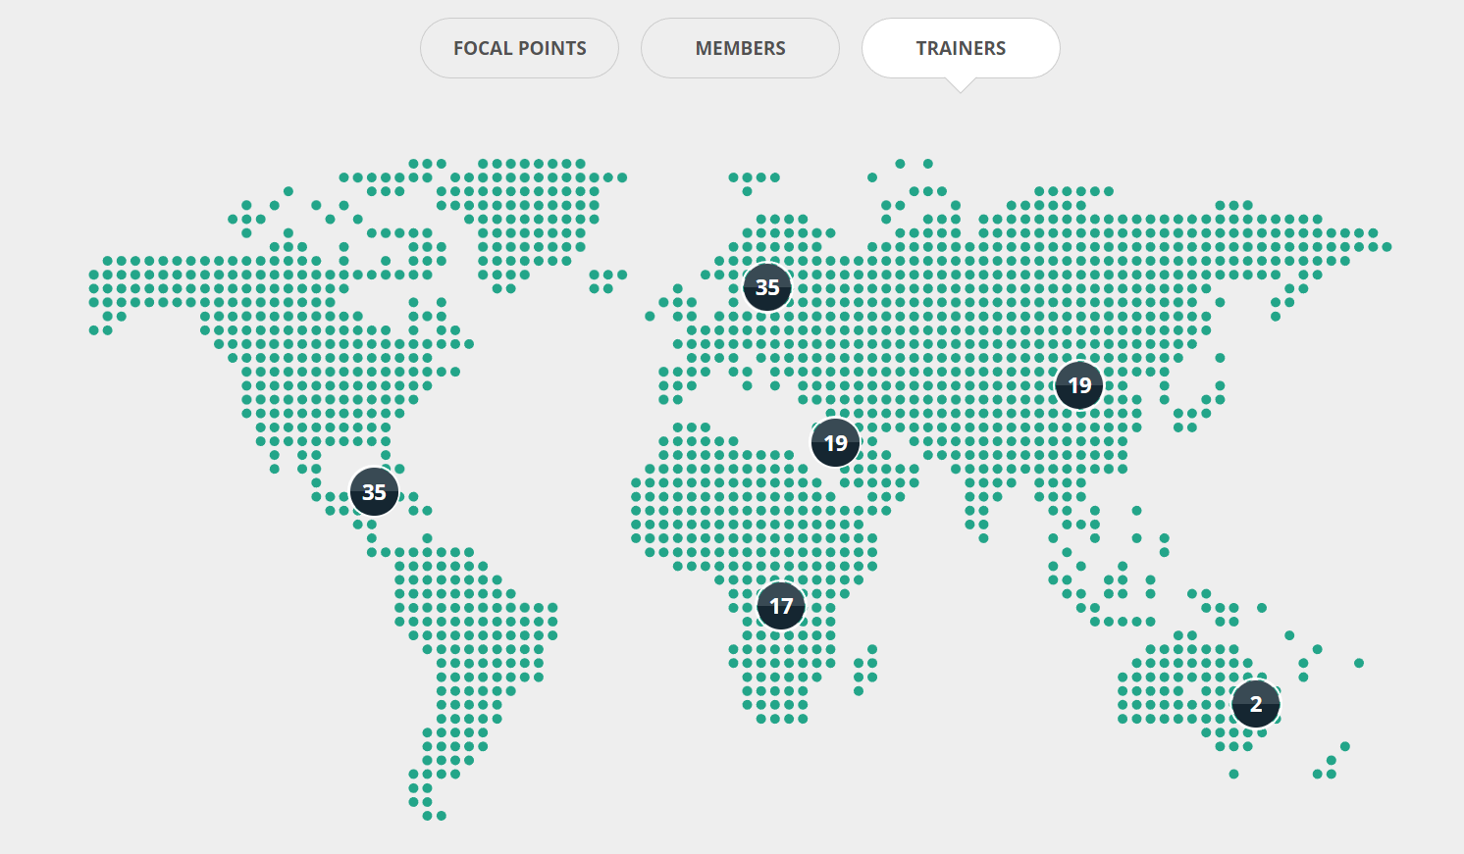

Slide 34
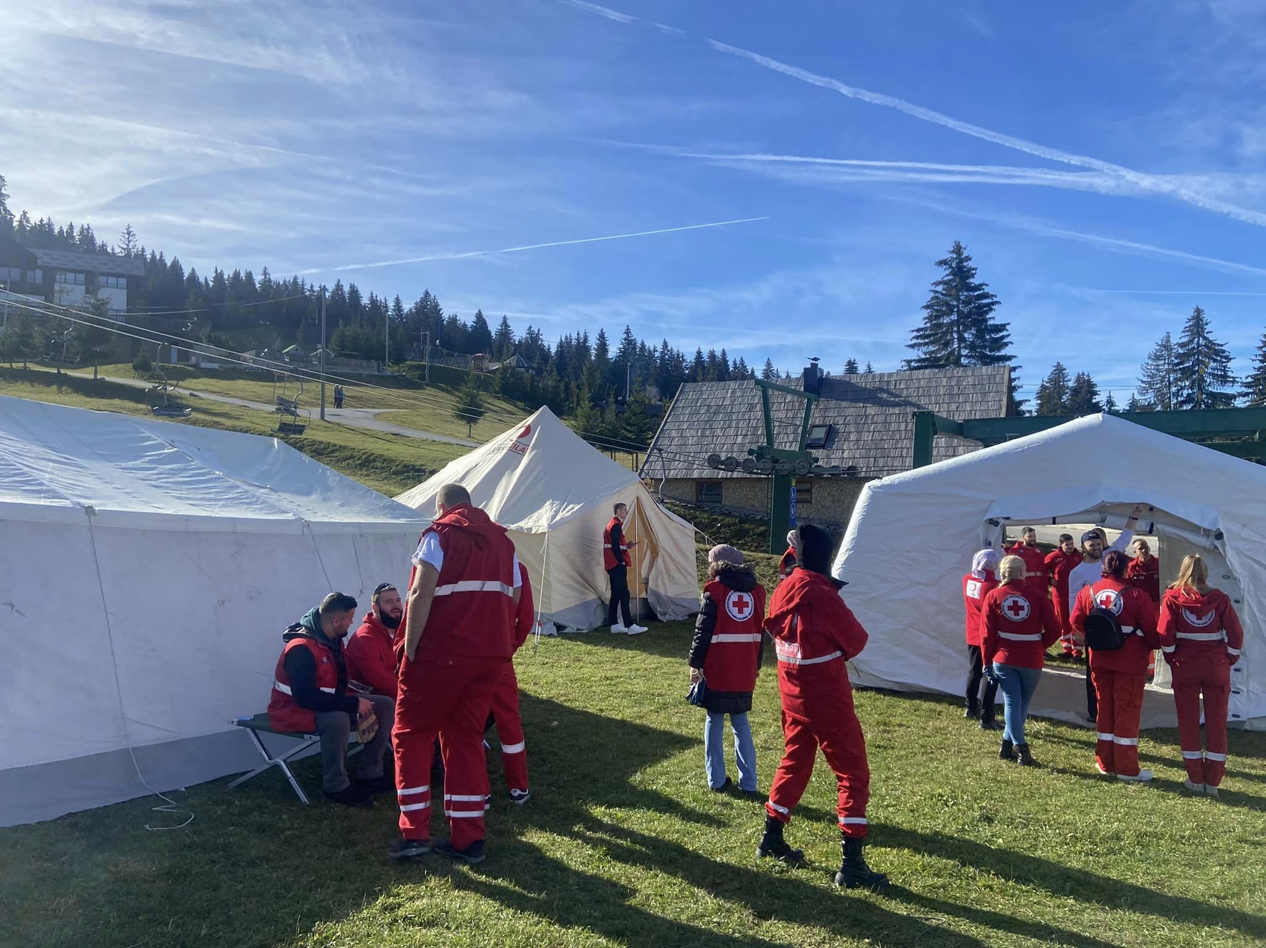

Slide 35
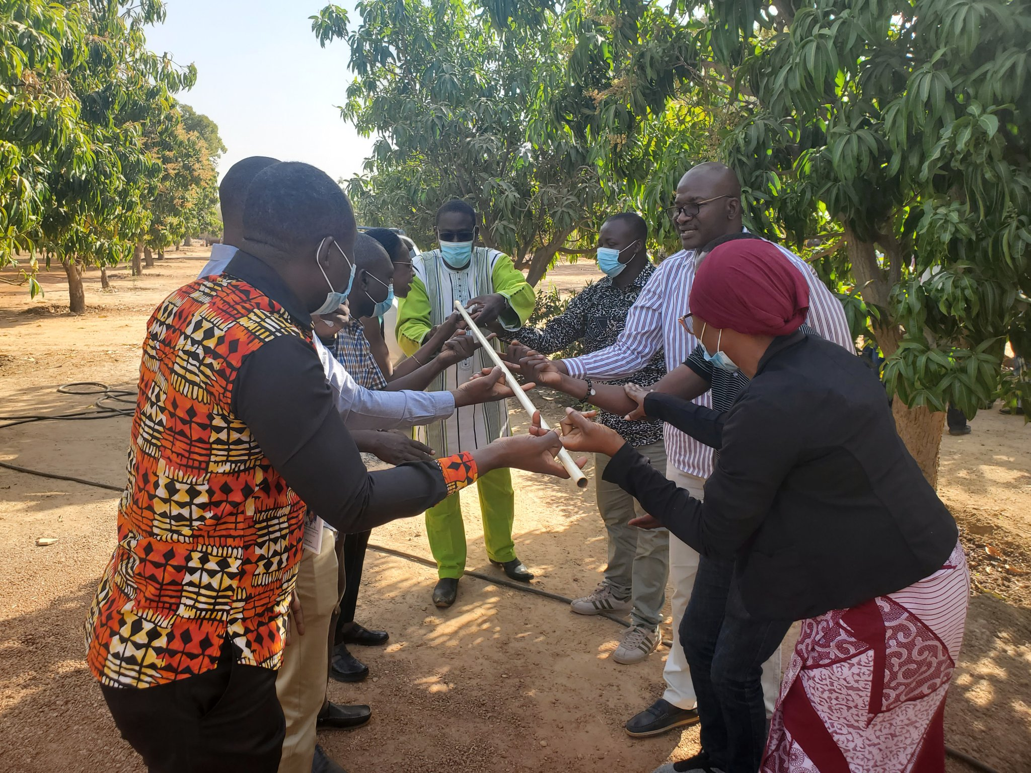

Slide 36
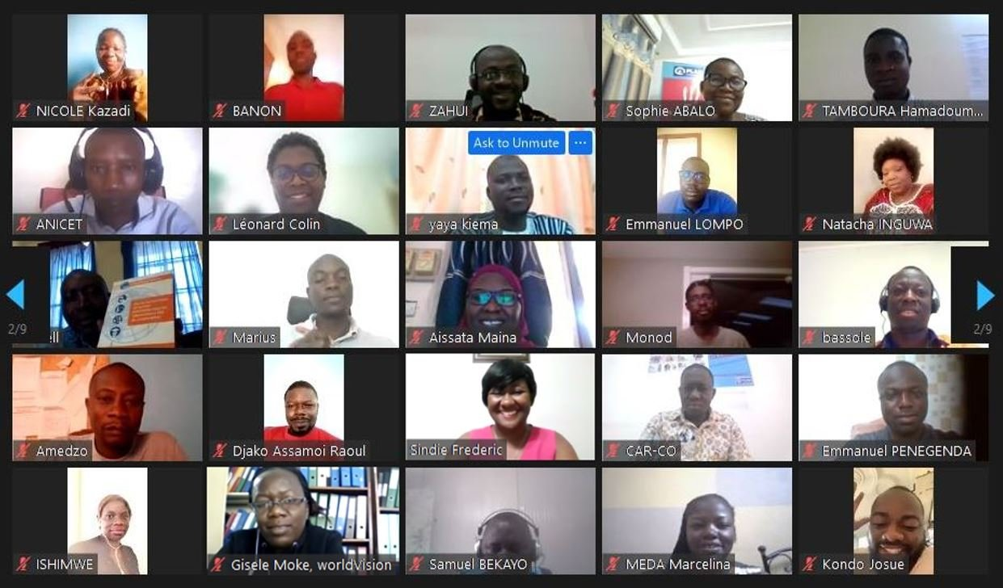

Slide 37
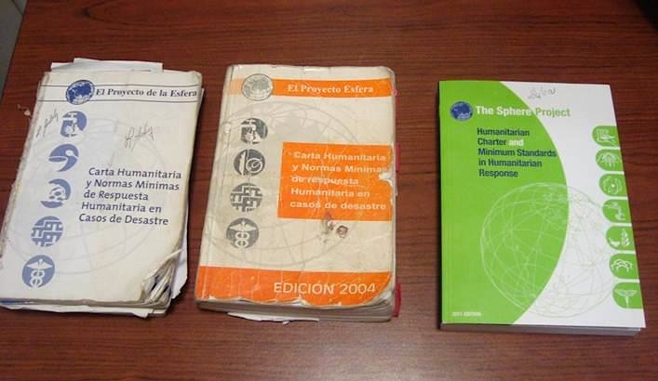
Photo: © Lourdes Ardon
Notes:
37
37
Sphere established in 1997
First “beta” version of handbook published in 1998: ring binder. Tested
Reviewed and strengthened: Edition 1 issued in 2000
Edition 2: 2004
Edition 3: 2011
Important evolution… What was new in 2011
Protection principles
Shift from disaster response to humanitarian response
Humanitarian Charter revised
he Handbook enjoys broad acceptance by the humanitarian sector as a whole.
Photo from Honduras
It is available in 24 additional language versions.
19 of them were developed on the initiative of the humanitarian community, which shows the acceptance of the tool.
Established 1997 by and for practitioners
Standards first published 1998 (2000, 2004, 2011), quickly became the most widely used humanitarian reference document
‘One-stop shop’ for the principles, rights, duties and good practice that guide a high quality and accountable humanitarian response
A common language and reference point used broadly: governments, donors, UN, Red Cross/Red Crescent movement, international and national NGOs, volunteers, others)
37

