Slide 1
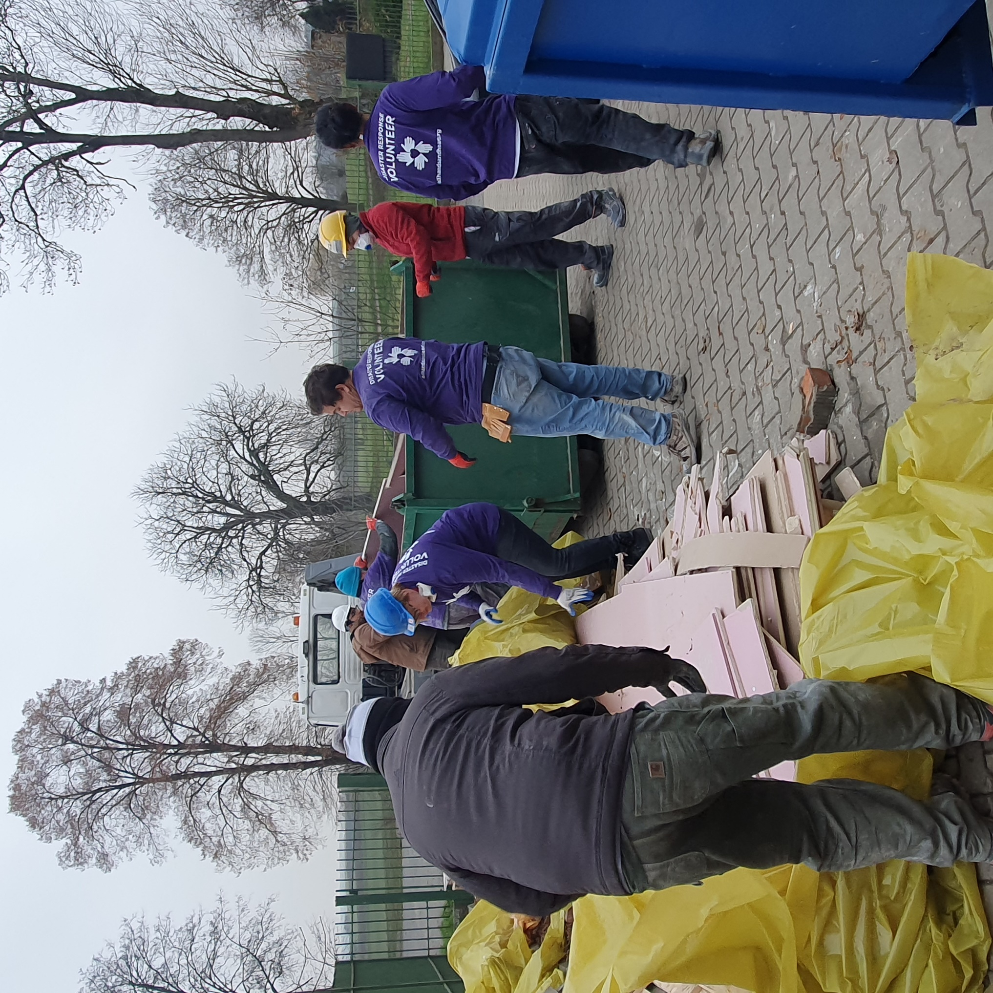
All Hands and Hearts training,
Poland,
3 December 2022
Notes:
This session is only used if you are conducting a multi-day training event. Considerable time is devoted to getting to know the participants and establishing their own backgrounds, familiarity with Sphere and their own learning objectives. It should take about 90 minutes for a group of 20–30 participants. Larger or smaller groups will affect the overall timing, as it takes twice as long to introduce 30 people as it does 15.
In preparation for the introduction exercise, mark a spot in the centre of the training room with a large X in tape on the floor. You can also mark the spot with a jerry can, a small “tent” folded from A4 paper, or other object to represent people needing emergency assistance. If there are specific locally recognised elements to represent “the field” in your region then try to find and use those.
It is a good idea to prepare a flipchart or paper on the wall or whiteboard as a “Parking Lot” for issues or questions which may arise that are better addressed in later sessions, or for which there is no time in the current session. Make a habit of keeping this up for all sessions and be careful to monitor it and address all issues that are “parked” before the end of the workshop.

Slide 2

Timetable
Introductions and warm-up
Break
Deep dive into Sphere Handbook
Break
Deep dive into Technical Standards
Break
Contextualising Indicators
Quiz

Slide 3
By the end of this session you will be able to:
Explain the philosophy of Sphere
Use the Sphere Handbook to deliver people-centred and accountable humanitarian assistance

Slide 4

Ground rules
Phones set to “silent” (please take emergency calls outside)
Laptops closed
Ears and minds set to “open”
Chatham House Rules apply (what is said in the training room stays in the training room – so speak your mind)
Let the facilitator know if anything is too fast, unclear, or if there are too many acronyms

Slide 5
Introductions
Who are we, and where are we in relation to people who need humanitarian assistance?
Instructions:
Stand up
Walk to the location of your day-to-day life relative to people needing humanitarian assistance

Slide 6

Place yourself in the room based on how close you are to those in need
Academic
Field worker or community member – daily direct contact
Manager at district level
National level
International offices or HQ
Just interested, but not involved
Notes:
The idea is that participants move to their relative locations closer or nearer to people in need. If you have a handy prop to represent the field (jerry can, cooking set, flipchart with drawing of a family sheltering in a tent, etc.) use it to mark the “centre” of the exercise. Participants will have to talk among themselves to accomplish the task. It should work in any size or shape room. In very large rooms you many need to ask some participants to come back closer to the centre to be able to hear their introductions. This discussion and movement phase will take no more than 5 minutes.
Three considerations for conducting this exercise:
Do it quickly – it may be uncomfortable for some people to stay on their feet for long periods of time. This is best accomplished by setting the example for very quick introductions without long explanations. Accommodate people with difficulties standing by offering chairs if needed.
Do it in a fun and upbeat way. The idea isn’t to create a hierarchy between people who are more experienced, and those without experience, but rather to be clear about our role as learners and to best understand participants’ likely ability to relate to field examples and to share their own. For people with little experience or who feel far from direct contact in the field, acknowledge their roles in the humanitarian system and what their learning needs might be. For those who feel close to the field and direct contact, explore their possible need to gain perspective and distance to better understand their day-to-day experiences. Everyone should finish this exercise feeling comfortable about their own learning needs, perspectives, and opportunities for contributing to the discussion.
For some audiences where the expectation is that no-one in the group has close contact with the field, or where no-one is expected to have had any exposure to Sphere previously, it may be better to use the “Treasure Hunt” introduction option described in the notes of the previous slide.

Slide 7
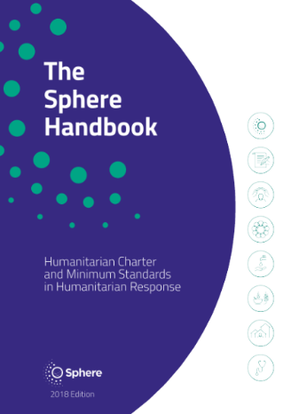
Move again: How close are you to Sphere?
I use it almost every day
I occasionally use it
I’ve heard of it but never really looked at it
It’s completely new to me
Notes:
After the introductions are finished, ask participants to make one more move before returning to their seats.
Replace the mark or item used to represent the people in need of humanitarian assistance with a copy of the Sphere Handbook. Now ask them to relocate themselves in the room based on their existing familiarity with, and use of, the Sphere Handbook.

Slide 8
The Sphere movement
Started in 1997 by NGOs and the International Red Cross and Red Crescent Movement.
Developed a Humanitarian Charter and humanitarian standards to be applied in humanitarian response.
The Sphere Handbook is a primary reference tool for national and international NGOs, volunteers, UN agencies, governments and donors.
Sphere is a worldwide community working to improve the quality and accountability of humanitarian assistance.
Notes:
This is just a quick background to explain the origins of Sphere and its status in the humanitarian community today.

Slide 9

How it all began…
Notes:
Play the short video clip. Ask participants to listen closely for the discussion of why the Sphere Project was started.
Stop the video at 1m34s. Click “cc” in the video to view subtitles.

Slide 10
The Sphere philosophy
The Sphere philosophy is based on two core beliefs:
1. People affected by disaster or conflict have the right to life with dignity and, therefore, the right to assistance.
2. All possible steps should be taken to alleviate human suffering arising out of disaster or conflict.
Notes:
If you used STP session 1 then this is a reminder and a revisit.
Ask participants for their definition of dignity. If there isn’t clarity on this, call for examples (in lieu of a definition) of programmes where dignity was preserved, or where it was diminished in humanitarian response.
Note that most dictionary definitions include language such as “the state or quality of being worthy of honour or respect” or “a sense of pride in oneself; self-respect”. This can be quite nuanced. In one sense dignity is self-defined – humanitarians can neither bestow it nor remove it, however we endeavour to treat people with honour and respect.
If the participants do not have adequate examples to share, these could be offered:
Providing shelter from the sun and distributing water to beneficiaries while they are waiting in line to receive hygiene kits
Providing people cash to buy the food they prefer (and decide to buy) instead of providing in-kind dried rations
At a registration centre, providing child-friendly spaces so their time and interests are respected

Slide 11

What is in the Handbook?
The Handbook is Sphere’s flagship publication. It includes the Humanitarian Charter, the Protection Principles, the Core Humanitarian Standard, and Minimum Standards in four vital areas of response:
Water supply, sanitation and hygiene promotion (WASH)
Food security and nutrition
Shelter and settlement
Health
Notes:
These beliefs led to the Sphere Project and ultimately to the Sphere Handbook, which has evolved to its current form and wide acceptance.

Slide 12
Deep dive into the Sphere Handbook
You are working on a new transit camp for refugees. You are asked for advice on the following issues:
Organising the living space in the shelter
Promoting good hygiene practices in the shelter
Protecting the shelter’s most vulnerable residents
Ensuring residents can participate in decisions that affect them, and give feedback
Find 10 references in the Sphere Handbook that will help you find the answers.
You have 20 minutes.
Notes:
This is just a quick background to explain the origins of Sphere and its status in the humanitarian community today.

Slide 13
4 ways to access the Handbook
As a printed book
As a PDF
https://www.spherestandards.org/handbook-2018/
Online via the Interactive Handbook
https://www.spherestandards.org/handbook-2018/
Via the HSP App on your phone
https://hspstandards.org/handbooks/#section-3

Slide 14

The Sphere Handbook – eight interdependent chapters
What is Sphere?
The Humanitarian Charter
Protection Principles
Core Humanitarian Standard
Water Supply, Sanitation and Hygiene Promotion (WASH)
Food Security and Nutrition
Shelter and Settlement
Health
FOUNDATION
CHAPTERS
TECHNICAL
CHAPTERS
Notes:
The key point of this slide is to highlight the fundamental point that informed use of Sphere means the use of all of Sphere – not just the four technical chapters if you are a field worker, and not just the foundation chapters if you are a protection officer.

Slide 15
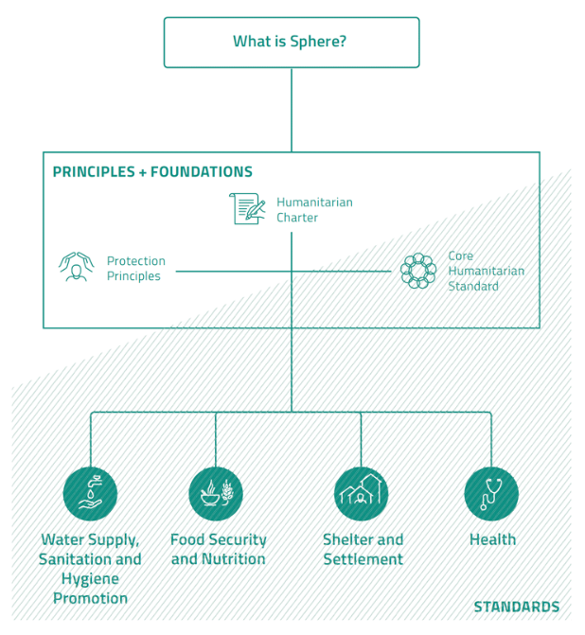
A holistic approach
Why? The Humanitarian Charter establishes the ethical and legal framework for humanitarian action, applying humanitarian principles, and draws on the RC/RC/NGO Code of Conduct
How? Protection principles translate the legal framework into strategies and actions so that assistance and protection are equal pillars in any response
Core Humanitarian Standard provides the framework for organizational responsibilities and fundamental accountability
What? Minimum standards in four key sectors give quantitative and qualitative indicators, actions, and guidance based on evidence and expert practice.

Slide 16

The Humanitarian Charter…
is the cornerstone of the Sphere approach;
recognises that people have a right to protection and assistance with dignity; and
provides the ethical and legal foundation for the Protection Principles, the Core Humanitarian Standard, and the Sphere Minimum Standards.
See pages 27–32
Notes:
Take a few moments for participants to locate this chapter in their Handbooks. Highlight the two core points underpinning the Sphere philosophy and approach – the right to assistance, and provision of that assistance with dignity.
Make a point that in one sense, the Charter answers the question of why we do humanitarian work. (What and how come next.)

Slide 17

Protection Principles
A practical translation of the Humanitarian Charter into four principles to guide humanitarian response:
Enhance people’s safety, dignity, and rights and avoid exposing them to further harm.
Ensure people’s access to impartial assistance, according to need and without discrimination.
Assist people to recover from the physical and psychological effects of …
Help people to claim their rights.
See pages 33–47
Notes:
Ask participants to locate this part of the Handbook. Ask them to quickly read the four principles, and relate these to the two fundamental philosophical points just discussed. They should see how these four principles flow from those two concepts by adding more detail. The two philosophical points about what people (affected people and people in general) should have are restated as four actions that humanitarians should take (enhance, ensure, assist, and help).
Make a point that the Protection Principles answer the question of what we are supposed to do (in broad terms). (How we go about this comes next.)

Slide 18

The Core Humanitarian Standard on Quality and Accountability (CHS)…
describes essential organisational responsibilities for quality and accountability in humanitarian response.
See pages 49–88
Notes:
Explain that as of the 2018 edition of the Handbook, the CHS is an integral part of the overall Sphere approach (replacing the earlier Sphere Core Standards).
Make a point that the CHS answers the question of how we conduct ourselves in humanitarian work (from a management perspective).
The technical “how” comes in the four technical chapters, though it should be noted that Sphere does not claim to be “a “how to” guide, but a description of what must be in place as a minimum for people to survive and recover from crisis with dignity (page 8). The key actions and guidance notes offer suggestions and advice, but it is up to practitioners to determine the best actions to take in the contexts in which they operate.

Slide 19
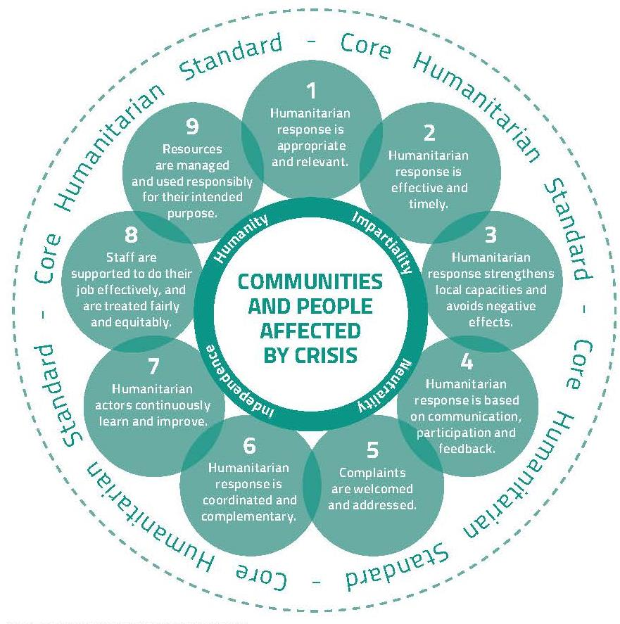
See page 50
Notes:
Ask participants to review the nine commitments of the CHS. Challenge them to explain the difference in approach/focus between these nine commitments and the four Protection Principles just discussed. Responses should lead to the observation that the nine commitments of the CHS are a further expansion of the same thinking, approach, and goals – but with more detail and a focus on specific organisational responsibilities for achieving them.
If you will use the STP session 6 (CHS) later in the course, then note that you’ll cover the CHS in more detail in a later session and move to the next slide. Otherwise, continue with the following discussion points:
To illustrate the point, ask participants to recall the two main tenets of the Sphere philosophy (the right to assistance, and assistance with dignity). Ask them which of these commitments would support the rights aspect, and which would support the dignity aspect. The result will be an overlapping set of (at least) the first five commitments.
Note that commitments 1 to 5 focus directly on accountabilities to affected communities, while commitments 6 to 9 include accountabilities to staff, other organisations and donors as well.

Slide 20
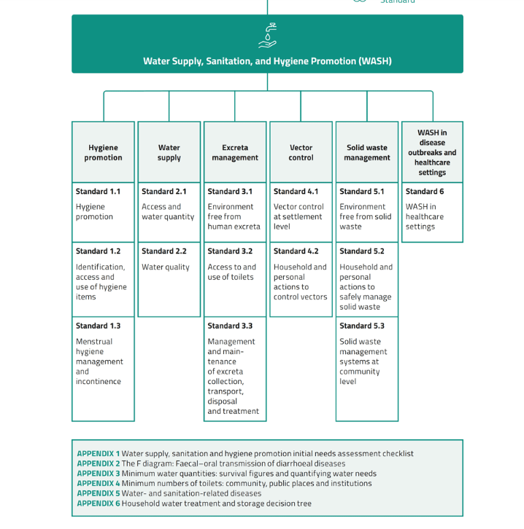

Deep dive into a Technical Chapter: WASH

Slide 21
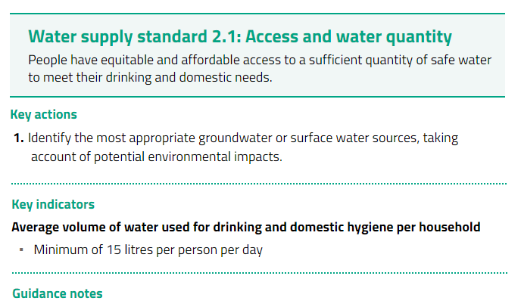
21

Slide 22
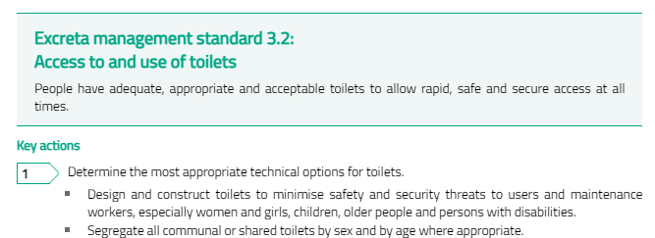

Slide 23
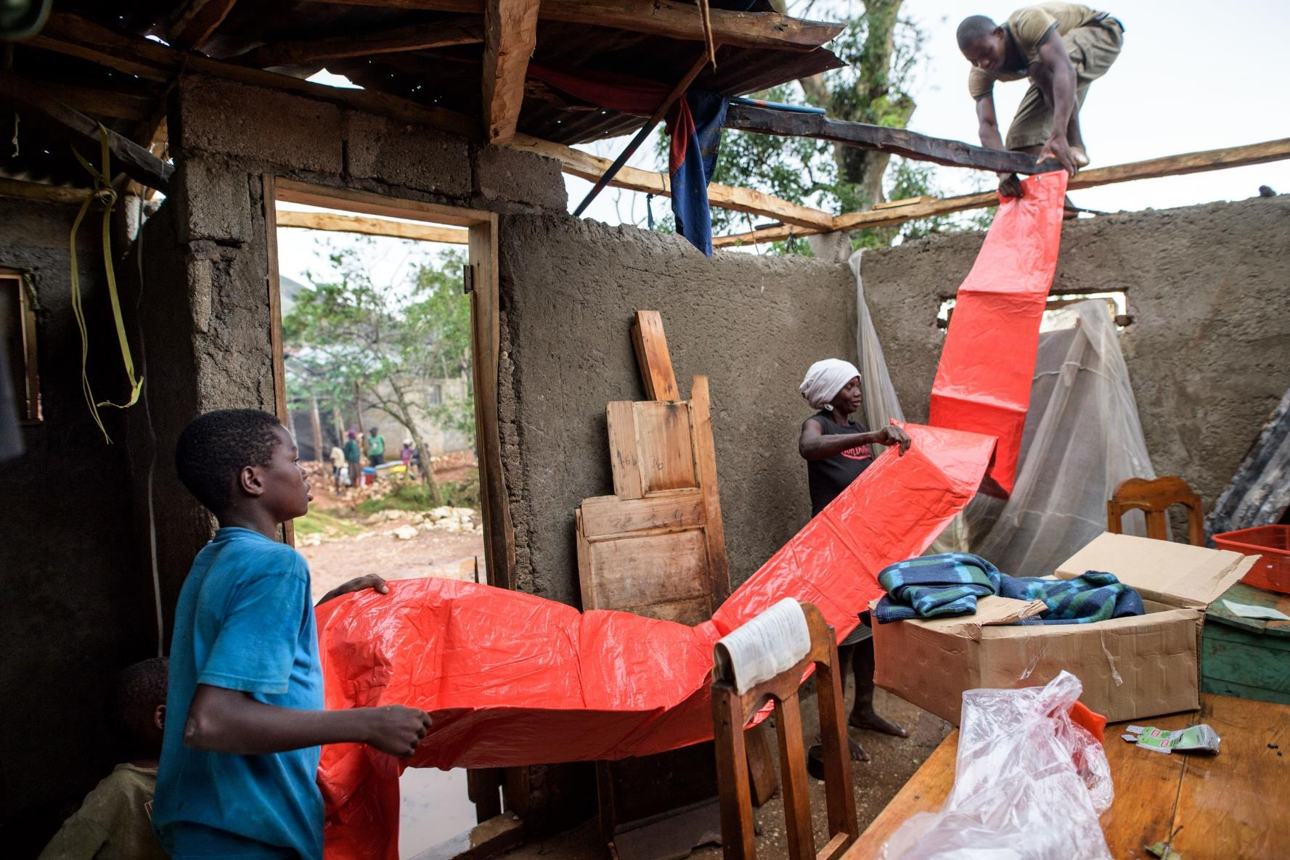
Key actions
Key actions outline practical steps to attain the Minimum Standard. These are suggestions and may not be applicable in all contexts. Users should select those most relevant to the situation.
Haiti, 2016. Lutheran World Services
Notes:
Review the text and ask participants to quickly find and cite one or two actions from the Shelter chapter to guide the activity shown in the photograph from Haiti (post-disaster home repair).
ALTERNATIVELY: If this is the first time that participants are required to search the Handbook for content related to a particular topic, this can be a daunting task. It may be better to work through this together then let participants search for themselves on the following three slides.
Step 1: Navigate to the chapter structure diagram at the start of the Shelter chapter (page 238).
Step 2: The task being undertaken is home repair following a disaster (Hurricane Matthew), so deduce that the most likely sections in which to find relevant key actions would be Living space or Technical assistance.
Step 3: Turn to page 254 to find the key actions for standard 3.
Step 4: Because the picture seems to show repairs being made to an existing shelter (rather than building a new shelter), the third key action seems to be the most relevant.
You could then ask participants to check standard 5 for relevant actions.
Possible answers: standard 3 – key actions 3, standard 5 – all key actions.

Slide 24
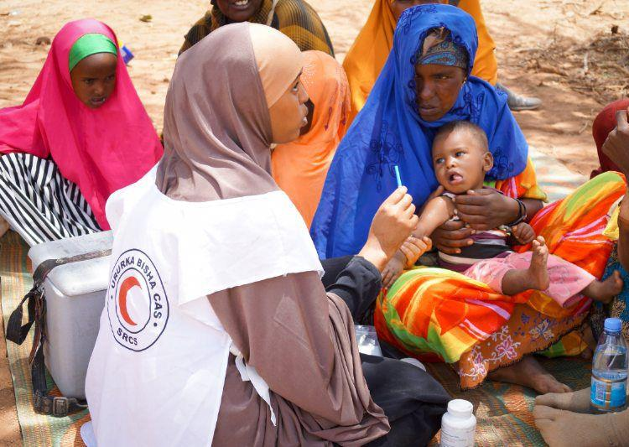
Key indicators
Key indicators serve as signals to indicate whether the standard they support is being attained.
Specific numbers (targets) are only included where there is sectoral consensus or scientific evidence.
IFRC/Alison Freebairn
24
Notes:
Review the text and ask participants to locate and cite an indicator from the health chapter that would be useful for monitoring this measles vaccination campaign.
Possible answer: standard 2.2.1 – first key indicator.

Slide 25
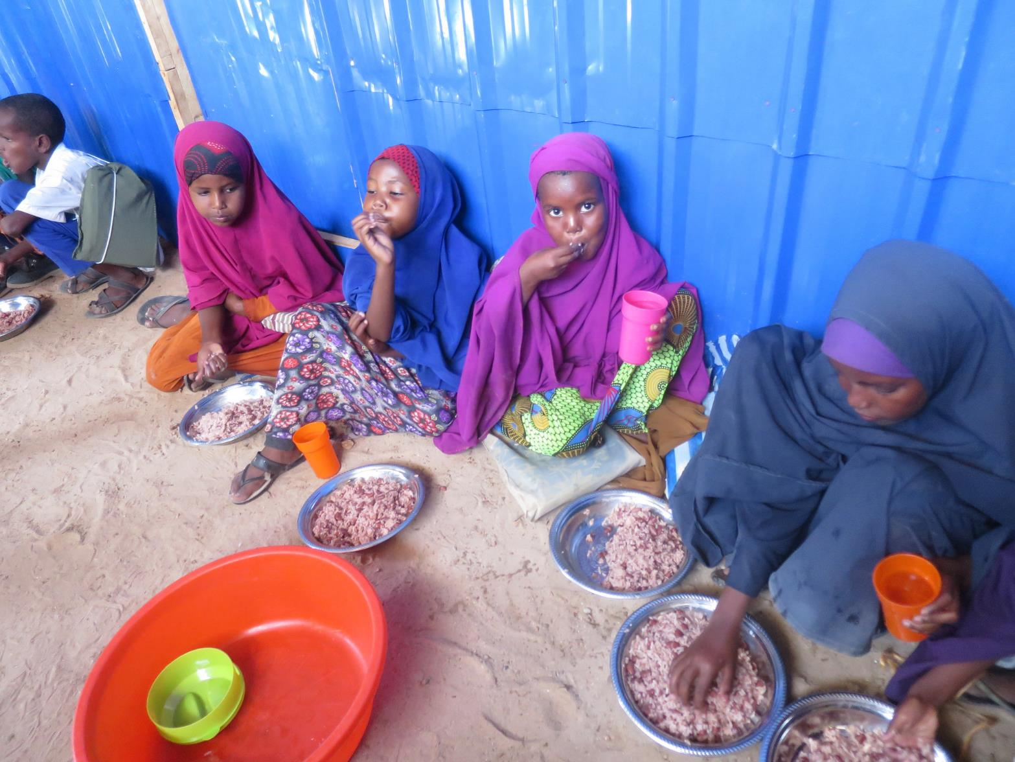
Guidance notes
Guidance notes provide additional information to support the key actions, with cross-references to the Protection Principles, the Core Humanitarian Standard, other standards in the Handbook and other standards of the Humanitarian Standards Partnership.
Kenya, 2017. Lutheran World Federation
Notes:
Review the definition provided and ask participants to find and cite one guidance note that would be useful to apply to this school feeding programme.
Possible answer: WASH standard 1.1: Hygiene promotion – Working with children: “Children can promote healthy behaviours to their peers and family. The department of education or social services can identify opportunities to promote hygiene in schools, residential care and child-headed households, and to children living on the street…”
This is the most challenging of these search tasks, and is best achieved using digital versions of the Handbook. If you search the interactive Handbook for “schools” then this piece of advice can be found quickly.

Slide 26

Using the indicators
The Sphere key indicators are a way to measure whether a standard is being achieved; they should not be confused with the standard itself. The standard is universal, but the key indicators, like the key actions, should be considered in light of both the context and phase of the response.
Bangladesh. Lutheran World Federation
Notes:
This is an important slide to spend a few minutes on. Advise participants to not confuse success or failure in achieving a single indicator with success or failure in meeting the related standard. They are only indicators. Their benefit is that they are quantifiable and measurable. When any one indicator is measured to fall short (particularly a process or target indicator), responders should immediately look to other indicators and other standards to confirm if indeed the standard is not being met. In some situations where an indicator is not met, the related standard can be met by compensating in other areas. For example, if water collection is less than 15 litres per day (page 106), but there is increased distribution and use of soap, adequate living space, and sufficient toilets, there may be no increased rate of diarrhea or other adverse effects on public health usually associated with inadequate water supply, i.e. despite having less than 15 litres per day, people have a sufficient quantity of water to meet their most important needs. (WASH standard 2.1, page 105)

Slide 27

Three types of indicators
Process indicators
Target indicators
#
Progress indicators
%
Provide observable criteria to be met (yes or no)
Provide units or scales, but without benchmarks
Provide specific measurable benchmarks
See page 7
Notes:
This may need careful explanation. Refer participants to page 7 and ask them to read the definitions there. Then explain the same ideas in simpler terms using the prepared slide. Ask participants to find an example of each type as you describe each one.
A few examples are provided below:
Example process indicators:
There are no cases of scurvy, pellagra, beriberi, or riboflavin deficiency (page 183)
All healthcare workers clean their hands, using soap or alcohol rub, before and after every patient contact (page 134)
Example progress indicators:
Percentage of public markets with appropriate and adequate waste storage (page 129)
Percentage of shelters and/or settlement sites that have safe access to essential services within an acceptable amount of time or distance (page 250)
Example target indicators:
Distance from dwellings to final distribution points or markets (in case of vouchers or cash) – target <5 kilometres (page 205)
Number of accessible toilets – minimum: 1 per 20 inpatients (page 135)

Slide 28
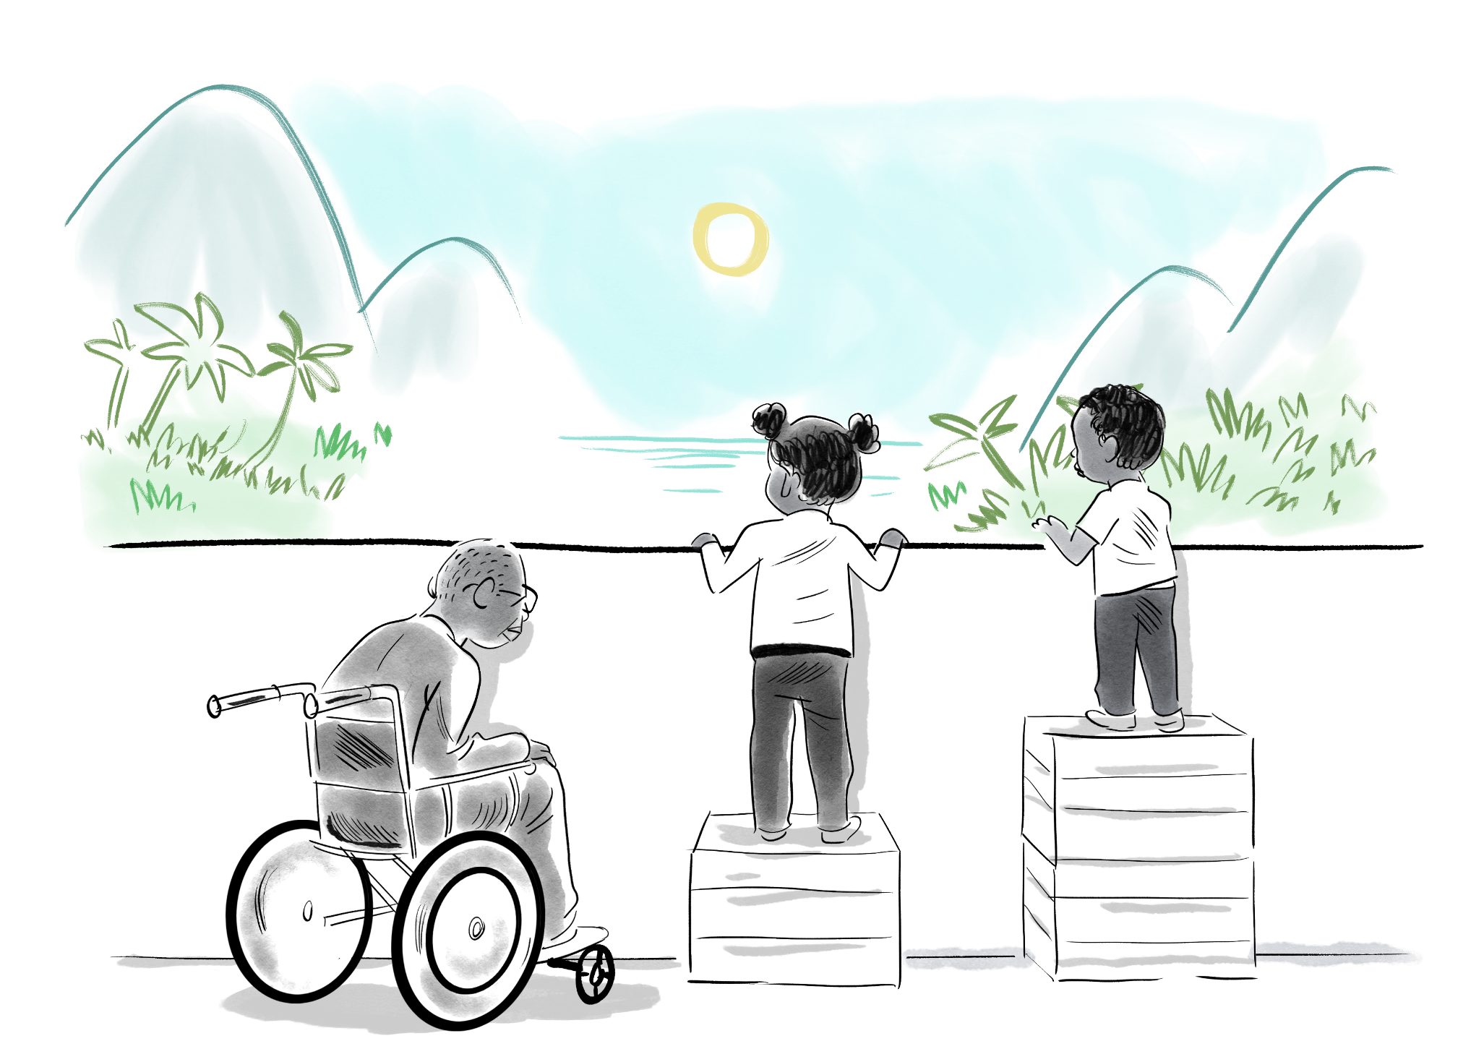
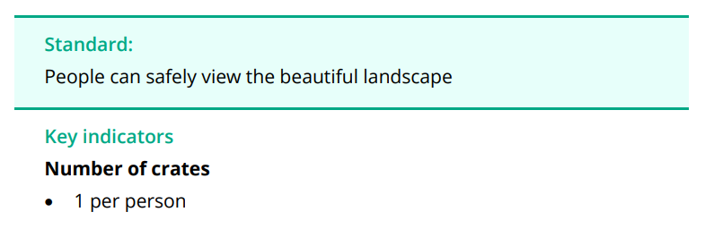
But do crates meet the needs of all our different users ?
Is the standard being met?
What is the indicator reading, i.e., the number of crates?
Is the indicator appropriate for the context?
What actions might you take to achieve the standard?
What is
happening?

Slide 29
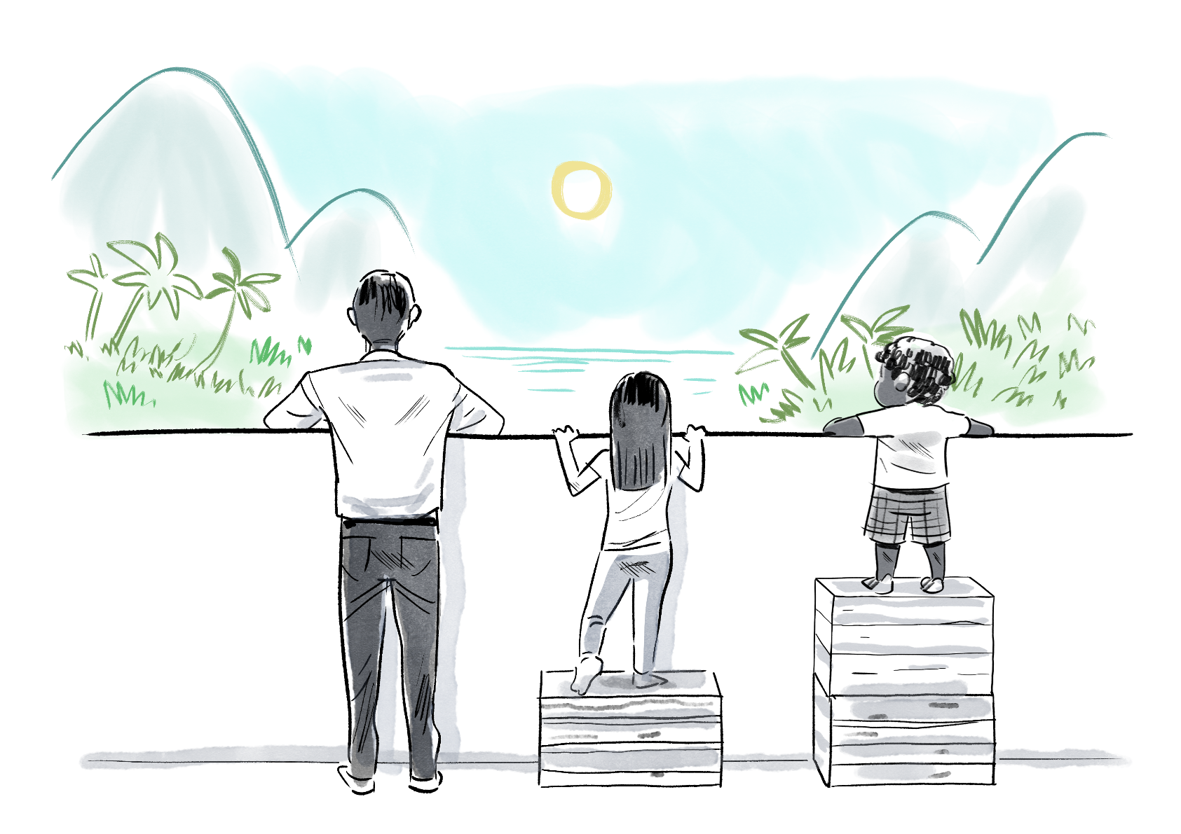
Standards v. indicators
Pursuing indicators rather than standards is to assume that everyone is born with equal needs, rather than equal rights, which is a potentially harmful error.
Always consider the context, including the needs, capacities and vulnerabilities of the people you are trying to assist.
People affected by crisis should participate actively at every stage of the response.

Slide 30
The Sphere Quiz!
The Sphere Quiz

Slide 31
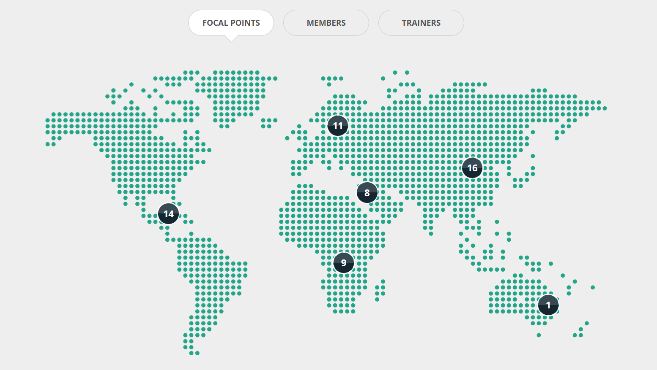

Slide 32
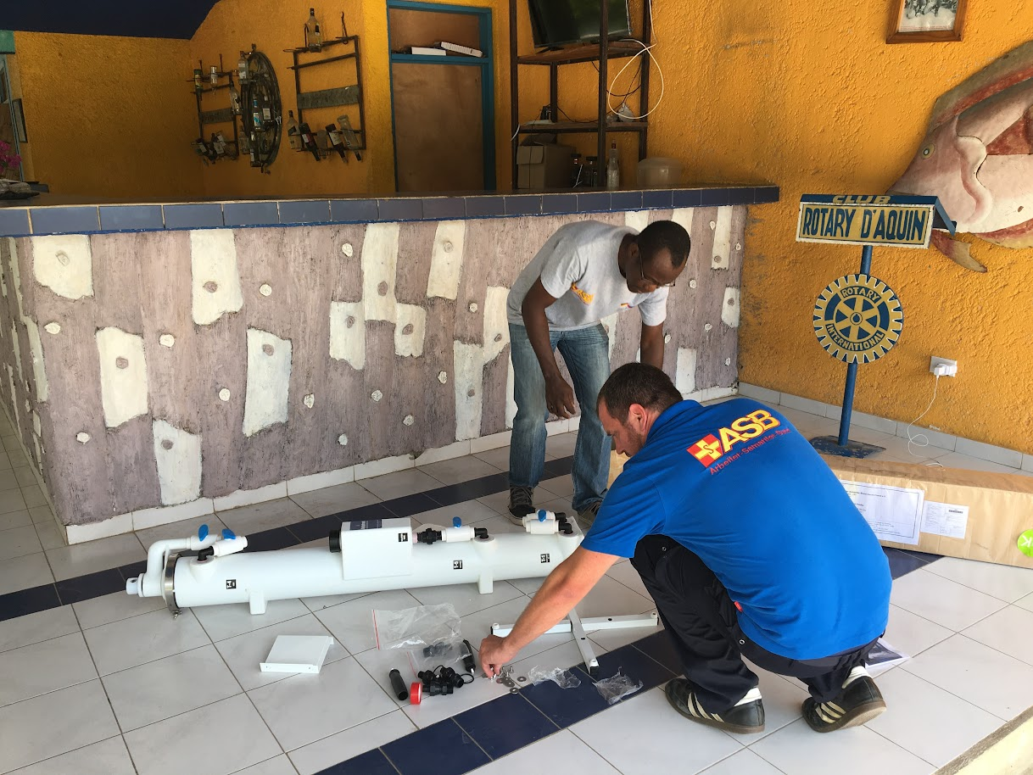
Notes:
ASB – focal point in Germany . Set up a water fil

Slide 33
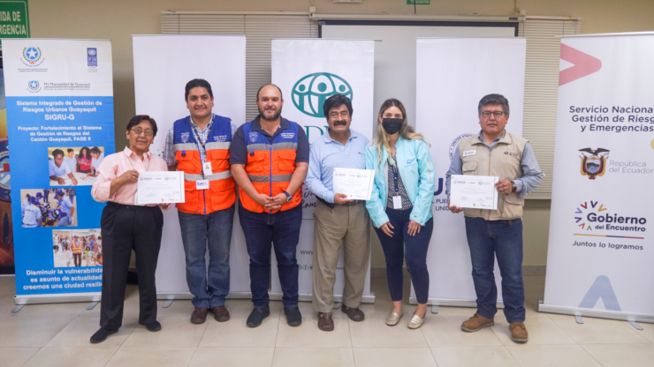
Notes:
Focal point in Bolivia created a Sphere training pack for working with National Disaster Management Agencies

Slide 34
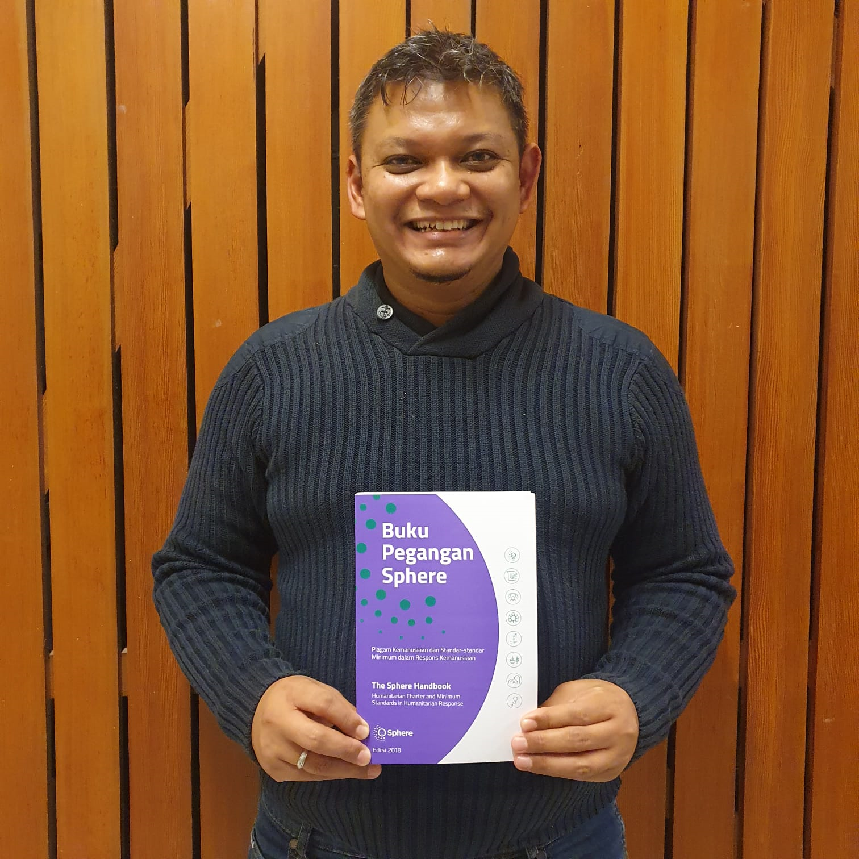
Notes:
MBPI (Indonesian society for Disaster Management) translated the handbook

Slide 35
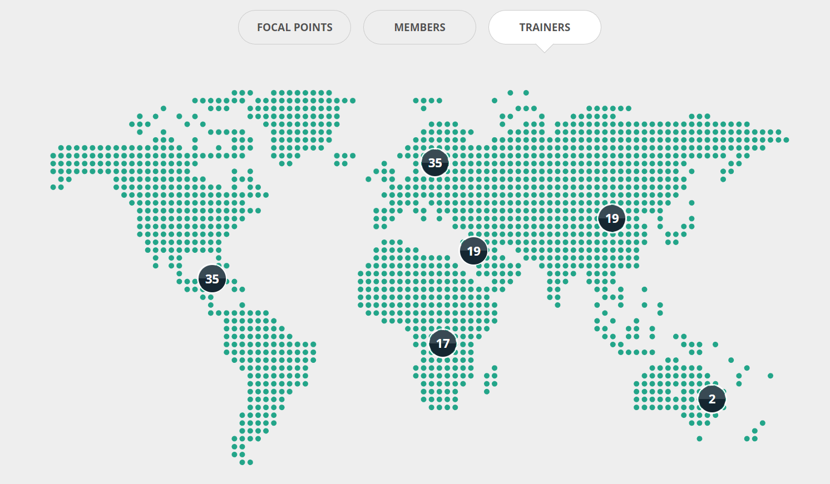

Slide 36
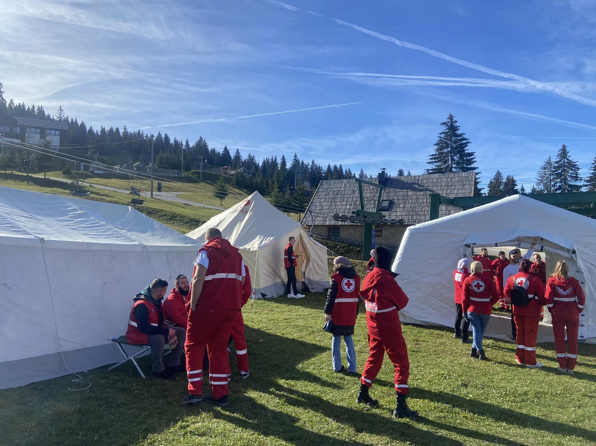

Slide 37
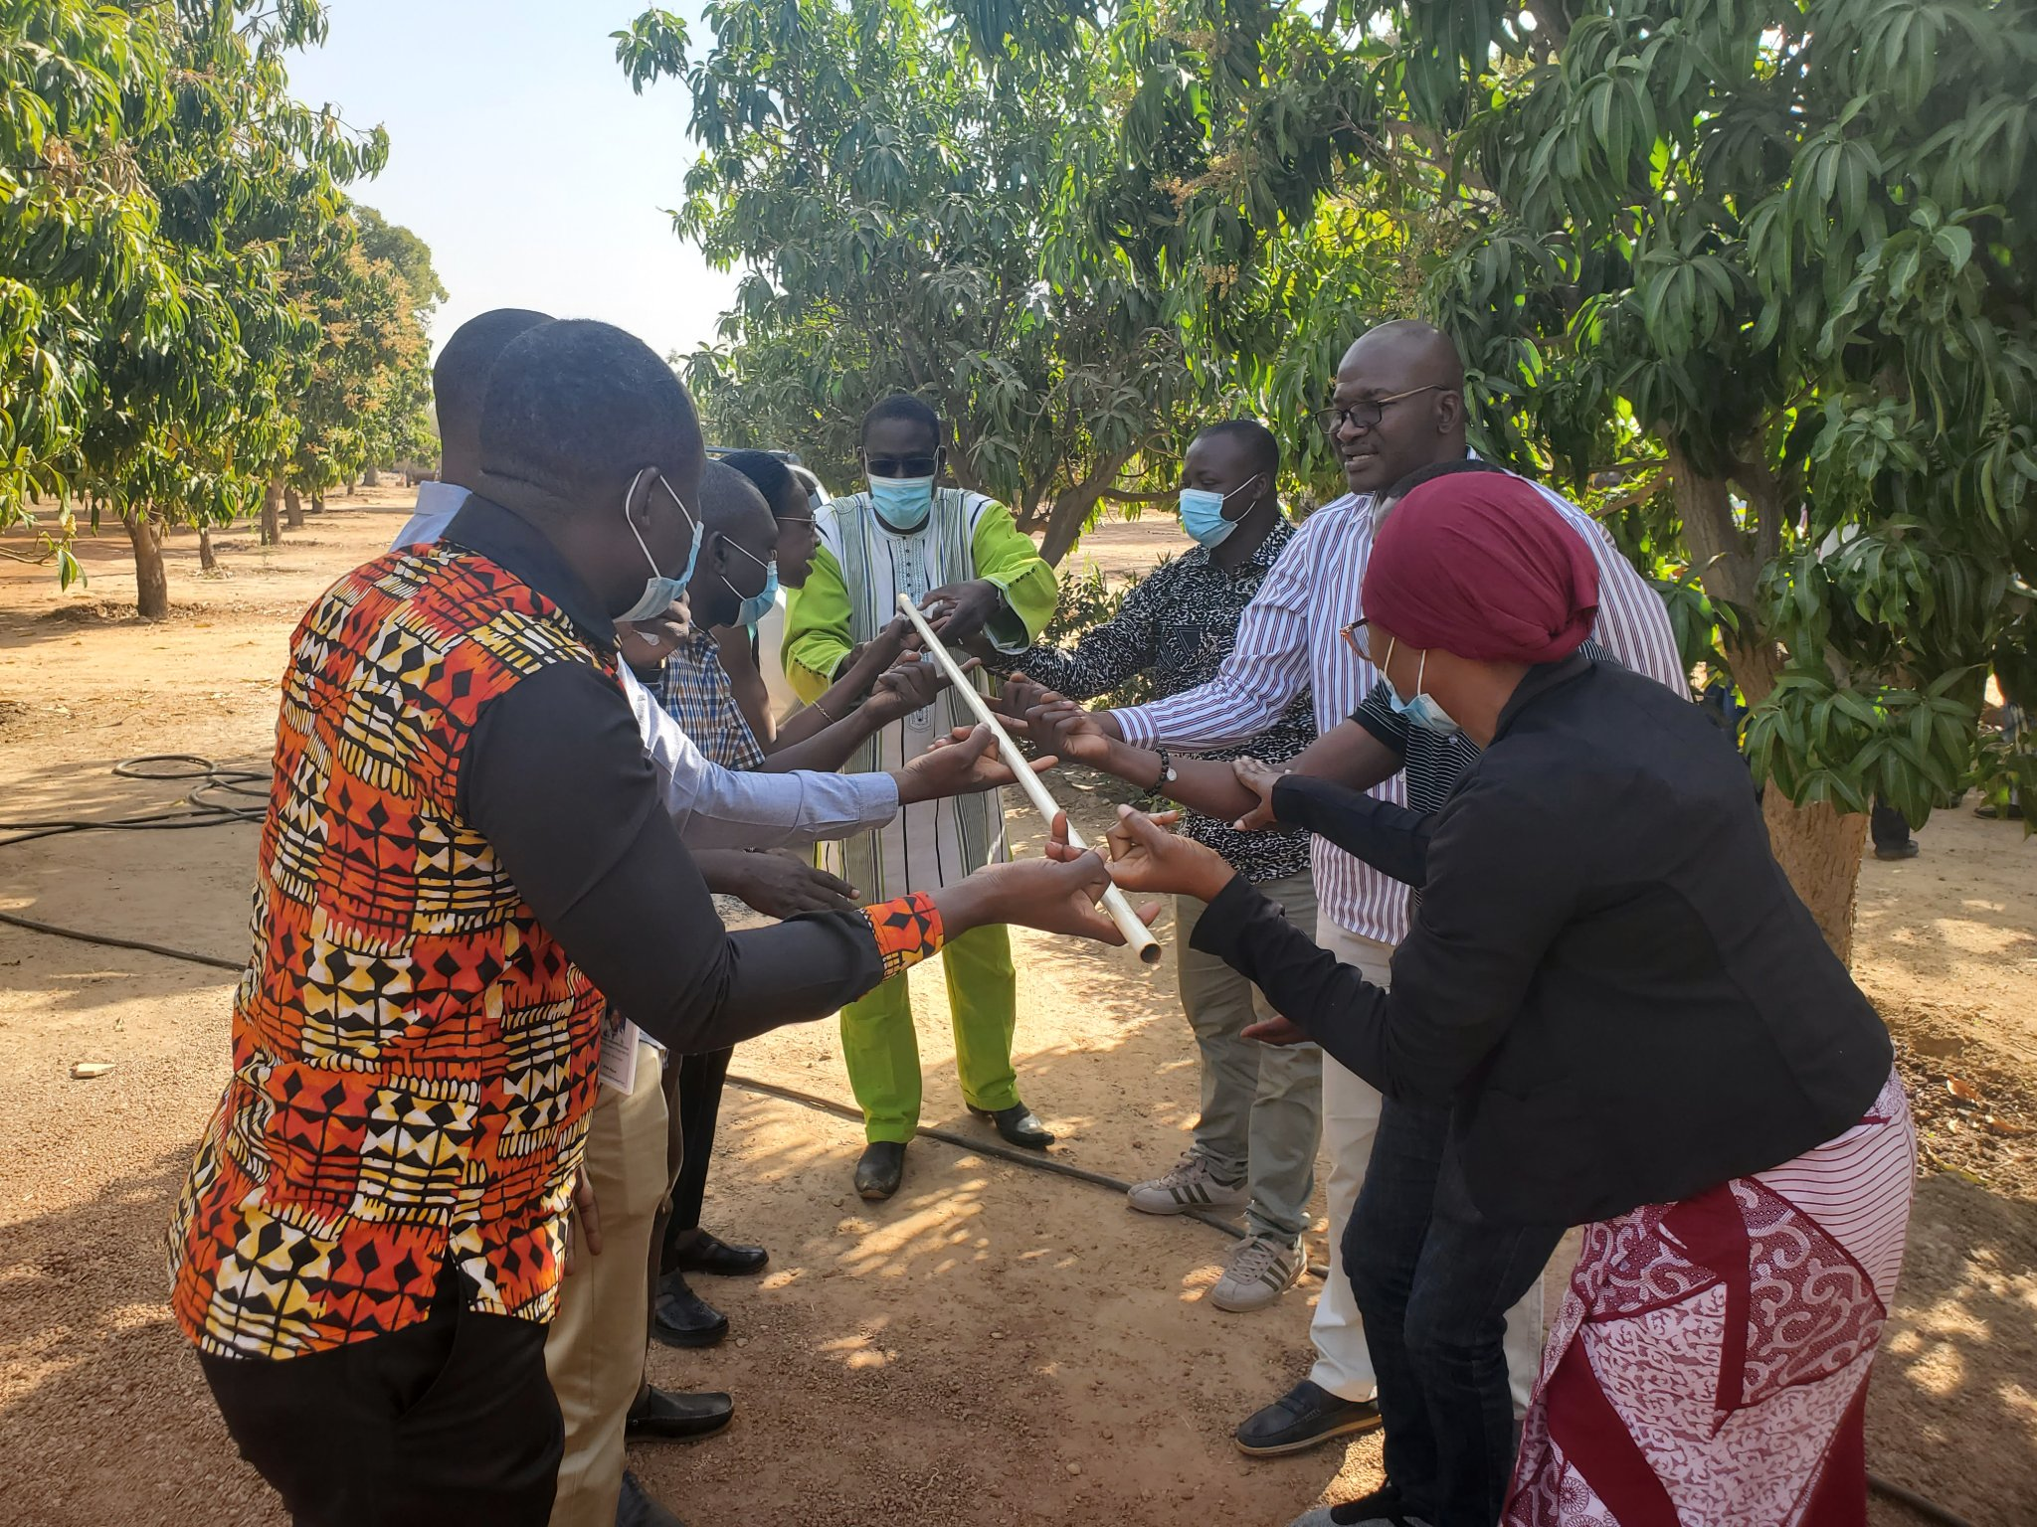

Slide 38
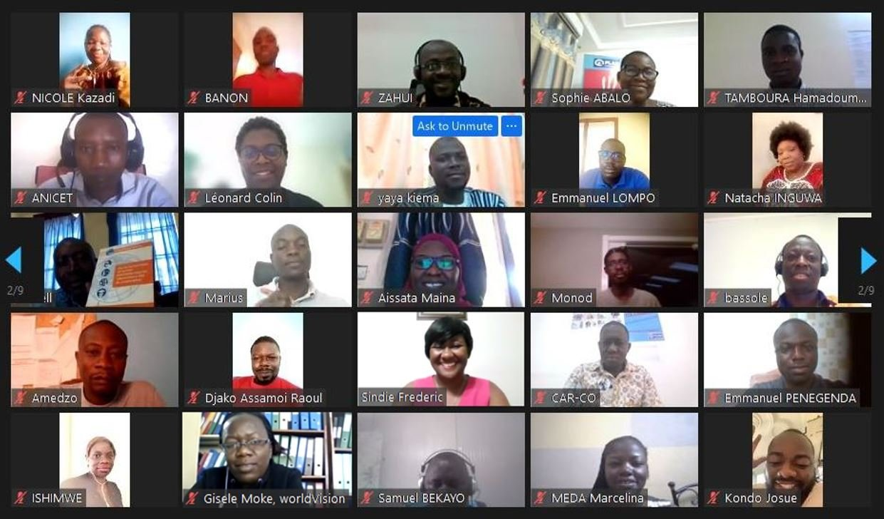

Slide 39
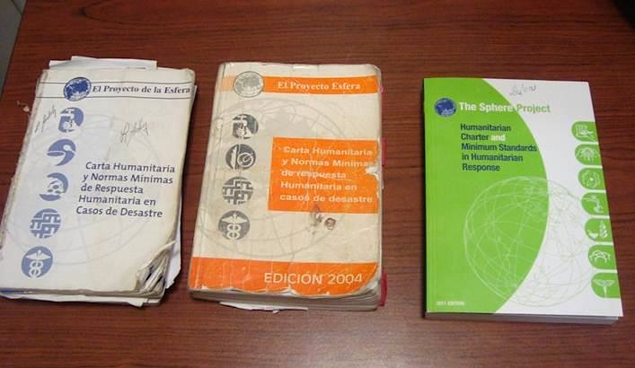
Photo: © Lourdes Ardon
Notes:
39
39
Sphere established in 1997
First “beta” version of handbook published in 1998: ring binder. Tested
Reviewed and strengthened: Edition 1 issued in 2000
Edition 2: 2004
Edition 3: 2011
Important evolution… What was new in 2011
Protection principles
Shift from disaster response to humanitarian response
Humanitarian Charter revised
he Handbook enjoys broad acceptance by the humanitarian sector as a whole.
Photo from Honduras
It is available in 24 additional language versions.
19 of them were developed on the initiative of the humanitarian community, which shows the acceptance of the tool.
Established 1997 by and for practitioners
Standards first published 1998 (2000, 2004, 2011), quickly became the most widely used humanitarian reference document
‘One-stop shop’ for the principles, rights, duties and good practice that guide a high quality and accountable humanitarian response
A common language and reference point used broadly: governments, donors, UN, Red Cross/Red Crescent movement, international and national NGOs, volunteers, others)
39

Slide 40
