Slide 1

SPHERE as a COMMUNITY
by
DARIA PISTRIAK
27 October 2022

Slide 2
Overview
Sphere’s place in the humanitarian sector
Why have humanitarian standards?
The Sphere Handbook, tools and services
Humanitarian Standards Partnership
Sphere’s Programme for Ukraine and Eastern Europe and other initiatives
2

Slide 3
The Sphere Project
Established in 1997 by humanitarian practitioners after Rwanda
Named based on the play of words “Standards”, “Project”, “Humanitarian”- SPH… - and the symbolic meaning of a sphere.
5 editions of Handbook: first draft in 1998. First version in 2000. Revised in 2004, 2011 and 2018
Became an NGO in 2016: Sphere.
Secretariat in Geneva. Permanent staff and contracted consultants.
Major products – Sphere Handbook on standards of humanitarian aid and associated guidance documents
3

Slide 4
Sphere as a Community
Wide network of
Members: organisations and individuals – special membership procedure – strategic engagement and voting rights
Focal points – country representatives – points of contact and Sphere promoters
Trainers – Sphere standards professionals
Champions – people who support Sphere standards and promote them in their work, in their communities, countries, etc.
Most of them are volunteers
and engage with Sphere because they BELIEVE in it!

Slide 5
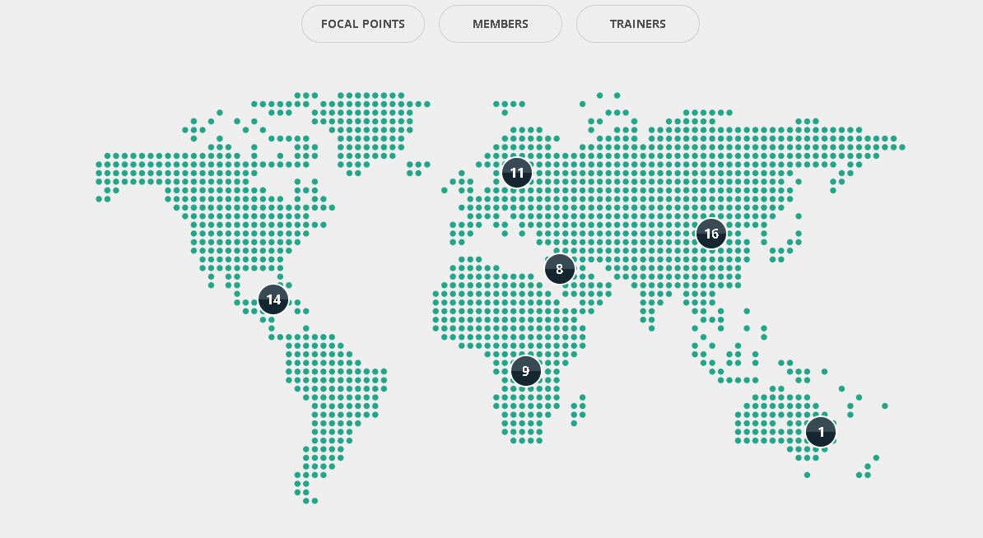
19
35
7
9
35
19
19
17
5
2

Slide 6

Why have humanitarian standards?
Notes:
Please have a look at this citation and at this picture

Slide 7
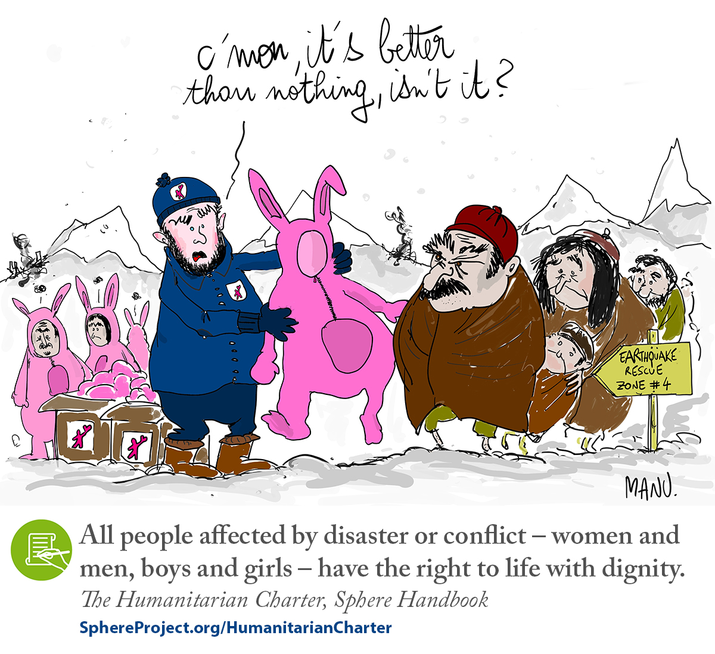

Slide 8
Core principles and values
DIGNITY: all people have intrinsic human dignity and have a right to control and live their lives with dignity.
→ Humanitarian Charter → inclusion, communities
EVIDENCE: practical tools that are based on evidence, good collective practice, and designed by and for field workers.
→ Handbook revision processes distil the collective knowledge of the sector
COLLABORATION: Sphere engages with various actors in inclusive, consultative processes
→ HSP, NDMA, Sphere community
8

Slide 9
Quality and Accountability
Quality is about doing work well. Humanitarian work is effective (impact), efficient (timely and with appropriate cost) and appropriate (taking account of needs and context).
→ NOT only standards, but also assessment, monitoring, evaluation and learning mechanisms
Accountability: the process of using power responsibly, taking account of, and being held accountable by, different stakeholders, and primarily those who are affected by the exercise of such power.
Context: recognise people’s needs and capacities and ambitions
9

Slide 10
So… why have humanitarian standards ?
Quality of assistance provided
Effectiveness: timely, relevant, agreed in advance
Professionalization of the sector
Accountability for resources and to people
Transparency
Predictability
Coordination
Assessment and evaluation
Advocacy
10

Slide 11
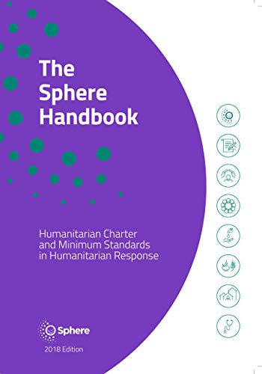
Sphere Handbook
The most widely used humanitarian reference document
Includes principles, rights, duties and best practice
Core Chapters: Protection Principles, Humanitarian Charter and Core Humanitarian Standard
Technical standards in 4 LIFE SAVING areas: WASH; Food Security and Nutrition; Shelter and Settlement; and Health
Applies in disaster preparedness, response and recovery in any context

Slide 12
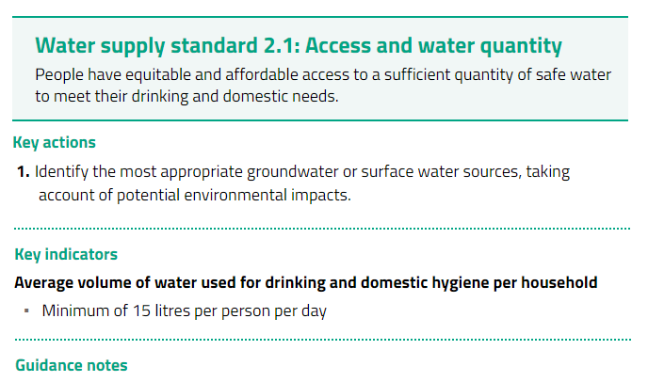

Structure of a standard: beyond metrics
12

Slide 13

Standards v. targets
Pursuing targets rather than standards is to assume that everyone is born with equal needs, rather than equal rights, which is a potentially harmful error.
Always consider the context, including the needs, capacities and vulnerabilities of the people you are trying to assist.
People affected by crisis should participate actively at every stage of the response.

Slide 14


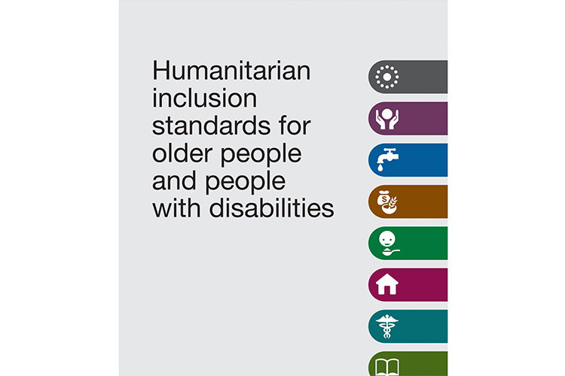
The Humanitarian Standards Partnership (HSP) is a network of 9 standard-setting initiatives and organisations – 8 Handbooks – 10+ sectors and themes .
14

Slide 15
Common purpose and priorities
Purpose: address two key issues
The proliferation and complexity of standards
The variable uptake of standards and limited diversity of stakeholders (localisation)
Strategic Priorities
Coherence among standards
Access to standards (localisation)
Joint outreach, trainings and advocacy
HSP as a “home for standards”

Slide 16
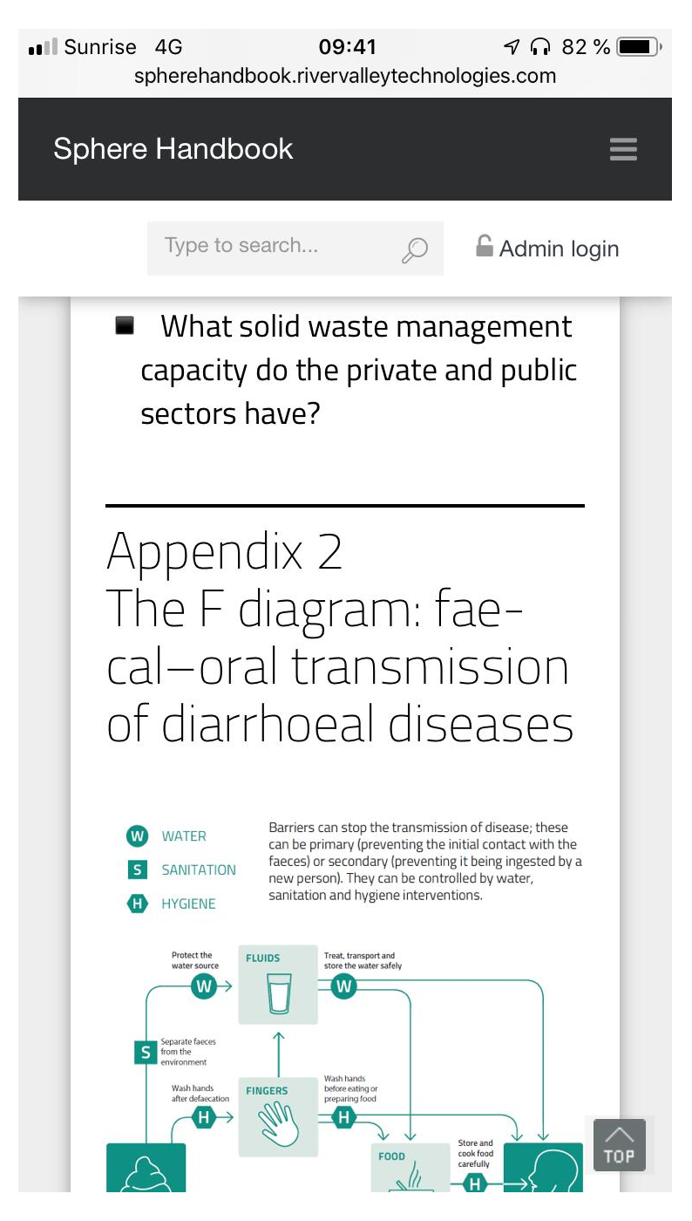
WAYS TO ACCESS SPHERE HANDBOOK and OTHER STANDARDS
Sphere Handbook is available in 43 languages and more are underway! Other Handbooks have also been translated into other languages.
Buy paper copies
Read interactive handbook online – NEW! HSP web-site – navigation tool
Download PDF
HSP Mobile application
Download the app:
humanitarianstandardspartnership.org
16

Slide 17
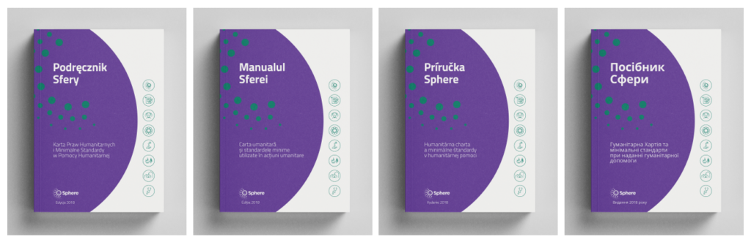
Sphere’s Programme for Ukraine and Eastern Europe
Launched in response to the war in Ukraine – major humanitarian crisis in Europe since WWII
Clear need to learn and apply standards
5 countries: Ukraine, Poland, Romania, Slovakia and Moldova – most affected by displacement
4 languages for the new Handbook translations – localization is important
Network
building
Trainings

Slide 18
Thank you and please contact me at daria.pistriak@spherestandards.org

