Slide 1

What is New in the 2018 Sphere Handbook?
Notes:
Before using this slideshow:
Read the accompanying guidance notes
Delete unneeded slides
This slide:
Remove “company name” and the vertical line next to it, or replace with you own logo(s)
To change the date, select Slide Master from the View menu. When done, click Close Master View to return.

Slide 2
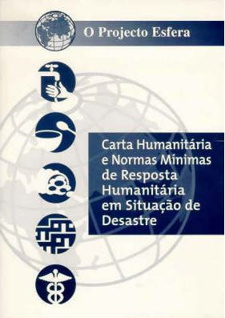
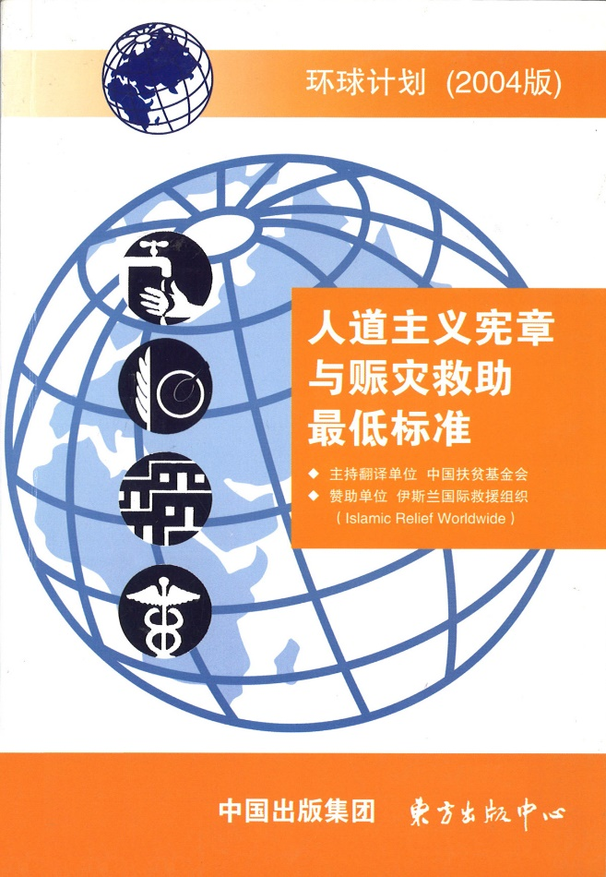

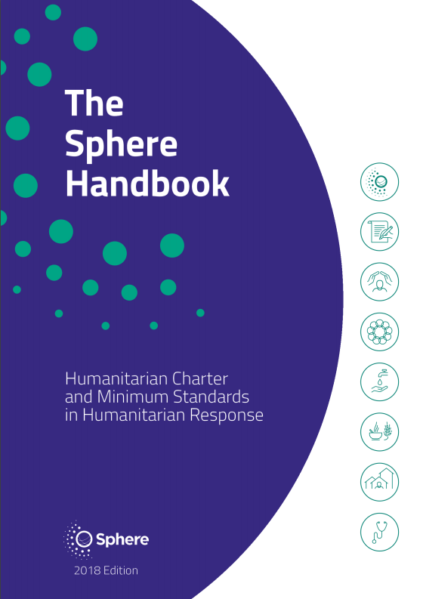
2

Slide 3


Learning objectives
By the end of this session, you will be able to recall:
the challenges in the sector which became the drivers of the Handbook revision,
the approach to and results of the
revision process,
the key changes between the 2011 and 2018 editions,
how Sphere has evolved and what
new products are on offer;
and you will be able to discuss:
how the 2018 edition is
adapted to the current contexts in which its users operate.
Knowledge
Comprehension
3
Notes:
Slide for training seminars/webinars only – delete for presentations

Slide 4
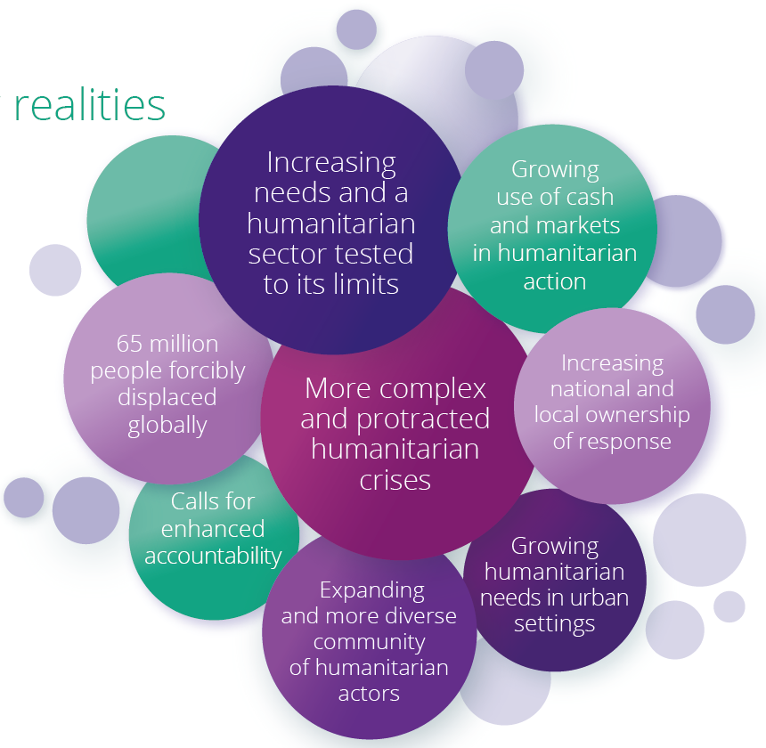
Today’s challenges and drivers of the revision
4
Notes:
This is a summary of the following 5 slides. For a shorter presentation, keep this one but delete the following 5. For longer presentations, you could delete this one.

Slide 5
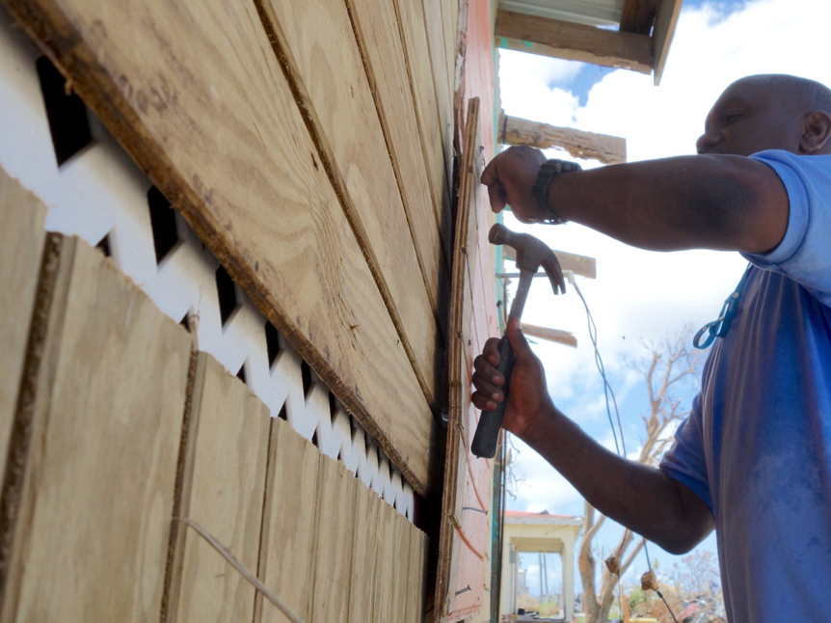
Learning and new evidence
Syrian conflict and refugee crisis
Issues of access, capacity building, protracted displacement, civilian and aid worker security, etc.
→ e.g. Shelter and Settlement
Outbreaks of Ebola, cholera and plague
→ e.g. WASH
Ben Parker/IRIN

Slide 6
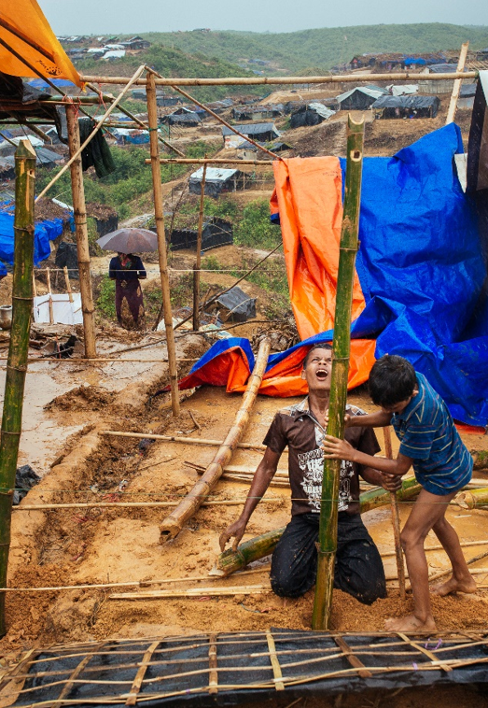
Benjamin Suomela/Finnish Red Cross
Evolving operating contexts
Protracted, complex and
recurring crises
Urban vs. rural settings
and communal settlements
Settings with increasingly
diverse operational actors
Climate change and environmental impact in humanitarian response

Slide 7
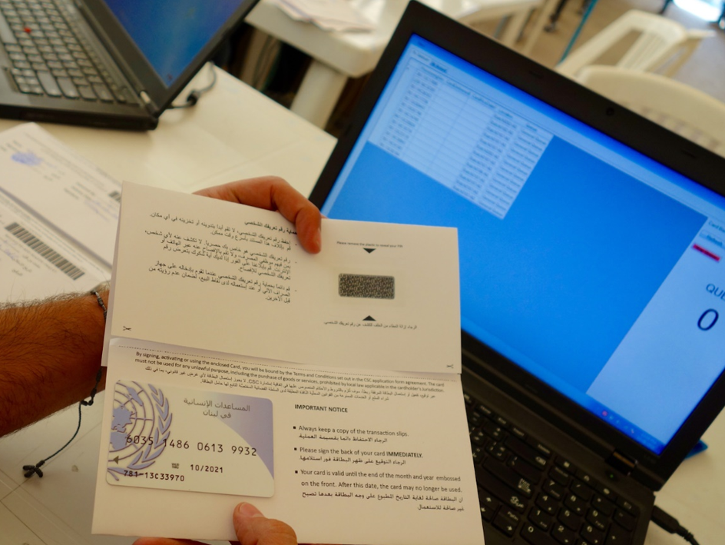
Fundamental shifts in how assistance is provided
Market-based programming, including cash transfers, and other assistance options
→ Implications for protection, accountability and quality monitoring
Ben Parker/IRIN

Slide 8
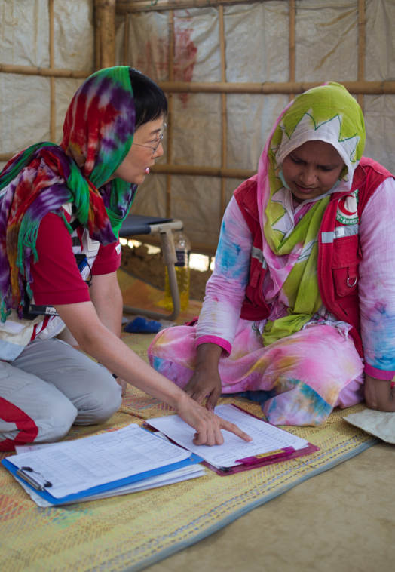
Community engagement and accountability
Renewed attention to accountability with
further learning
Participation
Supporting local actors
Working with local authorities
Core Humanitarian Standard
A.J. Ghani/IFRC

Slide 9
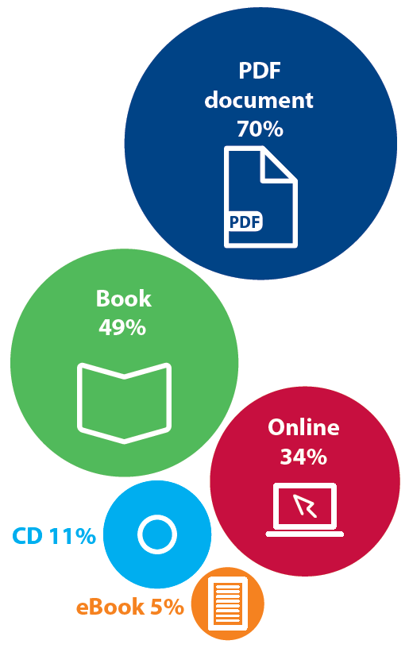

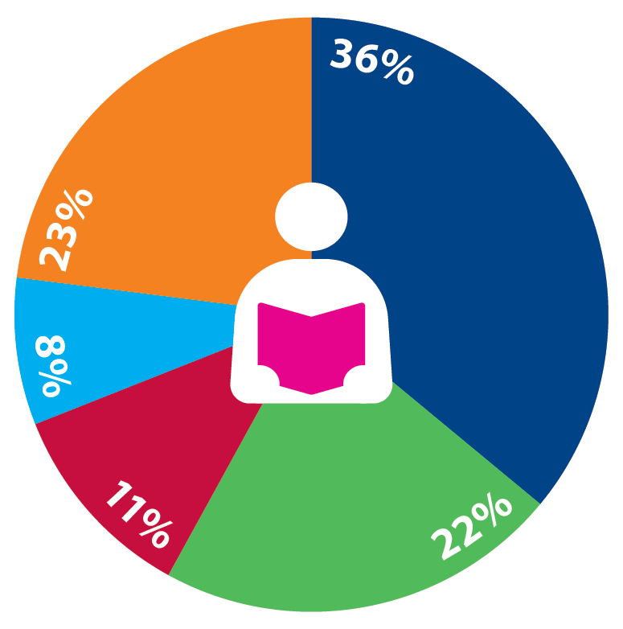
USE of the Handbook:
Multiple platforms
        “Who uses it?” survey finding plus HSP App
Diverse users
        “How do they access it?” survey finding
International NGOs
National/Local NGOs and Red Cross/Red Crescent
Government, civil defense and national service providers
UN and intergovernmental agencies
Other

Slide 10
Discussion:
TODAY’S CHALLENGES and drivers of change
From what crises and situations have you drawn expertise over the last 7 to 10 years?
How do the challenges presented above compare with your own observations and recent experiences?
What factors may drive the next revision?
Notes:
Optional slide depending on format of presentation/workshop.

Slide 11
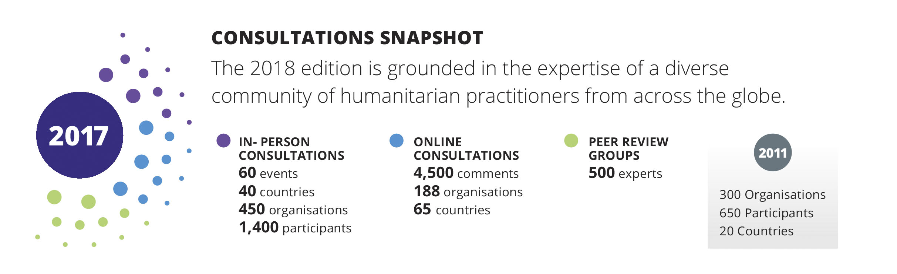
Handbook REVISION
Consultations
The most far-reaching and inclusive process in Sphere’s
20-year history
Notes:
Depending on your setting, consider deleting some or all of the CONSULTATIONS slides (6 starting from this one)

Slide 12
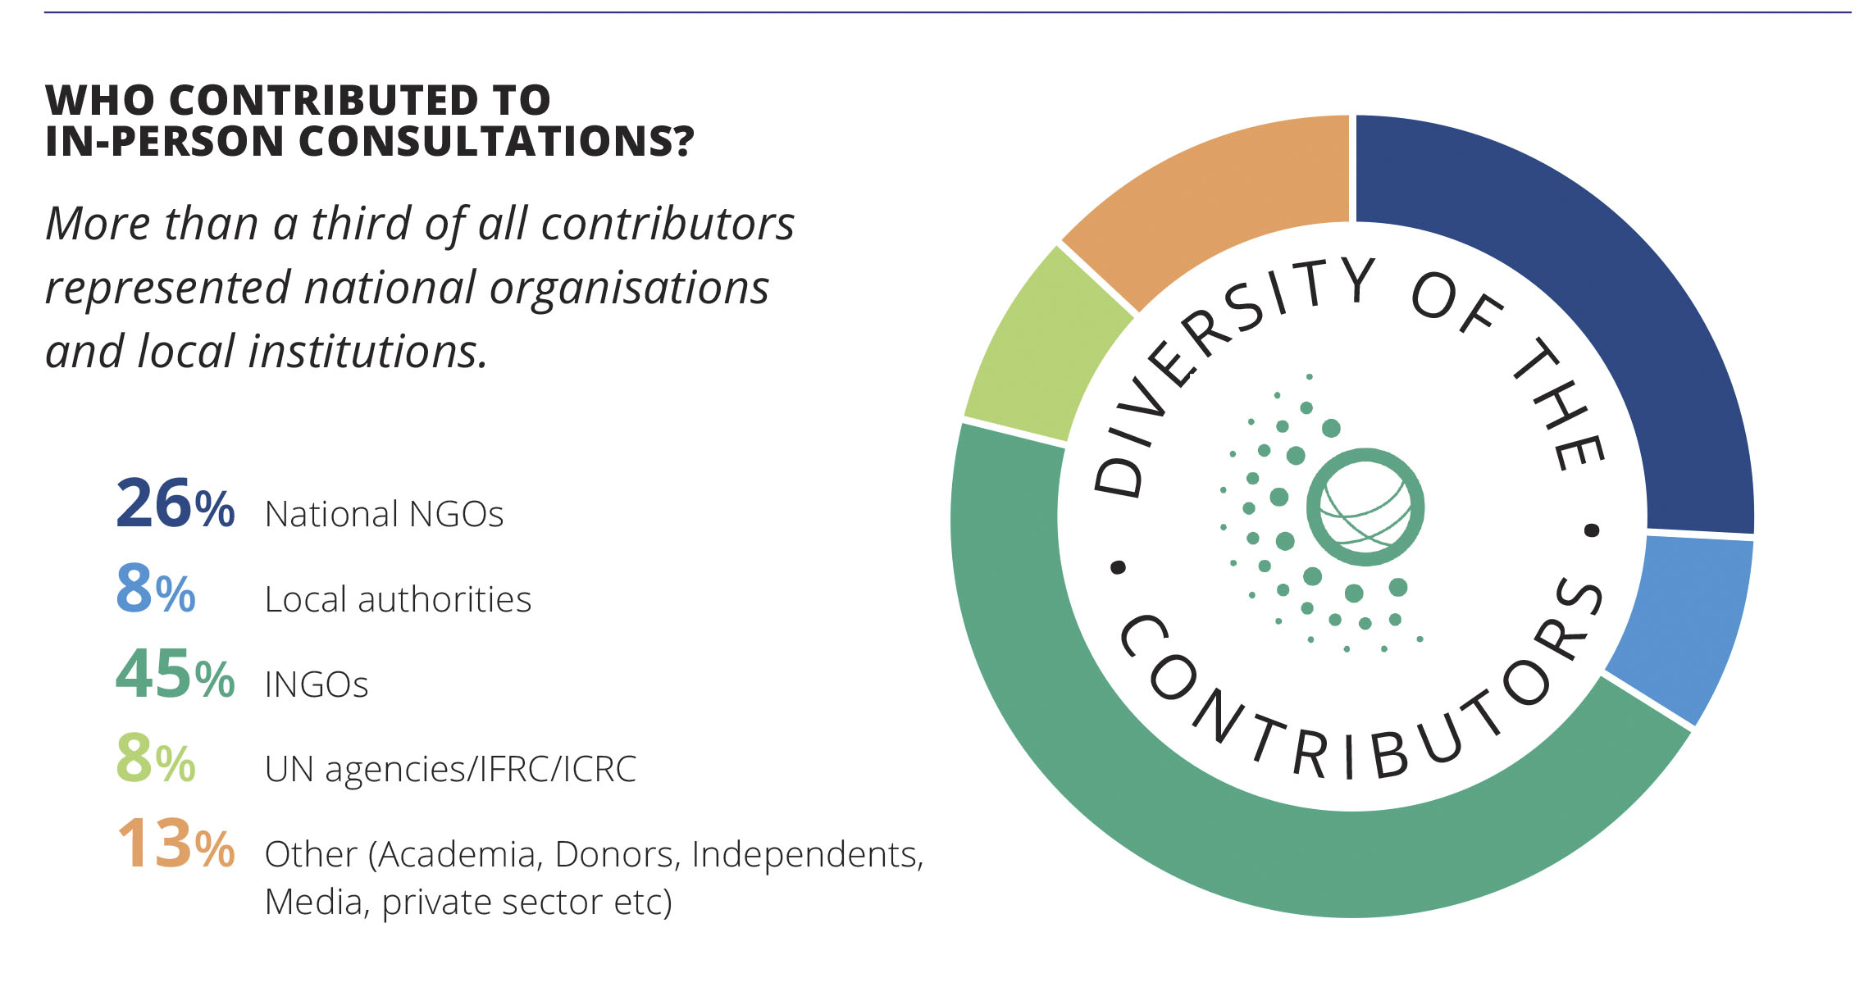
HANDBOOK REVISION Consultations:
Who contributed?

Slide 13
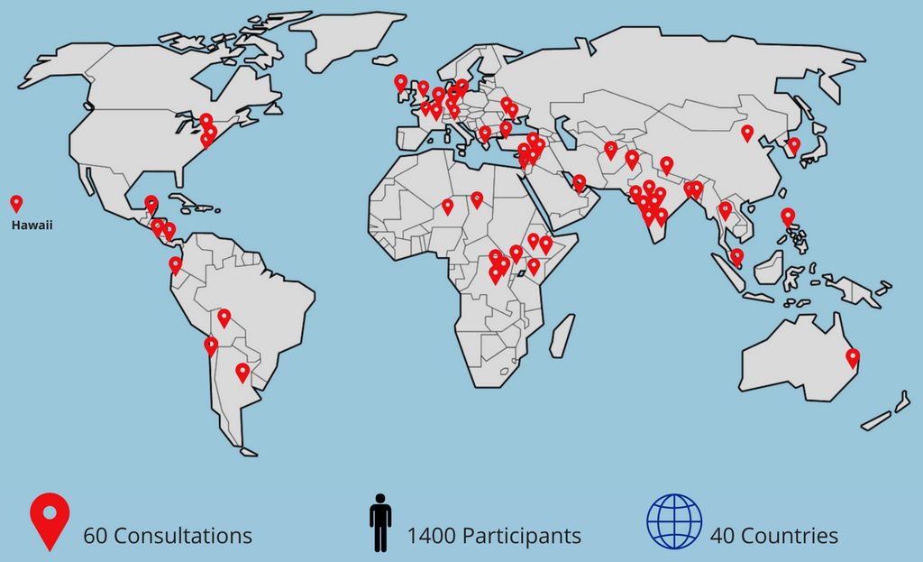
HANDBOOK REVISION Consultations:
Global reach

Slide 14
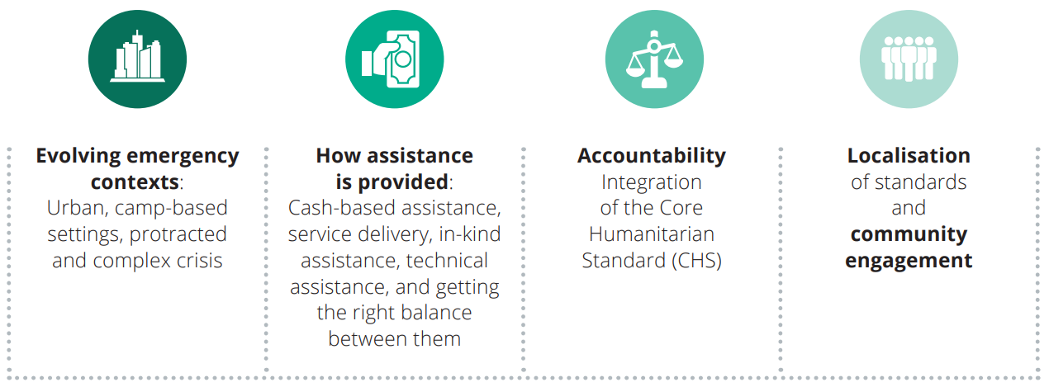
HANDBOOK REVISION Consultations
Topics discussed
14
Notes:
Improve resolution of image

Slide 15
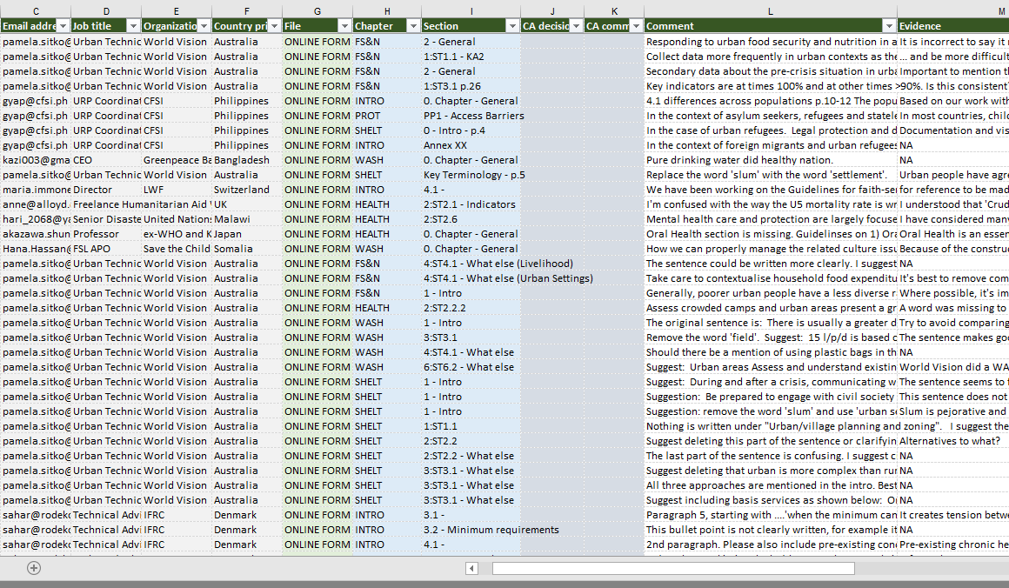
HANDBOOK REVISION:
Comments
Draft 1: 2,576 comments from 141 organisations
Draft 2: 1,914 comments from 93 organisations

Slide 16
Discussion:
HANDBOOK REVISION CONSULTATIONS and comments
Did you organize or attend a revision consultation?
What topics did you discuss?
Did you submit comments as an individual or group?
How can we keep the conversation going between now and the next revision?
Notes:
Optional slide depending on format of presentation/workshop.

Slide 17
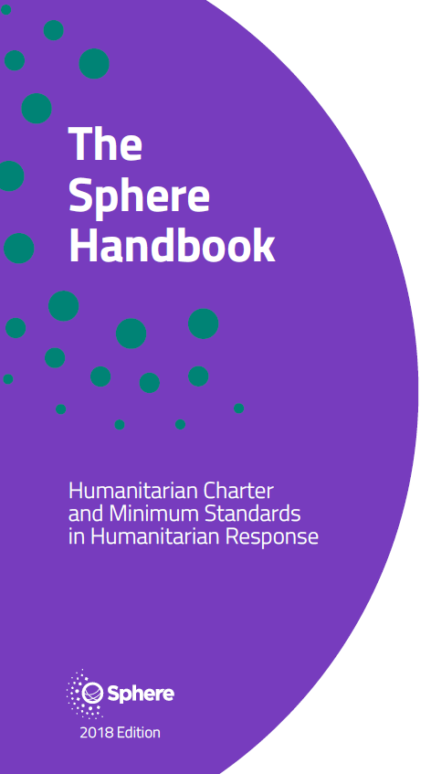
Structural CHANGES to the Handbook:
Standards are more outcome-oriented
Key actions are presented with sub-actions
Guidance notes are more concise
Indicators are reformulated
Foundation chapters are better integrated in technical chapters
Overall structure largely unchanged
17
Notes:
The set of CHANGES slides (12 starting with this one) should be the core content of your presentation/workshop.

Slide 18
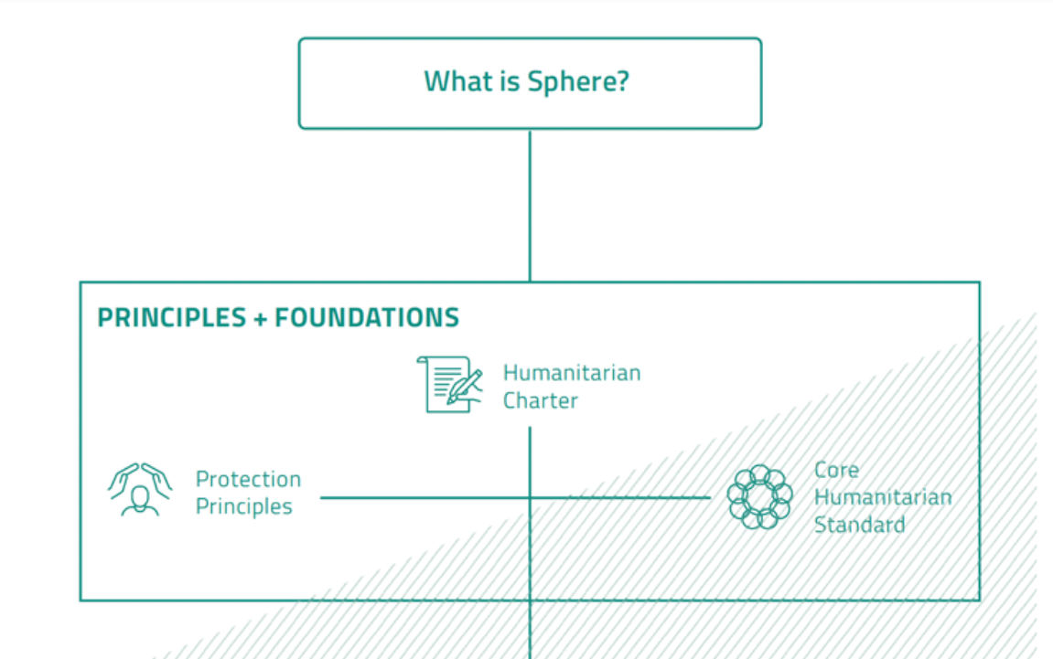
Foundation chapters
What is Sphere? revised
Humanitarian
Charter reviewed
and unchanged
Protection
Principles revised
Core
Humanitarian
Standard partially revised, replaces the Core Standards
Notes:
This slide is a summary of the following 4.

Slide 19
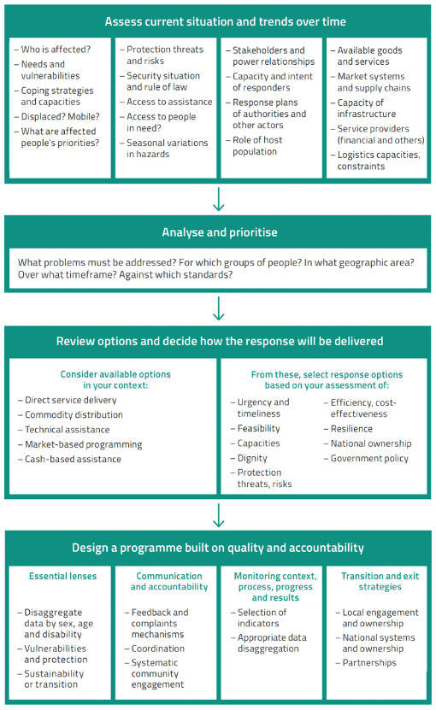
What is Sphere?
Two sections: The Handbook and Using the standards in context
New flowchart: Understanding context to apply the standards (pictured)
New data disaggregation table
Sections for programme cycle, vulnerabilities and capacities and operational settings
New Appendix:
Delivering assistance through markets
Focus on community engagement
Summary of Code of Conduct included
19

Slide 20


The Humanitarian Charter
Reviewed
No changes: Still valid and relevant following revision in 2010 to 2011
Resources section updated (Annex 1: Legal foundation to Sphere)

Slide 21

Protection Principles
Four principles maintained
Conceptual re-alignment:
  Do no harm by own interventions expanded to preventing harm more generally
  Impartial access includes deliberate denial of access and discrimination in access
  Support to recovery from violations
  Legal redress and strengthening the protection environment
Simplified language and diverse examples for general practitioners
Short appendix on the
ICRC Professional Protection standards
21

Slide 22
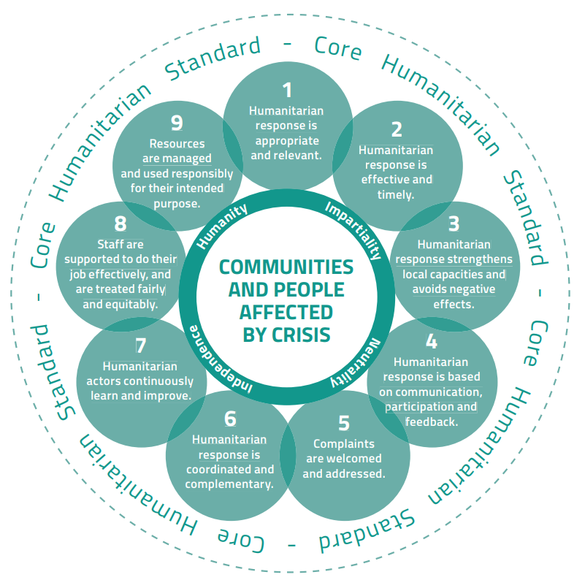
Core Humanitarian Standard
Original text maintained for
commitments (same CHS flower)
Performance indicators updated
minimally
Some content additions in
guidance notes and sub-
actions, notably:
  more references to
  governments, civil-military
  coordination, community
  self-help, and environmental
  considerations; and
  early addition of text on sexual harassment and abuse.
22

Slide 23
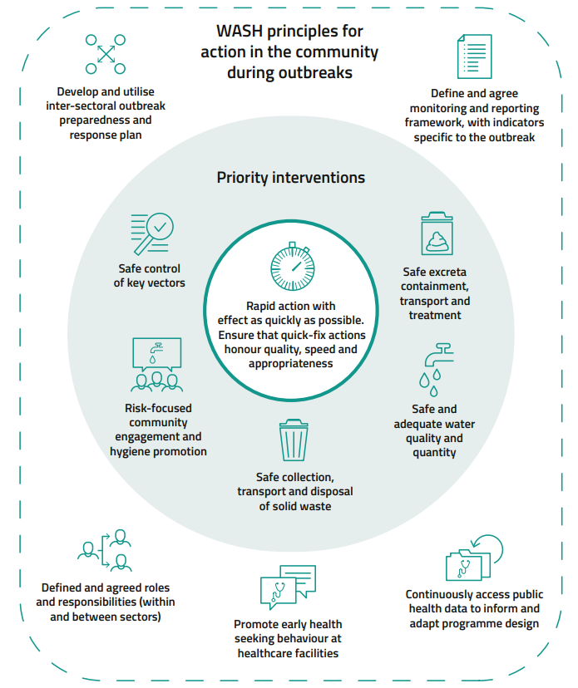
WASH
Stronger focus on
community engagement including new diagram in chapter introduction
Standard on general quality programming deleted, integrated throughout the chapter instead
Drainage standard removed. Topic now covered in both WASH and Shelter and Settlement chapters
New section/standard: WASH in disease outbreaks and healthcare settings
  Lessons learned from Ebola response
  Covers community-based response and infection prevention and control (IPC) in facilities
  New diagram (pictured)
23

Slide 24

Food Security and Nutrition
Slightly simplified structure which emphasizes interrelated food security and nutrition assessments, analysis and complementary programming.
Cash and vouchers, Supply chain management and Markets standards removed from the chapter, replaced with a new Appendix in What is Sphere and integrated throughout the Handbook.
Assessments section including two distinct assessment standards (remains)
24

Slide 25
Shelter and Settlement
Simplified structure 7 standards, no sub-sections
All NFI standards from 2011 integrated into single
Household items standard
New Security of tenure standard.
  Presented as actions and guidance notes in 2011
  Reflects increased importance of shelter solutions
  outside camps
Planning
Location and settlement planning
Living Space
Household Items
Technical assistance
Security of tenure
Environ-mental Sustain-ability
Broad → Detailed
Overarching considerations
25

Slide 26
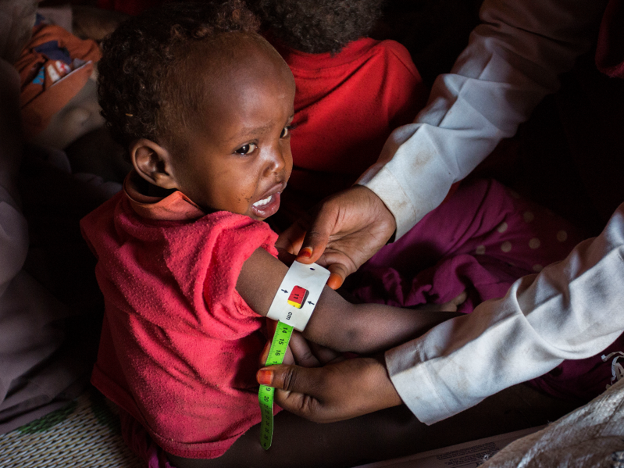
Health
Simplified chapter title
New section in introduction:
Special considerations to protect healthcare
Health systems - Leadership and coordination 2011 standard removed, content integrated
  Prioritising health services 2011 standard removed, content integrated
  Sexual and reproductive health section restructured to 3 standards, including an updated introduction and a new standard:
  Sexual violence and clinical management of rape
  New standard: Palliative care, reflects an ageing population and protracted situations. (The Non-communicable diseases section was new in 2011)
Arie Kievit/Netherlands Red Cross

Slide 27



Indicators
Process | Yes / No “There are no human faeces present in the environment in which people live, learn and work”
Progress | Establish baseline and measure progress “Percentage of recipients who are satisfied with menstrual hygiene management materials and facilities”
Target | Stated numerical target(s) “Percentage of MAM cases with access to treatment services (coverage) >50% rural, >70% urban, >90% formal camps”
27
Notes:
The way indicators are presented in the 2018 HB represents a major change. Read the guidance notes carefully and don’t skip this element.
There are MORE indicators with stated numerical targets in the 2018 HB than in the 2011 HB.
All 2018 HB indicators are designed to be MEASURABLE.

Slide 28
Where we are now
Focus on people, community engagement and supporting local action
Great attention to
use in context
Simplified language and presentation
Decisions tracked and documented
28
Notes:
This serves as a summary of the CHANGES slides above.

Slide 29
Discussion:
CHANGES TO THE HANDBOOK
Which changes in the 2018 edition will have the greatest impact on your work and the ways you use the Handbook?
What new content do you expect to see in the next edition of the Handbook?
Notes:
Optional slide depending on format of presentation/workshop.

Slide 30

A NEW IDENTITY
Discover the Sphere Standards
Sphere offers an extensive library of materials and tools to expand your knowledge and understanding of humanitarian standards.
Share your experience
Join a vibrant global community, committed to improving quality and accountability across the humanitarian sector.
Put standards into practice
Sphere strengthens your advocacy for improvements on the ground.
spherestandards.org
Notes:
Depending on your context, delete some or all of the SPHERE set of slides (4 starting with this one).
The Interactive Handbook and Sphere Champion e-learning were launched at the same time as the Sphere Handbook.
The more time that has passed since November 2018, the less relevant it is to promote these as NEW products.

Slide 31
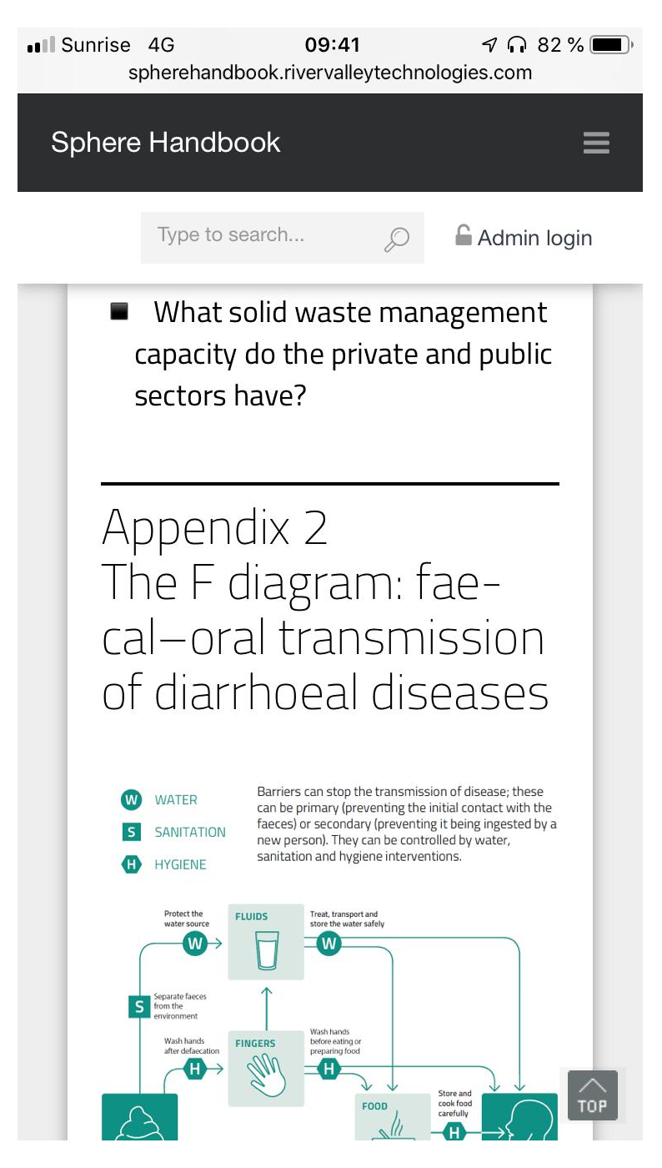
A NEW WAY TO ACCESS THE HANDBOOK
The Interactive Handbook
Launched 6th November for online access to the English Sphere 2018 Handbook.
Modern scalable Content Management System (CMS)
Responsive design (mobile-ready)
Enhancements for 2019
Supporting information
User comments
  Multiple handbooks (HSP members)
  in multiple languages (more than 4)
  Integration with other Sphere and
  3rd party systems
  Advanced Programming Interface (API)
handbook.spherestandards.org
31
Notes:
Image: The Interactive Handbook shown on an iPhone. The interface is a responsive web application so is designed to work on large screens (PCs) and mobile devices.

Slide 32

A NEW ONLINE COURSE
How to be a
Sphere Champion
Learn how to promote Sphere within your network, and how this benefits the people affected by crisis and disaster that you serve.
Anyone can be a Sphere Champion through their own actions and by encouraging those in power to act.
learning.spherestandards.org
32

Slide 33
Discussion 4:
THE EVOLUTION OF SPHERE AND ITS PRODUCTS
How can Sphere help you to LEARN?
How can Sphere help you to ACT?
How can Sphere help you to CONNECT?
In which ways do you access the Handbook?
How will you help Sphere to keep evolving and to meet the challenges of the future?
Notes:
Optional slide depending on format of presentation/workshop.

Slide 34
Notes:
To update the details, select Slide Master from the View menu. When done, click Close Master View to return.

